Slide 1
Maximum and Minimum Values of a Function on an Interval
(Extreme Values)

Slide 2
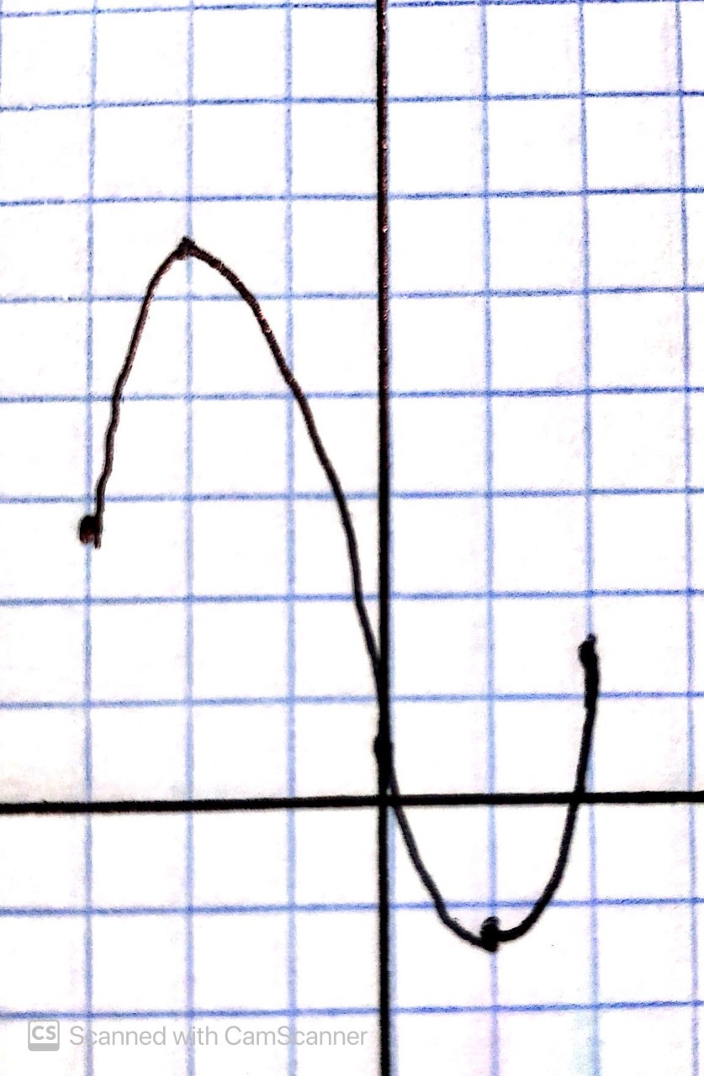
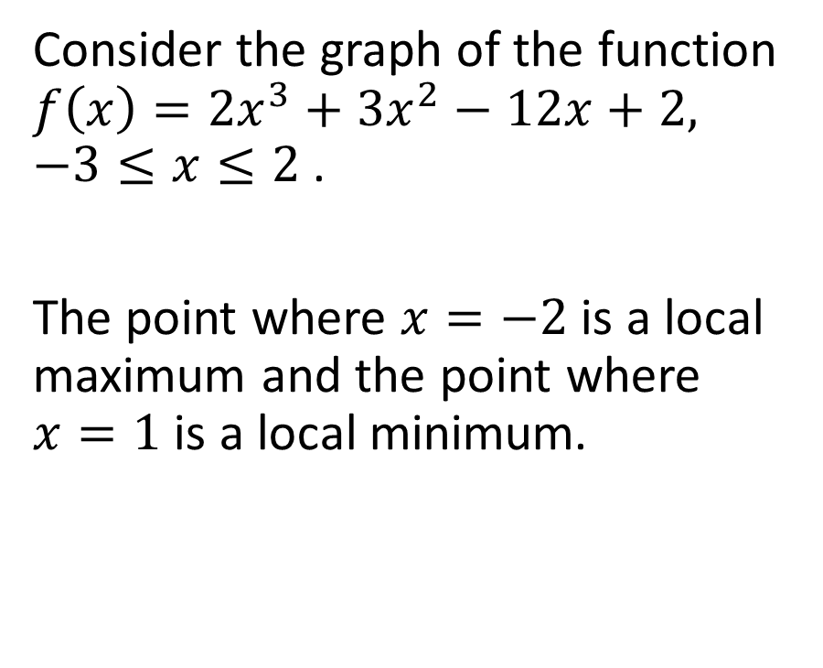


Example
Consider the graph of the function $f\left(x\right)=2x^{3}+3x^{2}−12x+2, −3≤x≤2$ .
The point where $x=−2$ is a local maximum and the point where $x=1$ is a local minimum.

Slide 3
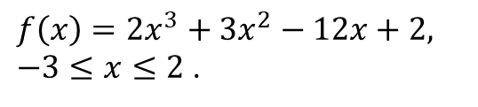
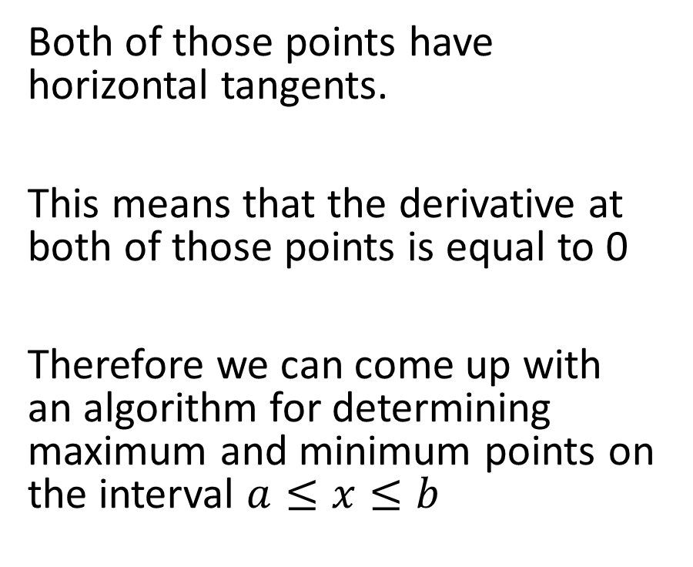
$f\left(x\right)=2x^{3}+3x^{2}−12x+2, −3≤x≤2$ .
Both of those points have horizontal tangents.
This means that the derivative at both of those points is equal to 0
Therefore we can come up with an algorithm for determining maximum and minimum points on the interval $a≤x≤b$

Slide 4
$f\left(x\right)=2x^{3}+3x^{2}−12x+2, −3≤x≤2$ .
Both minimum and maximum values are called optimum values.
The process of determining optimum values is called optimization.

Slide 5
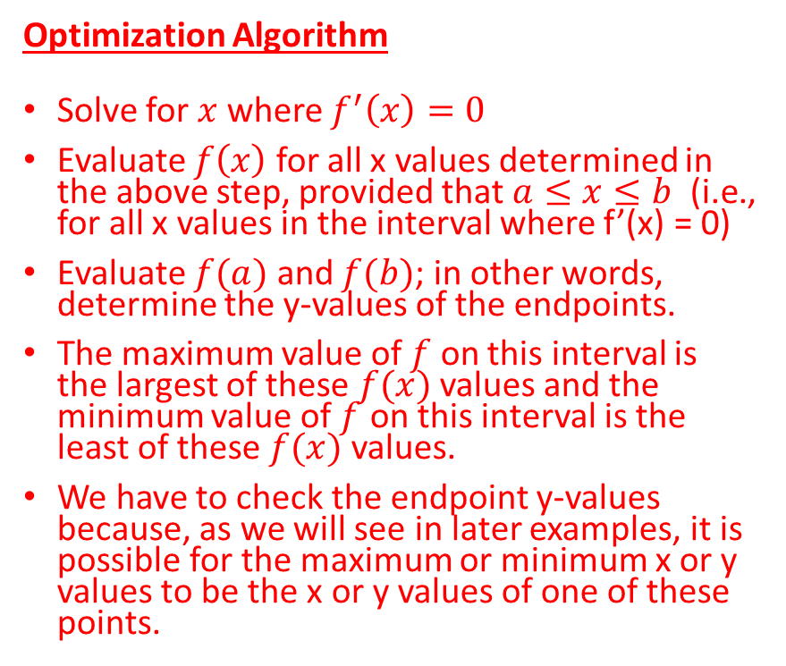
$f\left(x\right)=2x^{3}+3x^{2}−12x+2, −3≤x≤2$ .
Optimization Algorithm
Solve for $x$ where $f^{′}\left(x\right)=0$
Evaluate $f\left(x\right)$ for all x values determined in the above step, provided that $a≤x≤b$ (i.e., for all x values in the interval where f’(x) = 0)
Evaluate $f(a)$ and $f(b)$; in other words, determine the y-values of the endpoints.
The maximum value of $f$ on this interval is the largest of these $f(x)$ values and the minimum value of $f$ on this interval is the least of these $f(x)$ values.
We have to check the endpoint y-values because, as we will see in later examples, it is possible for the maximum or minimum x or y values to be the x or y values of one of these points.

Slide 6

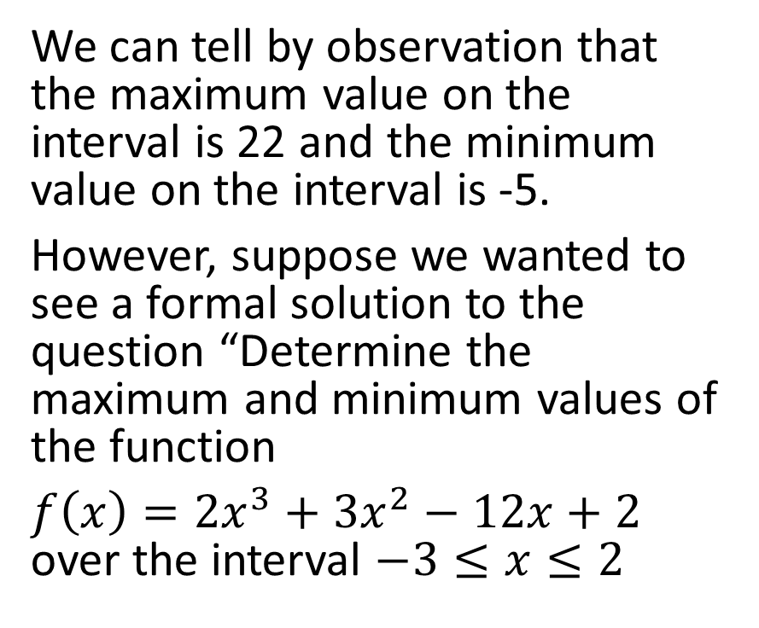

$f\left(x\right)=2x^{3}+3x^{2}−12x+2, −3≤x≤2$ .
We can tell by observation that the maximum value on the interval is 22 and the minimum value on the interval is -5.
However, suppose we wanted to see a formal solution to the question “Determine the maximum and minimum values of the function
$f\left(x\right)=2x^{3}+3x^{2}−12x+2$ over the interval $−3≤x≤2$

Slide 7
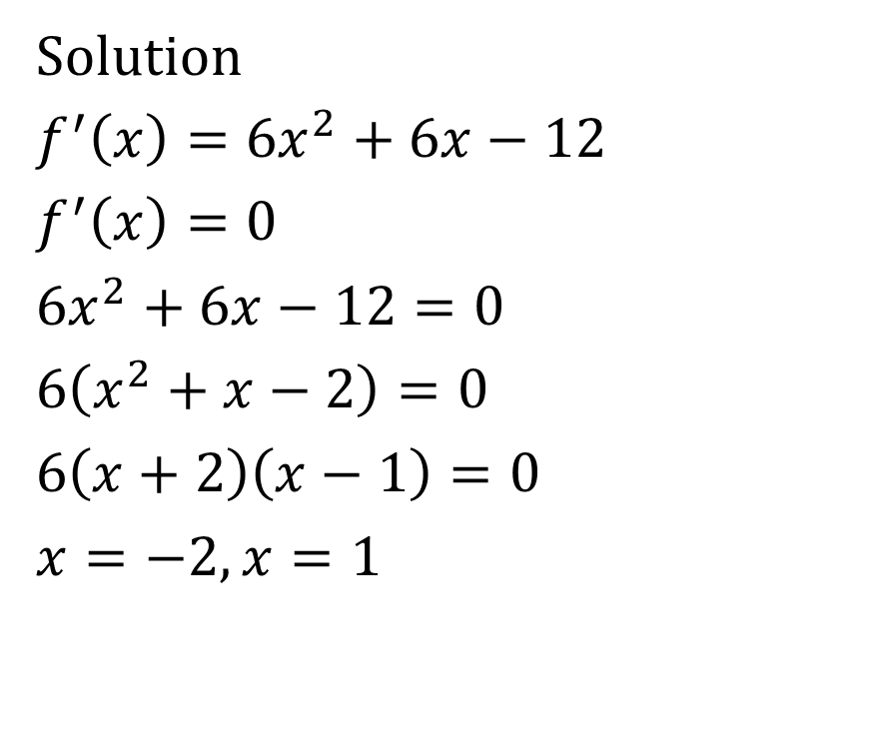
$f\left(x\right)=2x^{3}+3x^{2}−12x+2, −3≤x≤2$ .
Solution
$f^{′}\left(x\right)=6x^{2}+6x−12$
$f^{′}\left(x\right)=0$
$6x^{2}+6x−12=0$
$6\left(x^{2}+x−2\right)=0$
$6\left(x+2\right)\left(x−1\right)=0$
$x=−2, x=1$

Slide 8
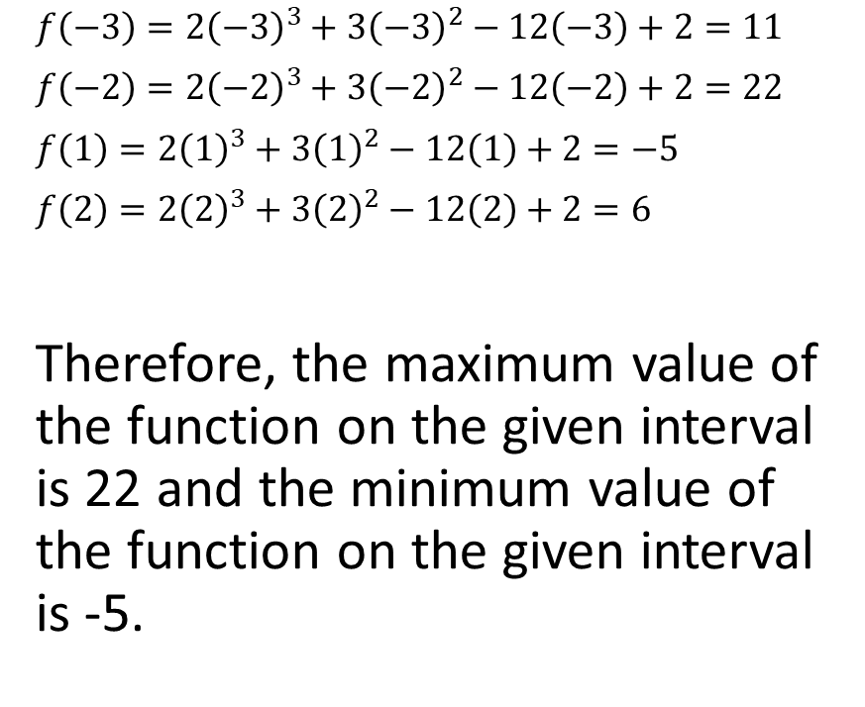
$f\left(x\right)=2x^{3}+3x^{2}−12x+2, −3≤x≤2$ .
$f\left(−3\right)=2{\left(−3\right)}^{3}+3{\left(−3\right)}^{2}−12\left(−3\right)+2=11$
$f\left(−2\right)=2{\left(−2\right)}^{3}+3{\left(−2\right)}^{2}−12\left(−2\right)+2=22$
$f\left(1\right)=2{\left(1\right)}^{3}+3{\left(1\right)}^{2}−12\left(1\right)+2=−5$
$f\left(2\right)=2{\left(2\right)}^{3}+3{\left(2\right)}^{2}−12\left(2\right)+2=6$
Therefore, the maximum value of the function on the given interval is 22 and the minimum value of the function on the given interval is -5.

Slide 9
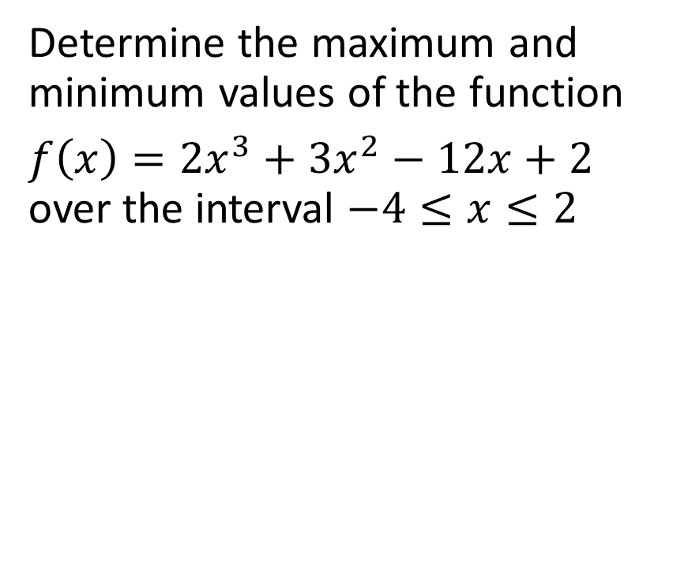
Example
Determine the maximum and minimum values of the function
$f\left(x\right)=2x^{3}+3x^{2}−12x+2$ over the interval $−4≤x≤2$

Slide 10
Solution
$f^{′}\left(x\right)=6x^{2}+6x−12$
$f^{′}\left(x\right)=0$
$6x^{2}+6x−12=0$
$6\left(x^{2}+x−2\right)=0$
$6\left(x+2\right)\left(x−1\right)=0$
$x=−2, x=1$

Slide 11
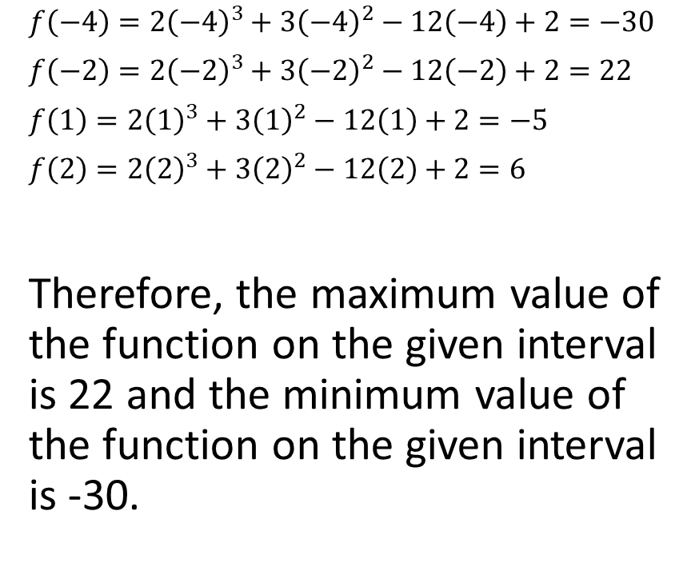
$f\left(−4\right)=2{\left(−4\right)}^{3}+3{\left(−4\right)}^{2}−12\left(−4\right)+2=−30$
$f\left(−2\right)=2{\left(−2\right)}^{3}+3{\left(−2\right)}^{2}−12\left(−2\right)+2=22$
$f\left(1\right)=2{\left(1\right)}^{3}+3{\left(1\right)}^{2}−12\left(1\right)+2=−5$
$f\left(2\right)=2{\left(2\right)}^{3}+3{\left(2\right)}^{2}−12\left(2\right)+2=6$
Therefore, the maximum value of the function on the given interval is 22 and the minimum value of the function on the given interval is -30.

Slide 12
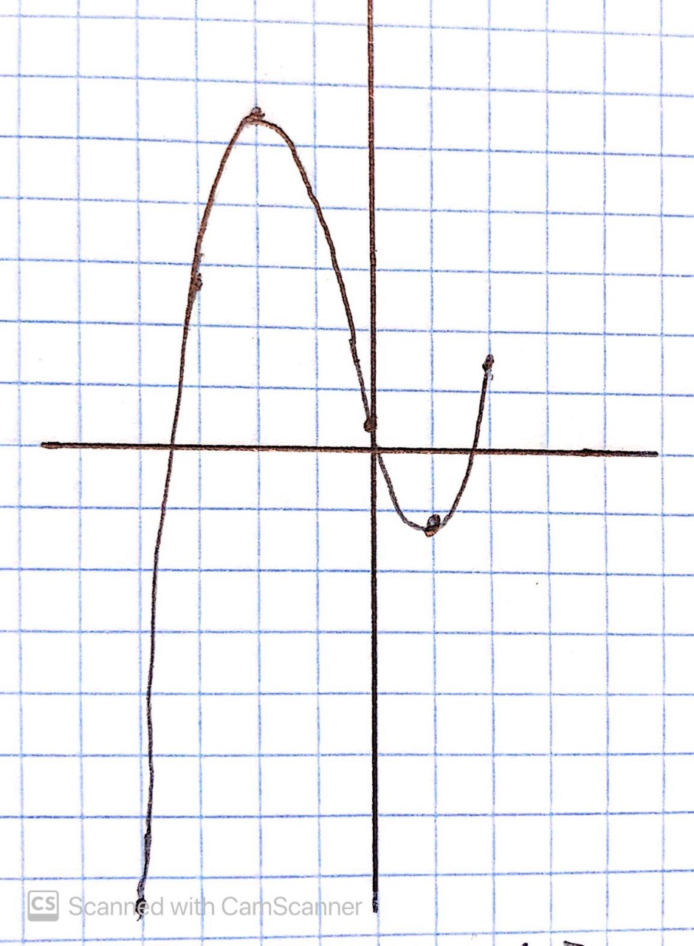


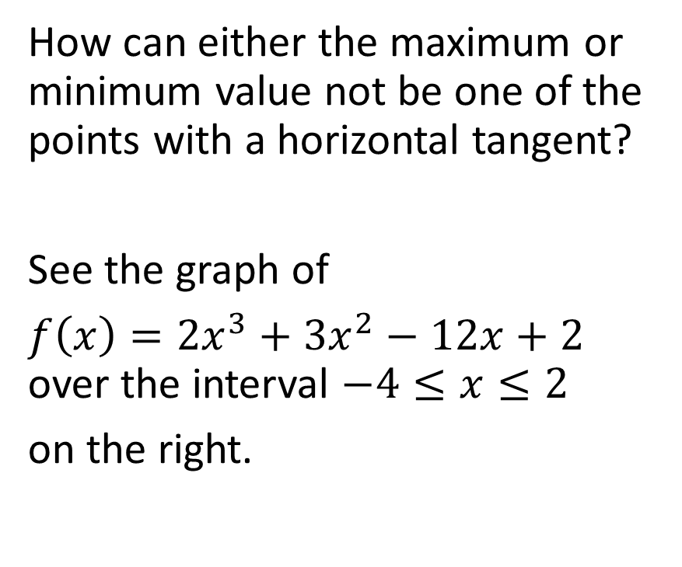


How can either the maximum or minimum value not be one of the points with a horizontal tangent?
See the graph of
$f\left(x\right)=2x^{3}+3x^{2}−12x+2$ over the interval $−4≤x≤2$
on the right.

Slide 13
Optimization Word Problems

Slide 14
Optimization may involve finding either the maximum or minimum value of the function over a set of values (domain).

Slide 15
Optimization may involve finding either the maximum or minimum value of the function over a set of values (domain).
Algorithm for Solving Optimization Problems
Develop a formula with only one independent variable.
Diagrams are sometimes helpful.
Determine the relevant domain of the independent variable (the question might include constraints on the variable).
Use the algorithm to optimize

Slide 16
Some convenient equations include
Revenue = (number of items sold) x (price of one unit)
Cost = (number of items produced) x (average cost to produce each unit)
Profit = Revenue – Cost
The best guide is common sense. The formula is usually relatively simple to apply if you slow down and think it through.

Slide 17
In this section, the question will sometimes tell you that you can use decimal approximations for your answers.
Similarly, sometimes a question will tell you that you can skip the domain analysis. In these questions, we just need to set the derivative to 0 and solve for the independent variable, then put the value(s) that we find back into the original formula and answer the question asked.

Slide 18
Example
Two positive numbers add to 24. The sum of the cube of one and the square of the other is a minimum. What are the numbers? (You may round your answers to two decimal places)

Slide 19
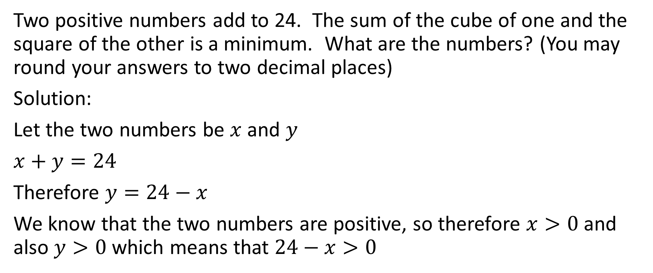
Two positive numbers add to 24. The sum of the cube of one and the square of the other is a minimum. What are the numbers? (You may round your answers to two decimal places)
Solution:
Let the two numbers be $x$ and $y$
$x+y=24$
Therefore $y=24−x$
We know that the two numbers are positive, so therefore $x>0$ and also $y>0$ which means that $24−x>0$

Slide 20
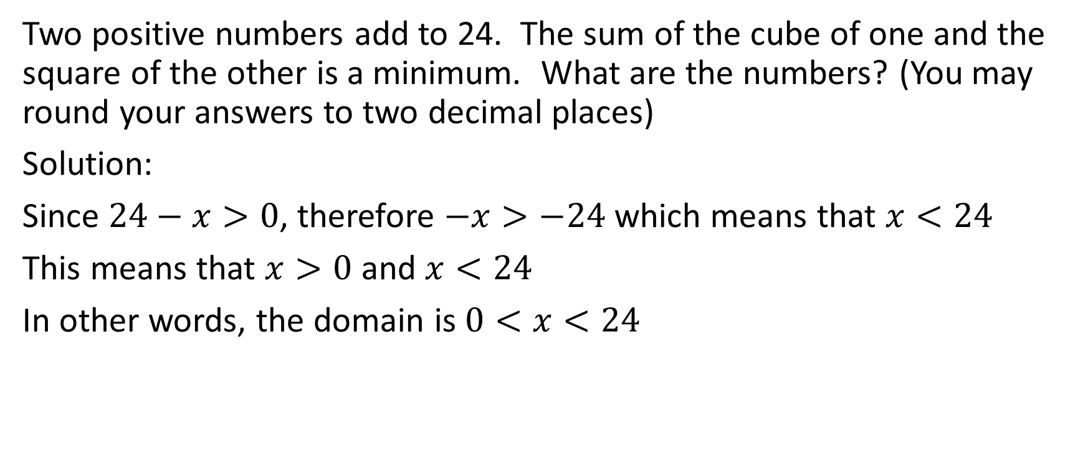
Two positive numbers add to 24. The sum of the cube of one and the square of the other is a minimum. What are the numbers? (You may round your answers to two decimal places)
Solution:
Since $24−x>0$, therefore $−x>−24$ which means that $x<24$
This means that $x>0$ and $x<24$
In other words, the domain is $0<x<24$

Slide 21
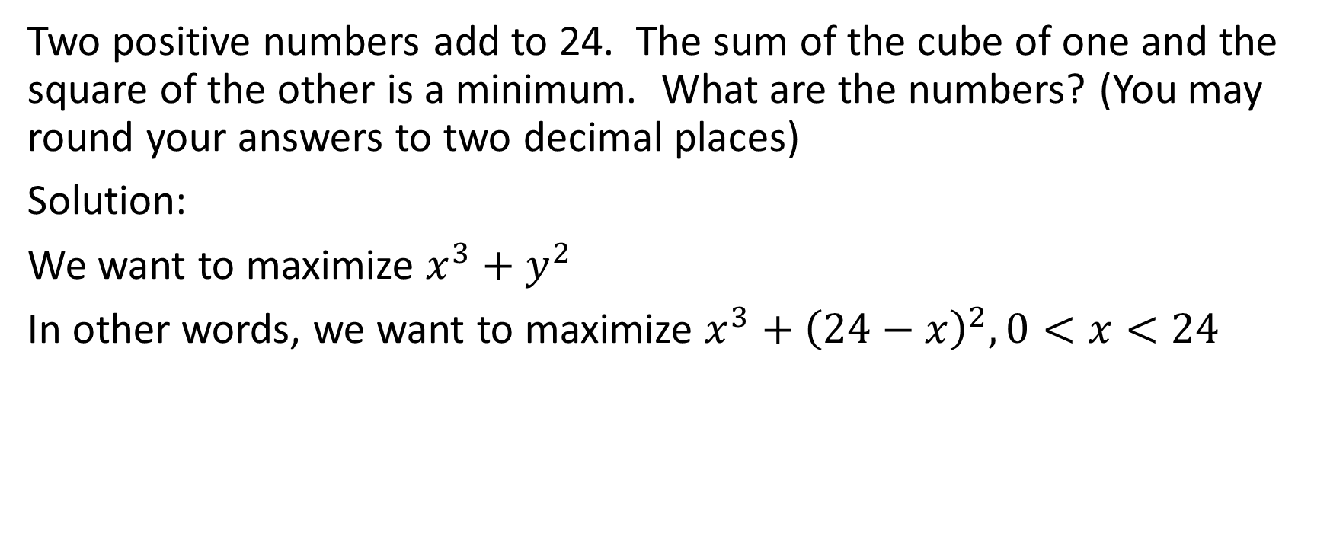
Two positive numbers add to 24. The sum of the cube of one and the square of the other is a minimum. What are the numbers? (You may round your answers to two decimal places)
Solution:
We want to maximize $x^{3}+y^{2}$
In other words, we want to maximize $x^{3}+{\left(24−x\right)}^{2},0<x<24$

Slide 22
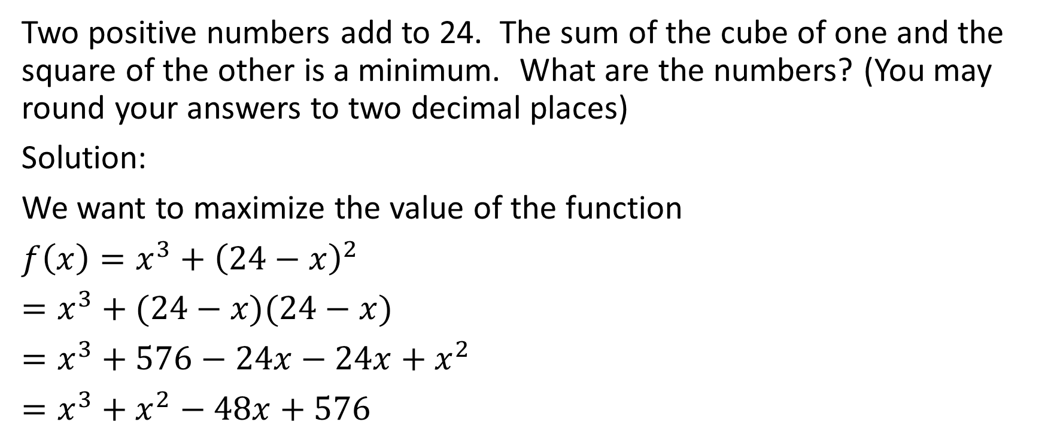
Two positive numbers add to 24. The sum of the cube of one and the square of the other is a minimum. What are the numbers? (You may round your answers to two decimal places)
Solution:
We want to maximize the value of the function
${f\left(x\right)=x}^{3}+{\left(24−x\right)}^{2}$
$=x^{3}+(24−x)(24−x)$
$=x^{3}+576−24x−24x+x^{2}$
$=x^{3}+x^{2}−48x+576$

Slide 23
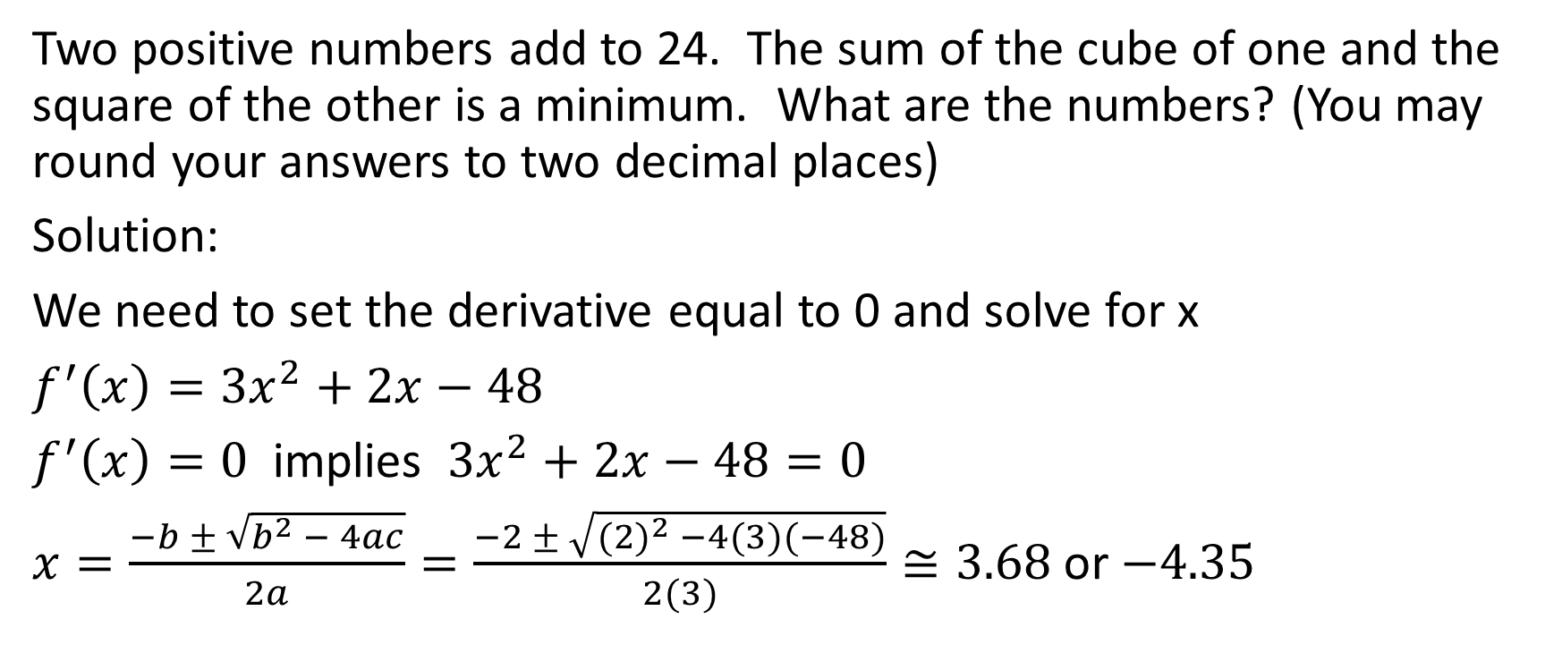
Two positive numbers add to 24. The sum of the cube of one and the square of the other is a minimum. What are the numbers? (You may round your answers to two decimal places)
Solution:
We need to set the derivative equal to 0 and solve for x
$f^{′}\left(x\right)=3x^{2}+2x−48$
$f^{′}\left(x\right)=0$ implies $3x^{2}+2x−48=0$
$x=\frac{−b ± \sqrt{b^{2} − 4ac}}{2a}=\frac{−2 ± \sqrt{{(2)}^{2} −4(3)(−48)}}{2(3)}≅3.68$or $−4.35$

Slide 24
Two positive numbers add to 24. The sum of the cube of one and the square of the other is a minimum. What are the numbers? (You may round your answers to two decimal places)
Solution:
The value of 3.68 falls in the domain of 0 < x < 24, but the value of
-4.35 does not fall in that domain.
We need to test the end values of x = 0 and x = 24 as well as the approximate value of x = 3.68 in the function that we established.

Slide 25
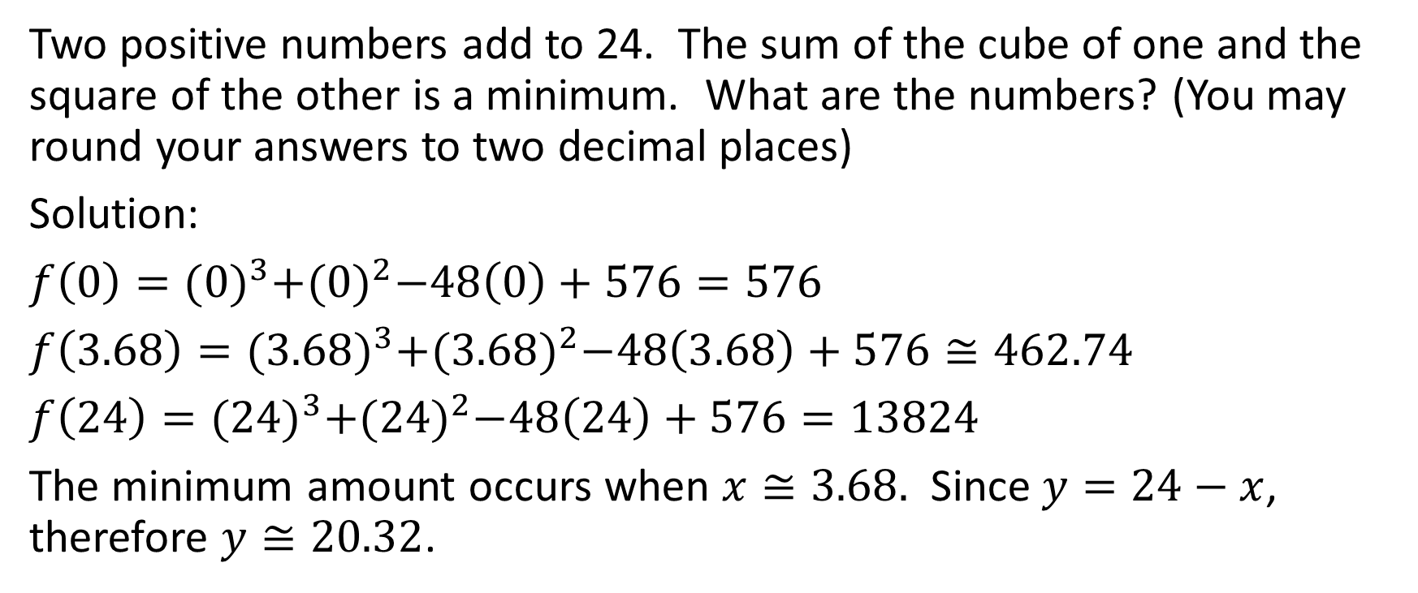
Two positive numbers add to 24. The sum of the cube of one and the square of the other is a minimum. What are the numbers? (You may round your answers to two decimal places)
Solution:
$f\left(0\right)={(0)}^{3}+{(0)}^{2}−48\left(0\right)+576=576$
$f\left(3.68\right)={(3.68)}^{3}+{(3.68)}^{2}−48\left(3.68\right)+576≅462.74$
$f\left(24\right)={(24)}^{3}+{(24)}^{2}−48\left(24\right)+576=13824$
The minimum amount occurs when $x≅3.68.$ Since $y=24−x$, therefore $y≅20.32$.

Slide 26
Two positive numbers add to 24. The sum of the cube of one and the square of the other is a minimum. What are the numbers? (You may round your answers to two decimal places)
Solution:
Therefore the numbers are approximately 3.68 (the number that would be cubed) and 20.32 (the number that would be squared).

Slide 27
Example
A farmer has 600 m of fencing and wishes to enclose a rectangular field. One side of the field is against a country road that is already fenced, so the farmer needs to fence only the remaining sides of the field. The farmer wants to enclose the maximum possible area and to use all the fencing. What dimensions will achieve this goal?

Slide 28
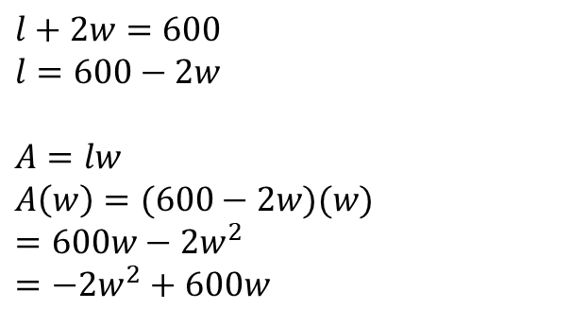
A farmer has 600 m of fencing and wishes to enclose a rectangular field. One side of the field is against a country road that is already fenced, so the farmer needs to fence only the remaining sides of the field. The farmer wants to enclose the maximum possible area and to use all the fencing. What dimensions will achieve this goal?
Example:
Fencing in red
$l+2w=600$
$l=600−2w$
$A=lw$
$A\left(w\right)=(600−2w)(w)$
$=600w−2w^{2}$
$=−2w^{2}+600w$
road
width
width
length

Slide 29
A farmer has 600 m of fencing and wishes to enclose a rectangular field. One side of the field is against a country road that is already fenced, so the farmer needs to fence only the remaining sides of the field. The farmer wants to enclose the maximum possible area and to use all the fencing. What dimensions will achieve this goal?
Example:
Fencing in red
$l+2w=600$
$l=600−2w$
$A=lw$
$A\left(w\right)=(600−2w)(w)$
$=600w−2w^{2}$
$=−2w^{2}+600w$
At this point we could certainly use quadratic principles from earlier grades to solve the problem. However, we will proceed with the methods talked about in this slide (which are applicable to non-quadratic scenarios as well.
road
width
width
length

Slide 30
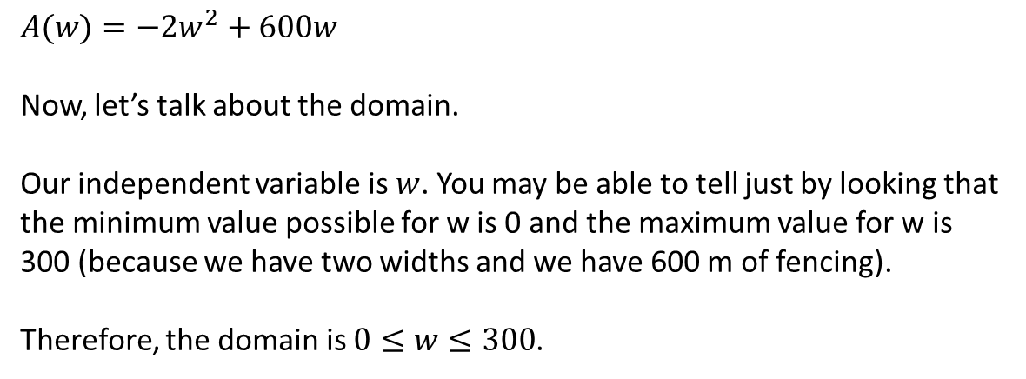
A farmer has 600 m of fencing and wishes to enclose a rectangular field. One side of the field is against a country road that is already fenced, so the farmer needs to fence only the remaining sides of the field. The farmer wants to enclose the maximum possible area and to use all the fencing. What dimensions will achieve this goal?
Example:
Fencing in red
$A(w)=−2w^{2}+600w$
Now, let’s talk about the domain.
Our independent variable is $w$. You may be able to tell just by looking that the minimum value possible for w is 0 and the maximum value for w is 300 (because we have two widths and we have 600 m of fencing).
Therefore, the domain is $0≤w≤300$.
road
width
width
length

Slide 31
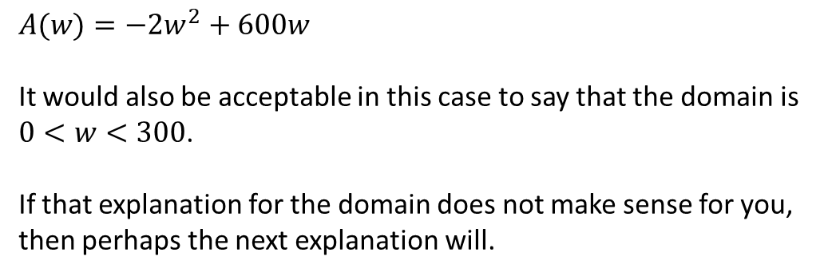
A farmer has 600 m of fencing and wishes to enclose a rectangular field. One side of the field is against a country road that is already fenced, so the farmer needs to fence only the remaining sides of the field. The farmer wants to enclose the maximum possible area and to use all the fencing. What dimensions will achieve this goal?
Example:
Fencing in red
$A(w)=−2w^{2}+600w$
It would also be acceptable in this case to say that the domain is $0<w<300$.
If that explanation for the domain does not make sense for you, then perhaps the next explanation will.
road
width
width
length

Slide 32
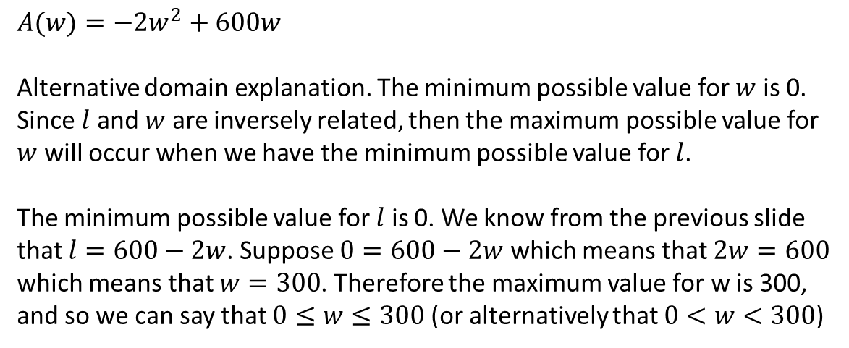
A farmer has 600 m of fencing and wishes to enclose a rectangular field. One side of the field is against a country road that is already fenced, so the farmer needs to fence only the remaining sides of the field. The farmer wants to enclose the maximum possible area and to use all the fencing. What dimensions will achieve this goal?
Example:
Fencing in red
$A(w)=−2w^{2}+600w$
Alternative domain explanation. The minimum possible value for $w$ is 0. Since $l$ and $w$ are inversely related, then the maximum possible value for $w$ will occur when we have the minimum possible value for $l$.
The minimum possible value for $l$ is 0. We know from the previous slide that $l=600−2w$. Suppose $0=600−2w$ which means that $2w=600$ which means that $w=300$. Therefore the maximum value for w is 300, and so we can say that $0≤w≤300$ (or alternatively that $0<w<300$)
road
width
width
length

Slide 33
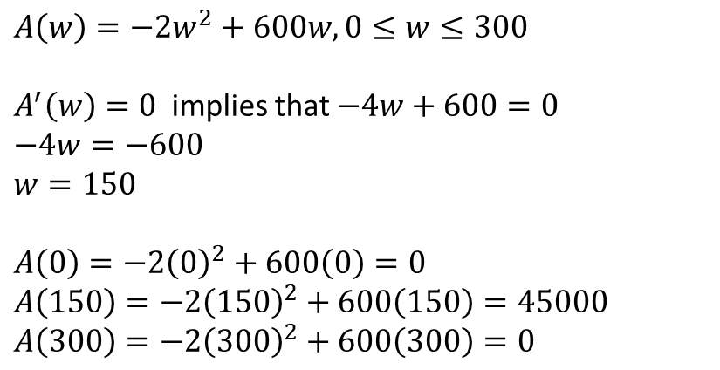
A farmer has 600 m of fencing and wishes to enclose a rectangular field. One side of the field is against a country road that is already fenced, so the farmer needs to fence only the remaining sides of the field. The farmer wants to enclose the maximum possible area and to use all the fencing. What dimensions will achieve this goal?
Example:
Fencing in red
$A\left(w\right)=−2w^{2}+600w, 0≤w≤300$
$A^{′}\left(w\right)=0$ implies that $−4w+600=0$
$−4w=−600$
$w=150$
$A\left(0\right)=−2{\left(0\right)}^{2}+600\left(0\right)=0$
$A\left(150\right)=−2{\left(150\right)}^{2}+600\left(150\right)=45000$
$A\left(300\right)=−2{\left(300\right)}^{2}+600\left(300\right)=0$
road
width
width
length

Slide 34
A farmer has 600 m of fencing and wishes to enclose a rectangular field. One side of the field is against a country road that is already fenced, so the farmer needs to fence only the remaining sides of the field. The farmer wants to enclose the maximum possible area and to use all the fencing. What dimensions will achieve this goal?
Example:
Fencing in red
Therefore, the maximum area occurs with a length of 300 m and a width of 150 m.
road
width
width
length

Slide 35
Example
A woman wants to create a rectangular fenced in field as shown. She wants to divide it in half with a fence parallel to one of the sides. She has 600 metres of fence with which to do the job. Determine the maximum possible area.
road

Slide 36
A woman wants to create a rectangular fenced in field as shown. She wants to divide it in half with a fence parallel to one of the sides. She has 600 metres of fence with which to do the job. Determine the maximum possible area.
Solution:
Just like with the last question, we could use quadratic
principles from earlier grades for this solution, but instead
we’ll use the optimization algorithm.
road

Slide 37
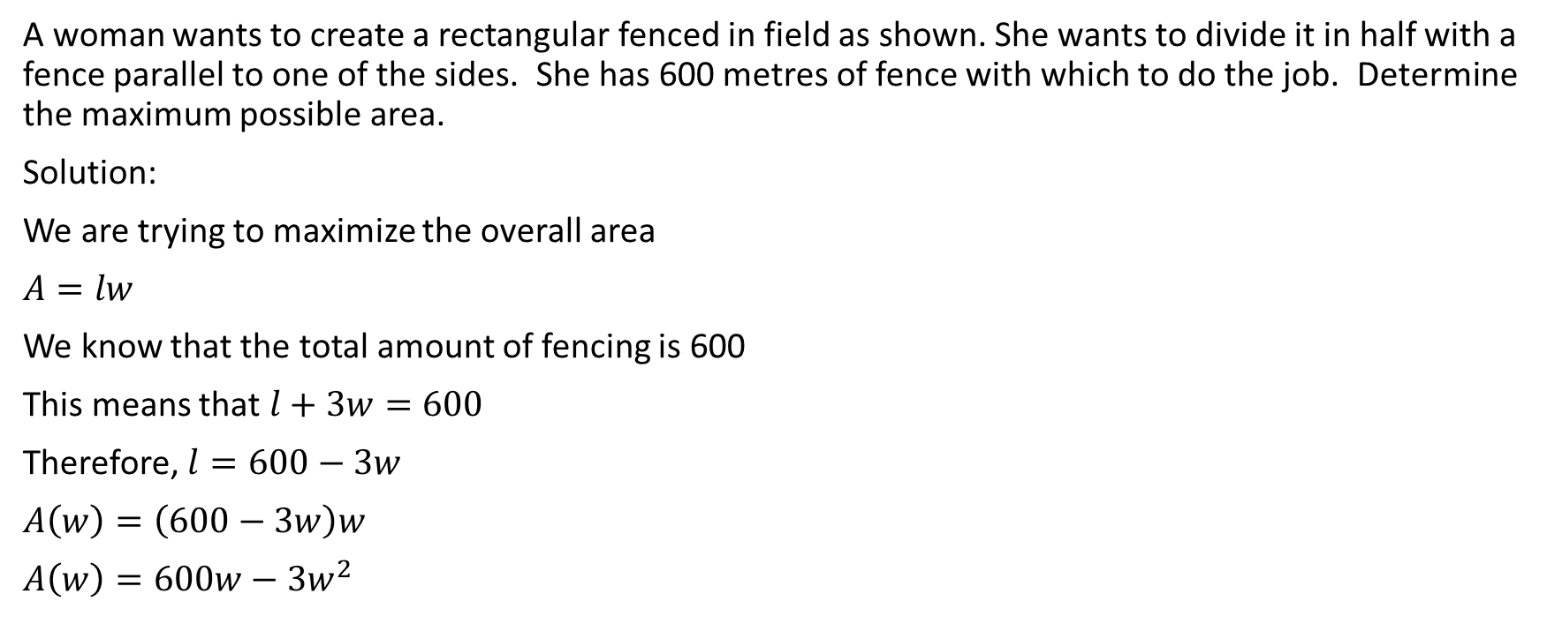
A woman wants to create a rectangular fenced in field as shown. She wants to divide it in half with a fence parallel to one of the sides. She has 600 metres of fence with which to do the job. Determine the maximum possible area.
Solution:
We are trying to maximize the overall area
$A=lw$
We know that the total amount of fencing is 600
This means that $l+3w=600$
Therefore, $l=600−3w$
$A\left(w\right)=\left(600−3w\right)w$
$A\left(w\right)=600w−3w^{2}$
road
width
width
width
length

Slide 38
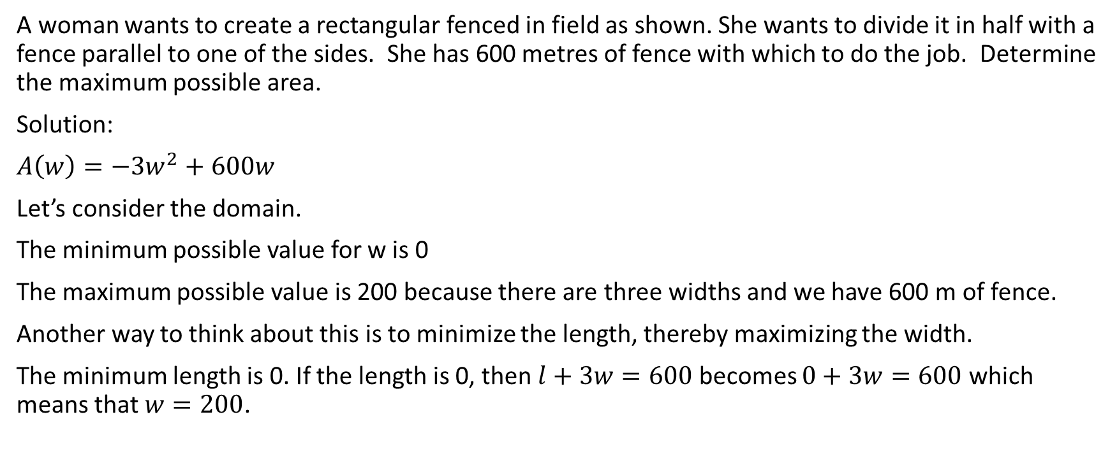
A woman wants to create a rectangular fenced in field as shown. She wants to divide it in half with a fence parallel to one of the sides. She has 600 metres of fence with which to do the job. Determine the maximum possible area.
Solution:
$A\left(w\right)=−3w^{2}+600w$
Let’s consider the domain.
The minimum possible value for w is 0
The maximum possible value is 200 because there are three widths and we have 600 m of fence.
Another way to think about this is to minimize the length, thereby maximizing the width.
The minimum length is 0. If the length is 0, then $l+3w=600$ becomes $0+3w=600$ which means that $w=200$.
road
width
width
width
length

Slide 39
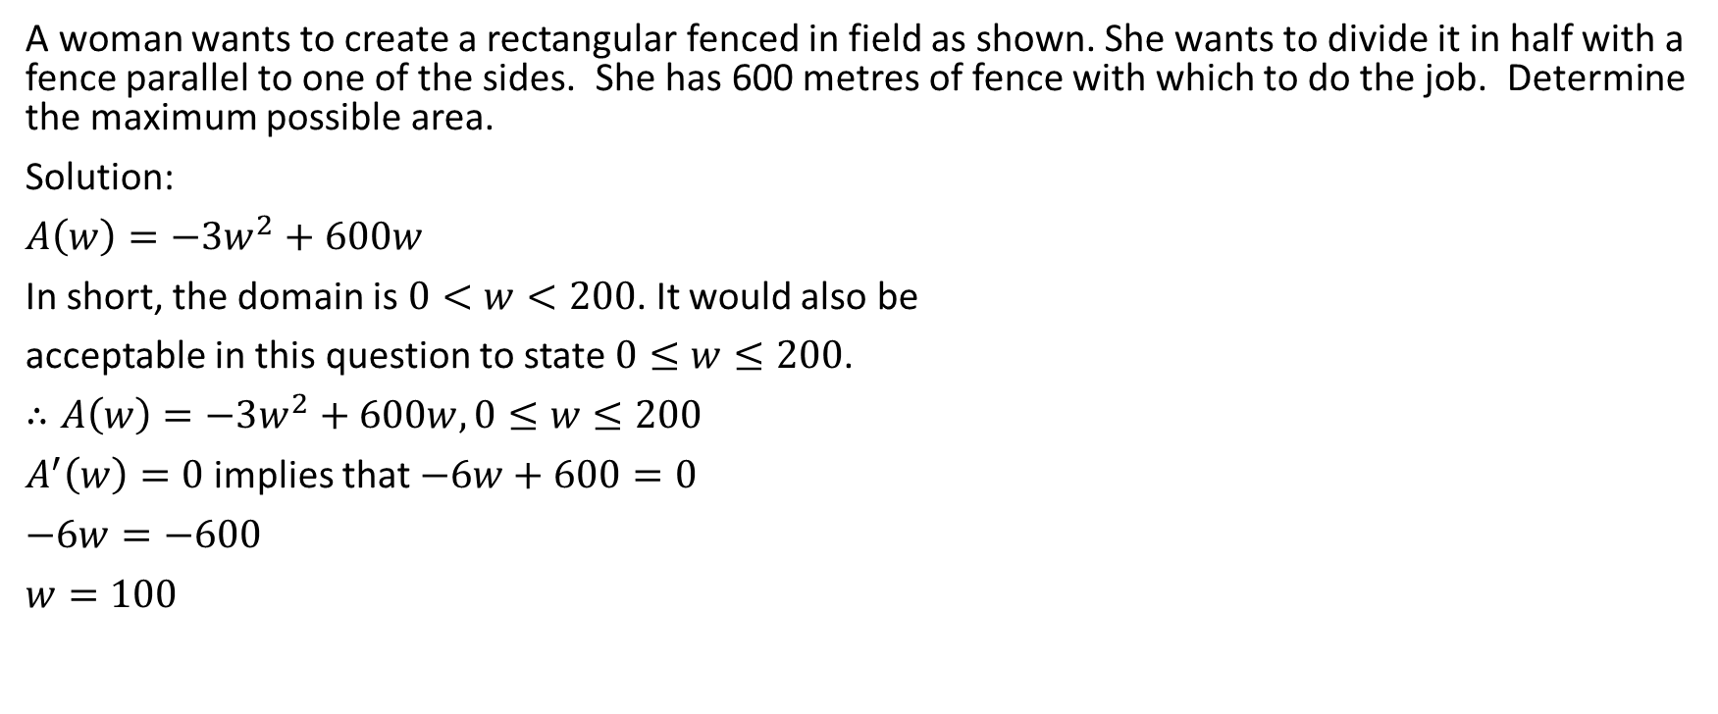
A woman wants to create a rectangular fenced in field as shown. She wants to divide it in half with a fence parallel to one of the sides. She has 600 metres of fence with which to do the job. Determine the maximum possible area.
Solution:
$A\left(w\right)=−3w^{2}+600w$
In short, the domain is $0<w<200$. It would also be
acceptable in this question to state $0≤w≤200$.
$∴A\left(w\right)=−3w^{2}+600w,0≤w≤200$
$A^{′}\left(w\right)=0$ implies that $−6w+600=0$
$−6w=−600$
$w=100$
road
width
width
width
length

Slide 40
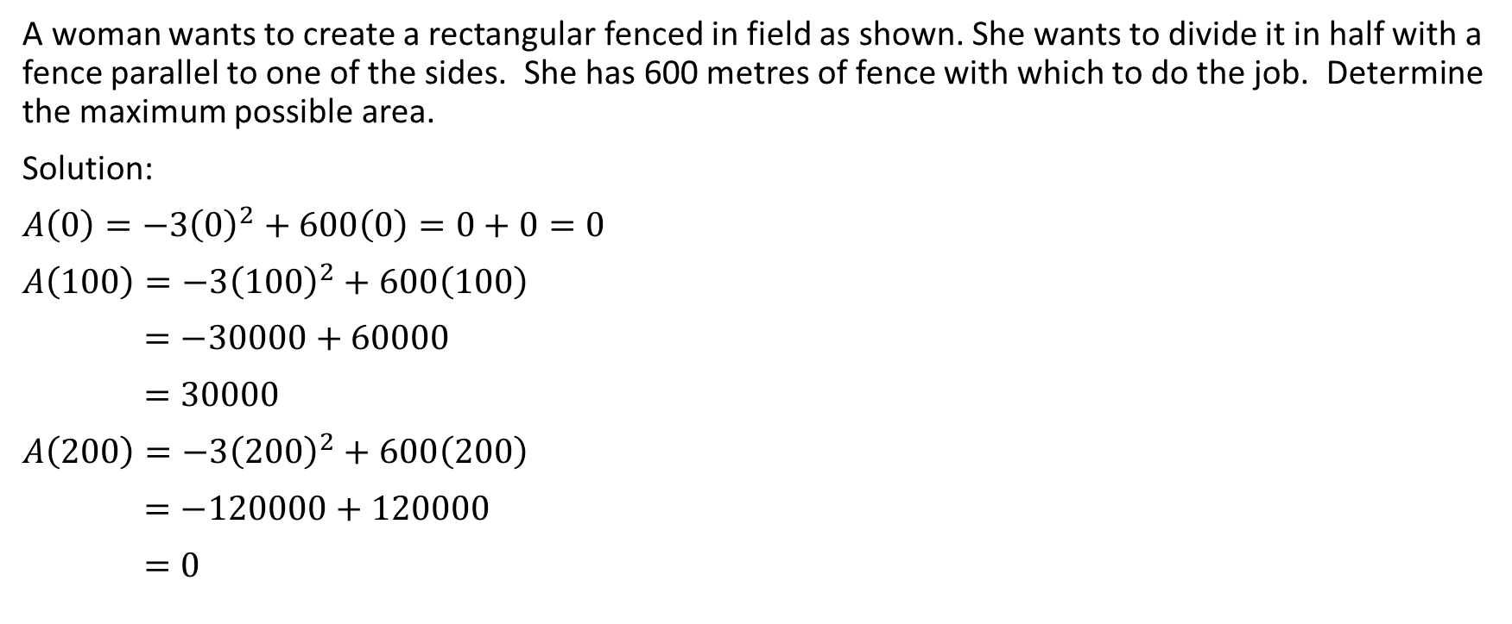
A woman wants to create a rectangular fenced in field as shown. She wants to divide it in half with a fence parallel to one of the sides. She has 600 metres of fence with which to do the job. Determine the maximum possible area.
Solution:
$A\left(0\right)=−3{\left(0\right)}^{2}+600\left(0\right)=0+0=0$
$A\left(100\right)=−3{\left(100\right)}^{2}+600\left(100\right)$
$=−30000+60000$
$=30000$
$A\left(200\right)=−3{\left(200\right)}^{2}+600\left(200\right)$
$=−120000+120000$
$=0$
road
width
width
width
length

Slide 41
A woman wants to create a rectangular fenced in field as shown. She wants to divide it in half with a fence parallel to one of the sides. She has 600 metres of fence with which to do the job. Determine the maximum possible area.
Solution:
$A\left(0\right)=−3{\left(0\right)}^{2}+600\left(0\right)=0+0=0$
$A\left(100\right)=−3{\left(100\right)}^{2}+600\left(100\right)$
$=−30000+60000$
$=30000$
$A\left(200\right)=−3{\left(200\right)}^{2}+600\left(200\right)$
$=−120000+120000$
$=0$
road
width
width
width
length
Therefore, the maximum possible area is 30000 m²

Slide 42
Example
A piece of sheet metal, 60m by 30m, is to be used to make a rectangular box with an open top. Determine the dimensions that will give the box the largest volume. You may round your answer to two decimal places.

Slide 43
A piece of sheet metal, 60m by 30m, is to be used to make a rectangular box with an open top. Determine the dimensions that will give the box the largest volume. You may round your answer to two decimal places.
Solution:
We start with this sheet of metal.
Then, we cut a square of length x from each corner.

Slide 44


A piece of sheet metal, 60m by 30m, is to be used to make a rectangular box with an open top. Determine the dimensions that will give the box the largest volume. You may round your answer to two decimal places.
Solution:
We start with this sheet of metal.
Then, we cut a square of length x from each corner.

Slide 45


A piece of sheet metal, 60m by 30m, is to be used to make a rectangular box with an open top. Determine the dimensions that will give the box the largest volume. You may round your answer to two decimal places.
Solution:
We start with this sheet of metal.
Then, we cut a square of length x from each corner.

Slide 46

A piece of sheet metal, 60m by 30m, is to be used to make a rectangular box with an open top. Determine the dimensions that will give the box the largest volume. You may round your answer to two decimal places.
Solution:
We start with this sheet of metal.
Then, we cut a square of length x from each corner.
Then, we fold up along the black dotted lines,
creating an open topped box.

Slide 47
A piece of sheet metal, 60m by 30m, is to be used to make a rectangular box with an open top. Determine the dimensions that will give the box the largest volume. You may round your answer to two decimal places.
Solution:
We start with this sheet of metal.
Then, we cut a square of length x from each corner.
Then, we fold up along the black dotted lines,
creating an open topped box.
The base of the box will have a length of 60 – 2x
and a width of 30 – 2x. The height will be x.

Slide 48
A piece of sheet metal, 60m by 30m, is to be used to make a rectangular box with an open top. Determine the dimensions that will give the box the largest volume. You may round your answer to two decimal places.
Solution:
x
30-2x
60-2x

Slide 49
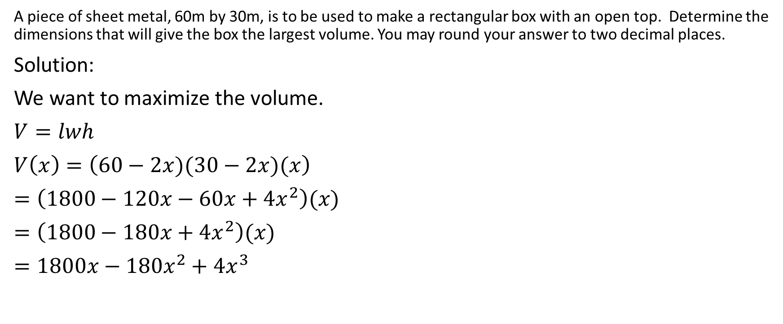
A piece of sheet metal, 60m by 30m, is to be used to make a rectangular box with an open top. Determine the dimensions that will give the box the largest volume. You may round your answer to two decimal places.
Solution:
We want to maximize the volume.
$V=lwh$
$V\left(x\right)=\left(60−2x)(30−2x)(x\right)$
$=\left(1800−120x−60x+4x^{2}\right)(x)$
$=\left(1800−180x+4x^{2}\right)(x)$
$=1800x−180x^{2}+4x^{3}$
x
30-2x
60-2x

Slide 50
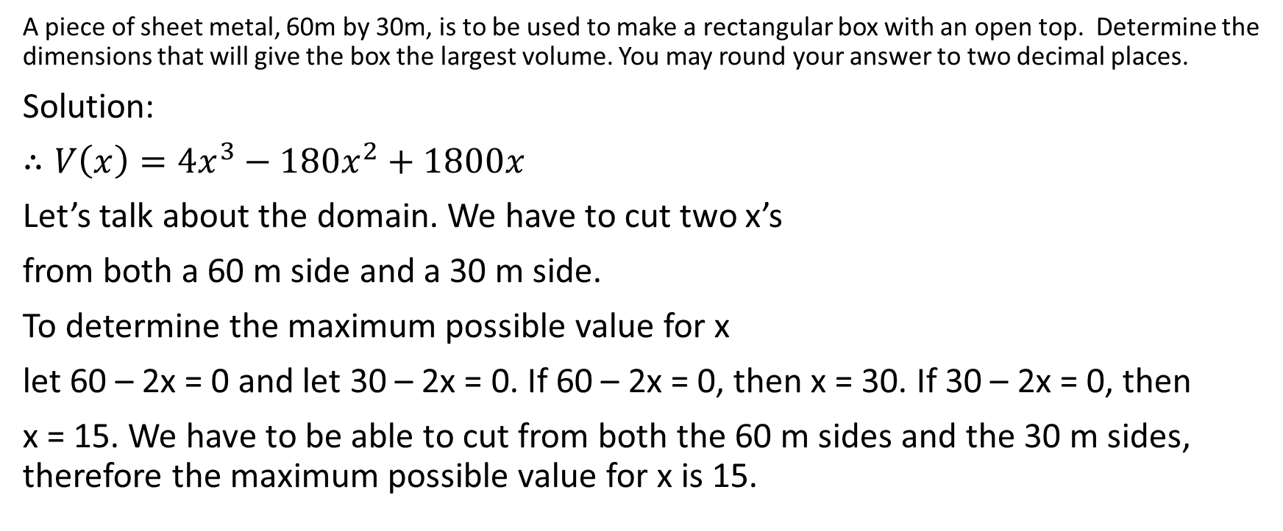
A piece of sheet metal, 60m by 30m, is to be used to make a rectangular box with an open top. Determine the dimensions that will give the box the largest volume. You may round your answer to two decimal places.
Solution:
$∴V\left(x\right)=4x^{3}−180x^{2}+1800x$
Let’s talk about the domain. We have to cut two x’s
from both a 60 m side and a 30 m side.
To determine the maximum possible value for x
let 60 – 2x = 0 and let 30 – 2x = 0. If 60 – 2x = 0, then x = 30. If 30 – 2x = 0, then
x = 15. We have to be able to cut from both the 60 m sides and the 30 m sides, therefore the maximum possible value for x is 15.
x
30-2x
60-2x

Slide 51
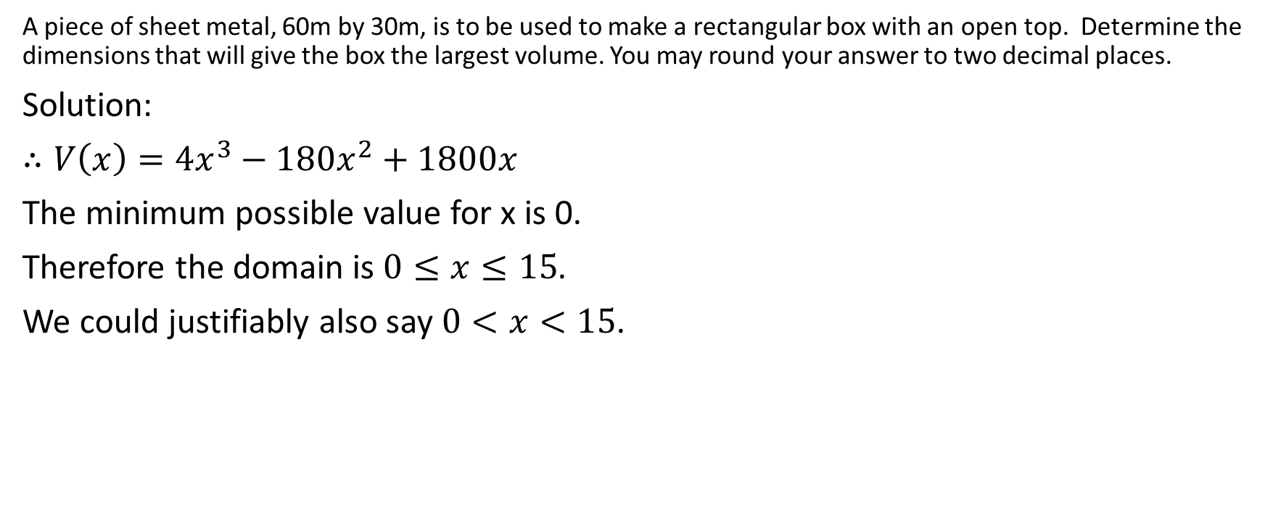
A piece of sheet metal, 60m by 30m, is to be used to make a rectangular box with an open top. Determine the dimensions that will give the box the largest volume. You may round your answer to two decimal places.
Solution:
$∴V\left(x\right)=4x^{3}−180x^{2}+1800x$
The minimum possible value for x is 0.
Therefore the domain is $0≤x≤15$.
We could justifiably also say $0<x<15$.
x
30-2x
60-2x

Slide 52
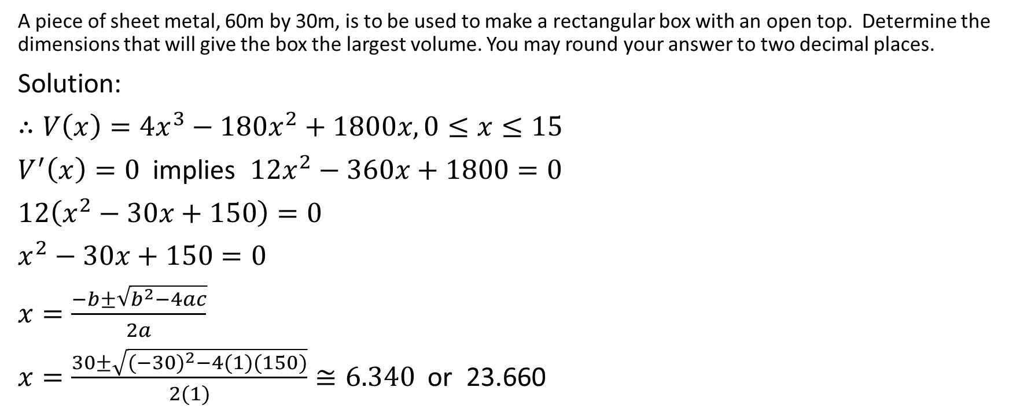
A piece of sheet metal, 60m by 30m, is to be used to make a rectangular box with an open top. Determine the dimensions that will give the box the largest volume. You may round your answer to two decimal places.
Solution:
$∴V\left(x\right)=4x^{3}−180x^{2}+1800x,0≤x≤15$
$V^{′}\left(x\right)=0$ implies $12x^{2}−360x+1800=0$
$12\left(x^{2}−30x+150\right)=0$
$x^{2}−30x+150=0$
$x=\frac{−b±\sqrt{b^{2}−4ac}}{2a}$
$x=\frac{30±\sqrt{{(−30)}^{2}−4(1)(150)}}{2(1)}≅6.340$ or 23.660
x
30-2x
60-2x

Slide 53
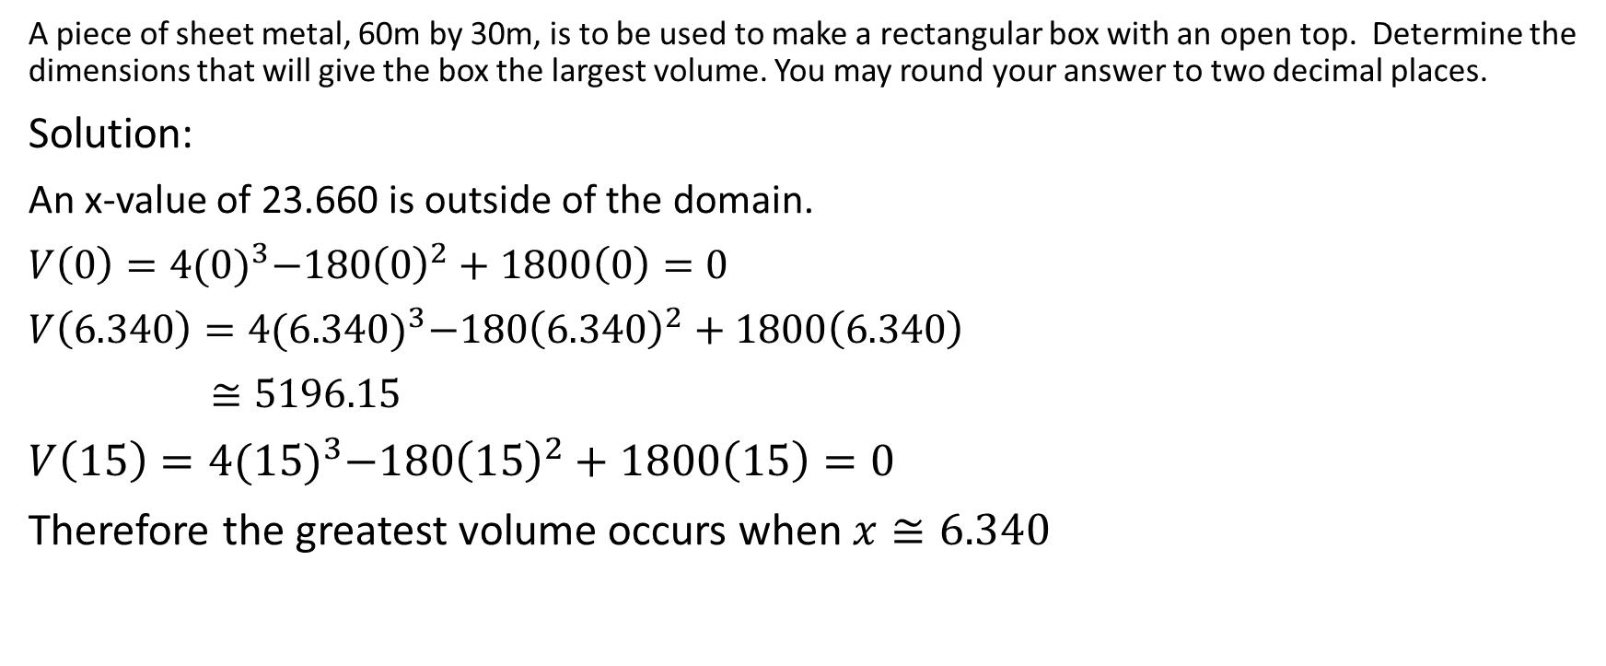
A piece of sheet metal, 60m by 30m, is to be used to make a rectangular box with an open top. Determine the dimensions that will give the box the largest volume. You may round your answer to two decimal places.
Solution:
An x-value of 23.660 is outside of the domain.
$V\left(0\right)=4{(0)}^{3}−180{\left(0\right)}^{2}+1800\left(0\right)=0$
$V\left(6.340\right)=4{(6.340)}^{3}−180{\left(6.340\right)}^{2}+1800\left(6.340\right)$
$≅5196.15$
$V\left(15\right)=4{(15)}^{3}−180{\left(15\right)}^{2}+1800\left(15\right)=0$
Therefore the greatest volume occurs when $x≅6.340$
x
30-2x
60-2x

Slide 54
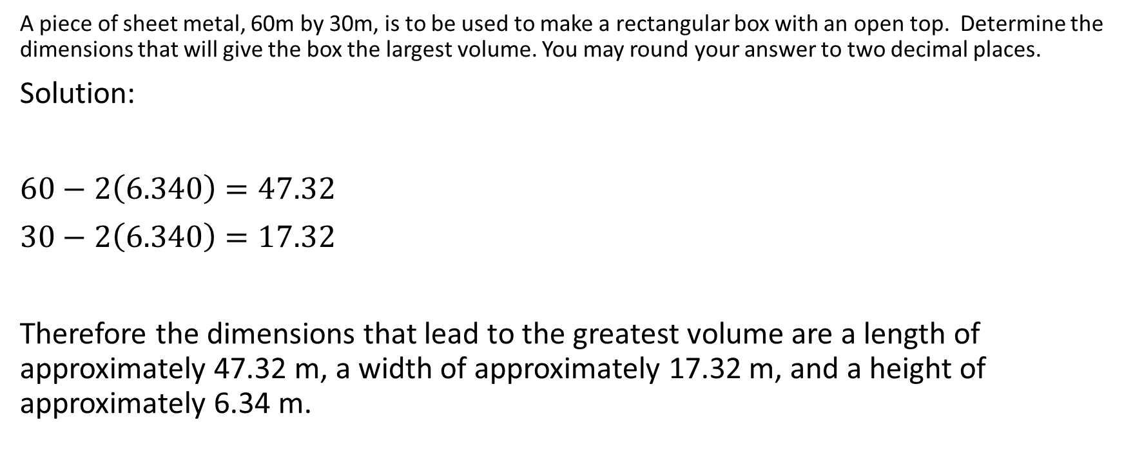
A piece of sheet metal, 60m by 30m, is to be used to make a rectangular box with an open top. Determine the dimensions that will give the box the largest volume. You may round your answer to two decimal places.
Solution:
$60−2\left(6.340\right)=47.32$
$30−2\left(6.340\right)=17.32$
Therefore the dimensions that lead to the greatest volume are a length of approximately 47.32 m, a width of approximately 17.32 m, and a height of approximately 6.34 m.
x
30-2x
60-2x

Slide 55
Example
A man wants to create a fenced in area of 1000 m². Three of the sides of the rectangle will use fencing that costs $50/m, and one of the sides will use fencing that costs $10/m. What is the cheapest price possible?

Slide 56
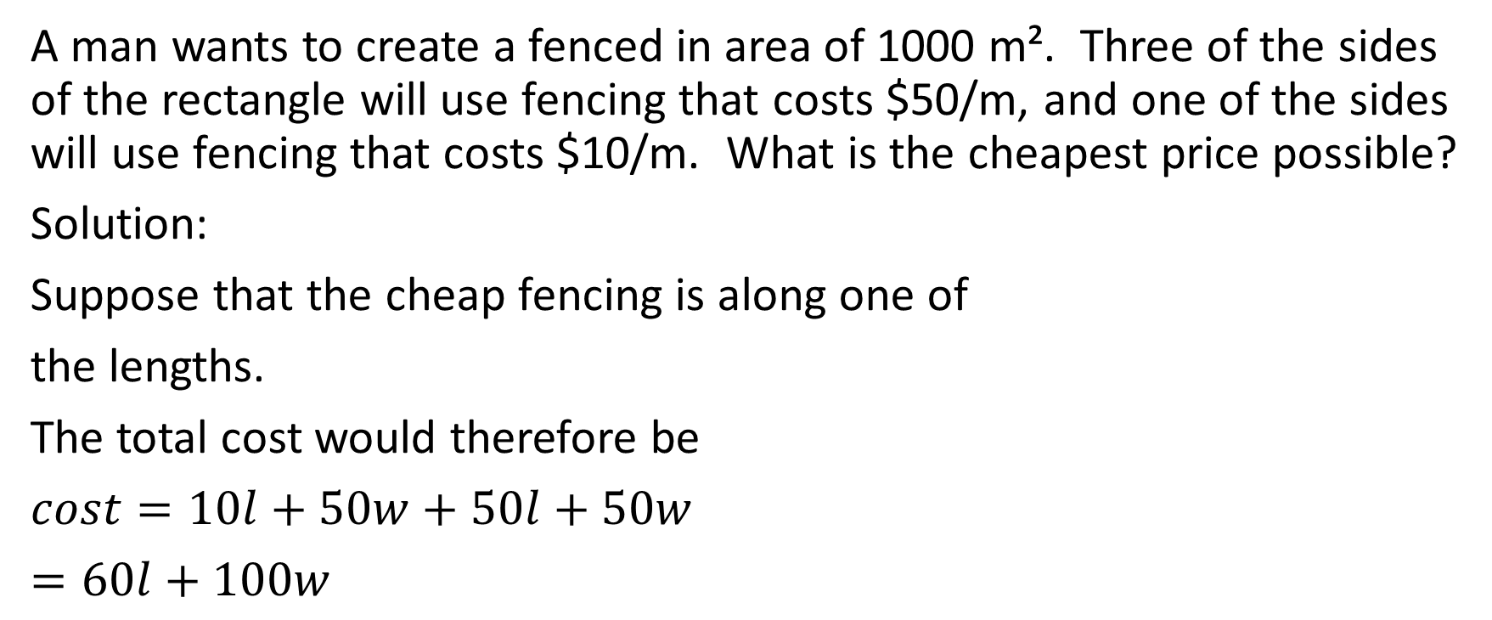
A man wants to create a fenced in area of 1000 m². Three of the sides of the rectangle will use fencing that costs $50/m, and one of the sides will use fencing that costs $10/m. What is the cheapest price possible?
Solution:
Suppose that the cheap fencing is along one of
the lengths.
The total cost would therefore be
$cost=10l+50w+50l+50w$
$=60l+100w$
length
width
width
length

Slide 57
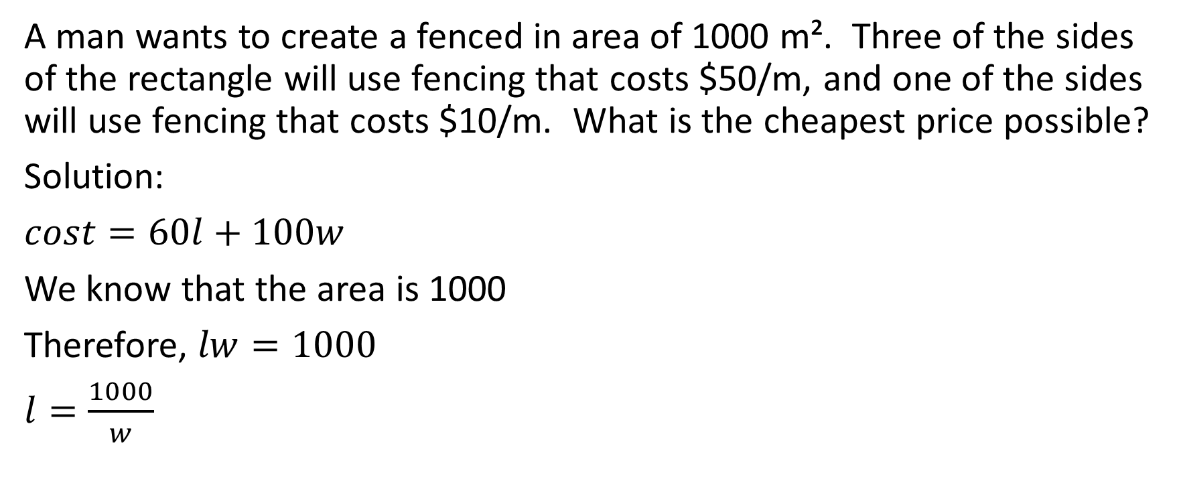
A man wants to create a fenced in area of 1000 m². Three of the sides of the rectangle will use fencing that costs $50/m, and one of the sides will use fencing that costs $10/m. What is the cheapest price possible?
Solution:
$cost=60l+100w$
We know that the area is 1000
Therefore, $lw=1000$
$l=\frac{1000}{w}$
length
width
width
length

Slide 58
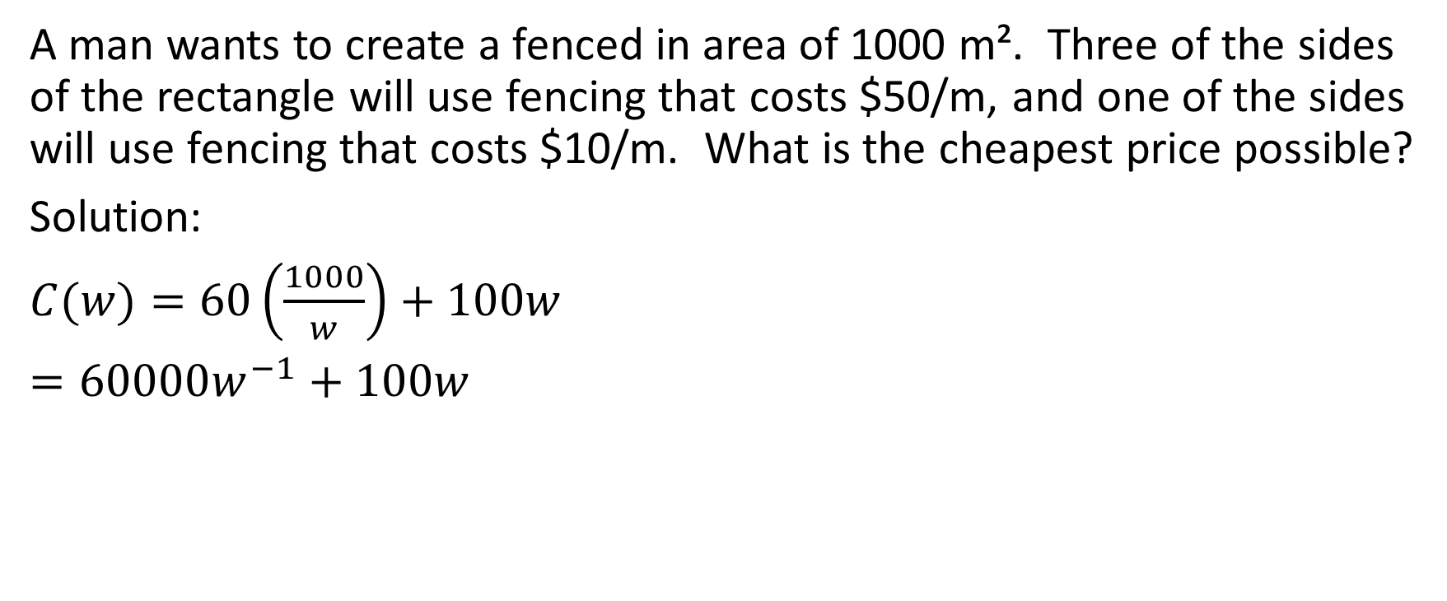
A man wants to create a fenced in area of 1000 m². Three of the sides of the rectangle will use fencing that costs $50/m, and one of the sides will use fencing that costs $10/m. What is the cheapest price possible?
Solution:
$C(w)=60\left(\frac{1000}{w}\right)+100w$
$=60000w^{−1}+100w$
length
width
width
length

Slide 59
A man wants to create a fenced in area of 1000 m². Three of the sides of the rectangle will use fencing that costs $50/m, and one of the sides will use fencing that costs $10/m. What is the cheapest price possible?
Solution:
Now, let’s discuss the domain. It is possible for a
rectangle of given area to have a width of
virtually 0 and an immeasurably long length.
Similarly, it’s possible for the same rectangle to have
a length of virtually 0 and an immeasurably long width
length
width
width
length

Slide 60
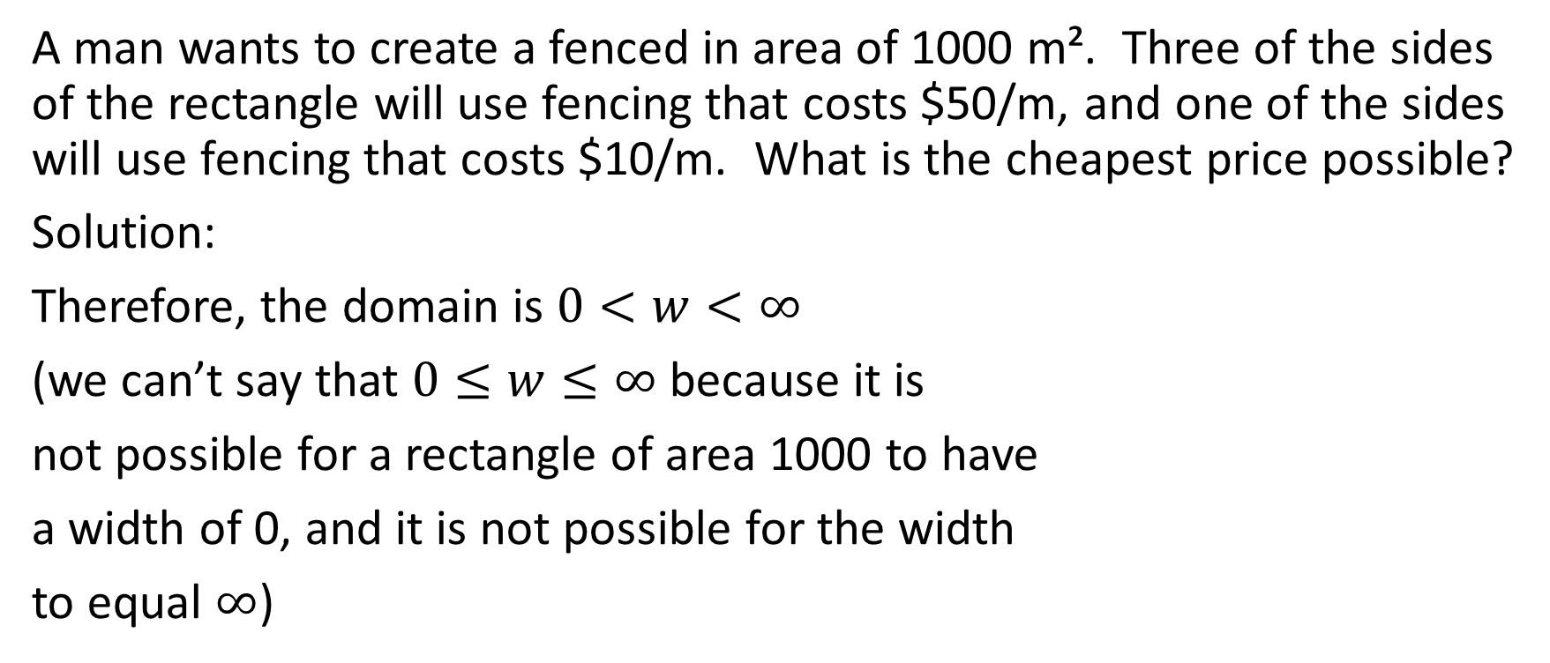
A man wants to create a fenced in area of 1000 m². Three of the sides of the rectangle will use fencing that costs $50/m, and one of the sides will use fencing that costs $10/m. What is the cheapest price possible?
Solution:
Therefore, the domain is $0<w<∞$
(we can’t say that $0≤w≤∞$ because it is
not possible for a rectangle of area 1000 to have
a width of 0, and it is not possible for the width
to equal $∞$)
length
width
width
length

Slide 61
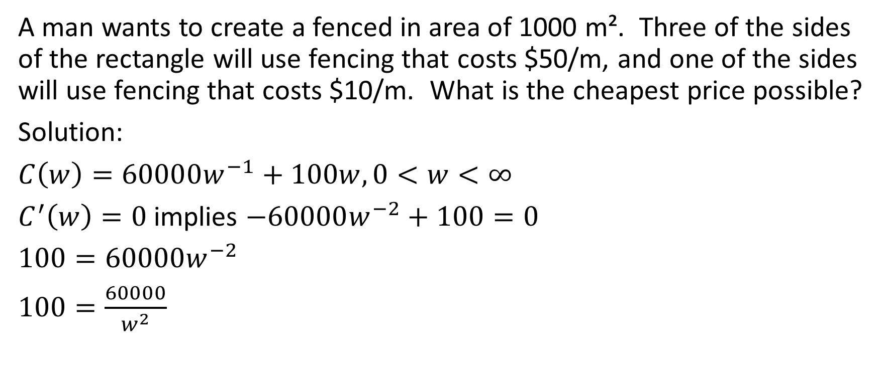
A man wants to create a fenced in area of 1000 m². Three of the sides of the rectangle will use fencing that costs $50/m, and one of the sides will use fencing that costs $10/m. What is the cheapest price possible?
Solution:
$C\left(w\right)=60000w^{−1}+100w,0<w<∞$
$C^{′}\left(w\right)=0$ implies $−60000w^{−2}+100=0$
$100=60000w^{−2}$
$100=\frac{60000}{w^{2}}$
length
width
width
length

Slide 62
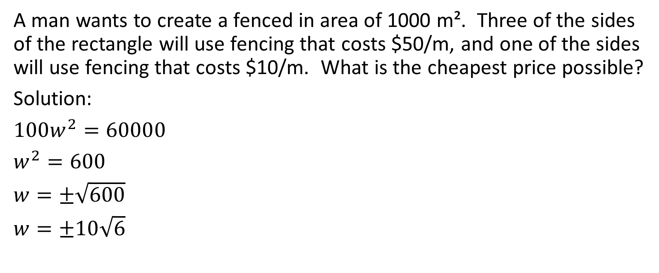
A man wants to create a fenced in area of 1000 m². Three of the sides of the rectangle will use fencing that costs $50/m, and one of the sides will use fencing that costs $10/m. What is the cheapest price possible?
Solution:
$100w^{2}=60000$
$w^{2}=600$
$w=±\sqrt{600}$
$w=±10\sqrt{6}$
length
width
width
length

Slide 63
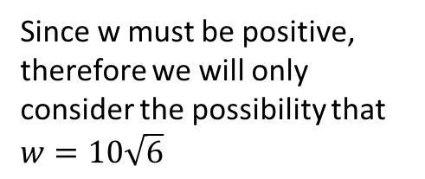
A man wants to create a fenced in area of 1000 m². Three of the sides of the rectangle will use fencing that costs $50/m, and one of the sides will use fencing that costs $10/m. What is the cheapest price possible?
Solution:
$100w^{2}=60000$
$w^{2}=600$
$w=±\sqrt{600}$
$w=±10\sqrt{6}$
length
width
width
Since w must be positive, therefore we will only consider the possibility that $w=10\sqrt{6}$
length

Slide 64
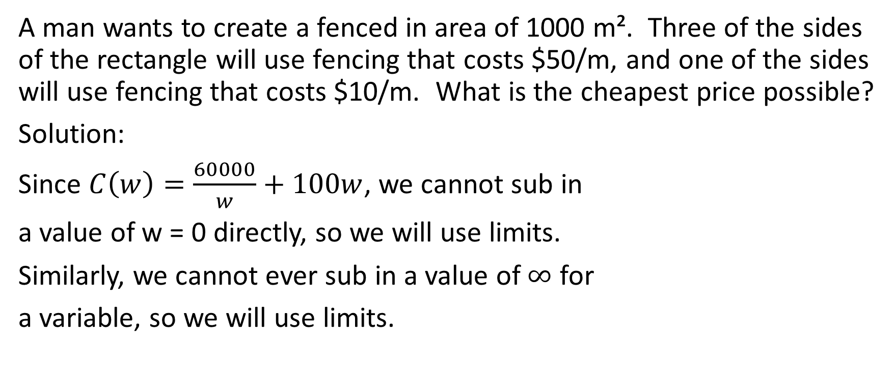
A man wants to create a fenced in area of 1000 m². Three of the sides of the rectangle will use fencing that costs $50/m, and one of the sides will use fencing that costs $10/m. What is the cheapest price possible?
Solution:
Since $C\left(w\right)=\frac{60000}{w}+100w$, we cannot sub in
a value of w = 0 directly, so we will use limits.
Similarly, we cannot ever sub in a value of $∞$ for
a variable, so we will use limits.
length
width
width
length

Slide 65
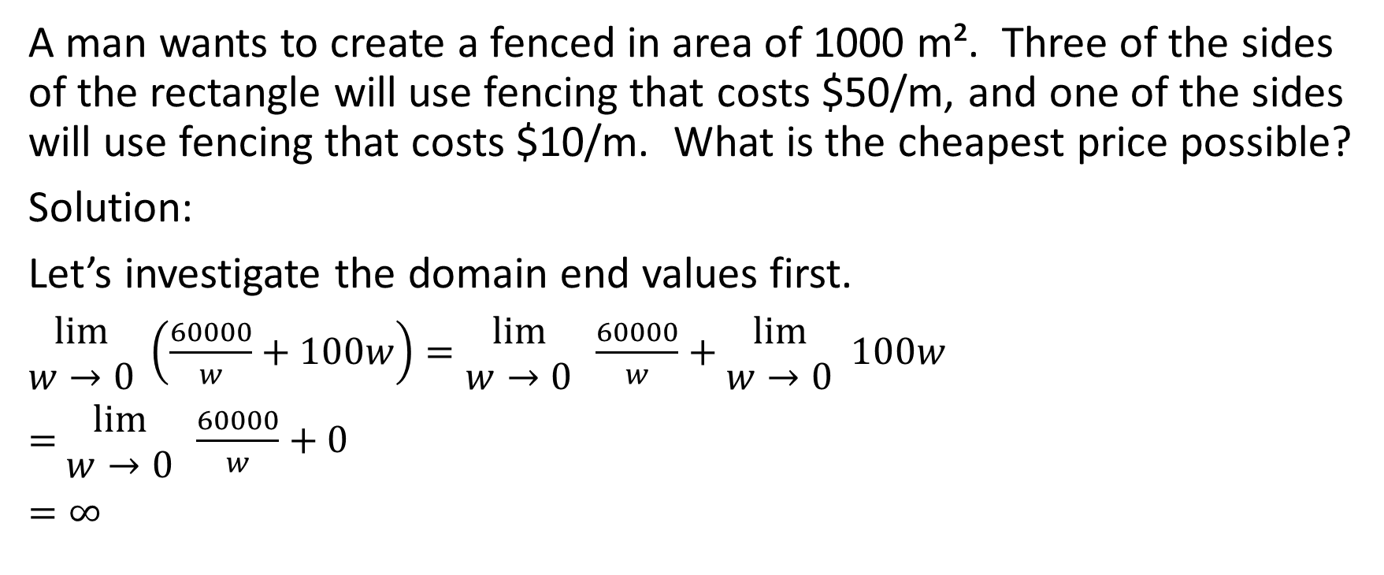
A man wants to create a fenced in area of 1000 m². Three of the sides of the rectangle will use fencing that costs $50/m, and one of the sides will use fencing that costs $10/m. What is the cheapest price possible?
Solution:
Let’s investigate the domain end values first.
$\begin{matrix}lim⁡ \\ w→0\end{matrix} \left(\frac{60000}{w}+100w\right)=\begin{matrix}lim⁡ \\ w→0\end{matrix} \frac{60000}{w}+\begin{matrix}lim⁡ \\ w→0\end{matrix} 100w$
$=$ $\begin{matrix}lim⁡ \\ w→0\end{matrix} \frac{60000}{w}+0$
$=∞$
length
width
width
length

Slide 66
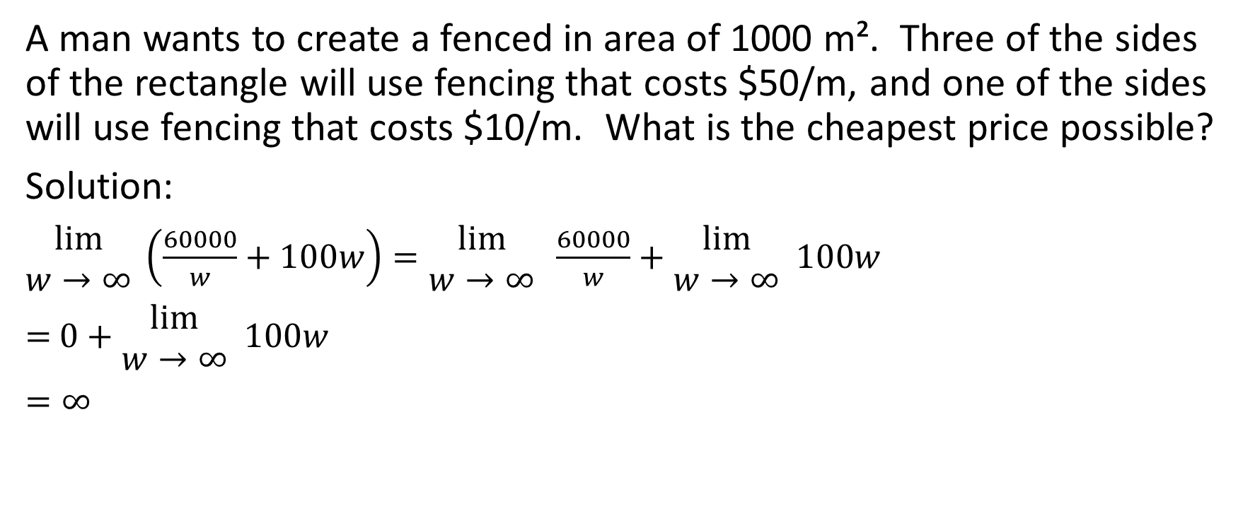
A man wants to create a fenced in area of 1000 m². Three of the sides of the rectangle will use fencing that costs $50/m, and one of the sides will use fencing that costs $10/m. What is the cheapest price possible?
Solution:
$\begin{matrix}lim⁡ \\ w→∞\end{matrix} \left(\frac{60000}{w}+100w\right)=\begin{matrix}lim⁡ \\ w→∞\end{matrix} \frac{60000}{w}+\begin{matrix}lim⁡ \\ w→∞\end{matrix} 100w$
$=$ $0+\begin{matrix}lim⁡ \\ w→∞\end{matrix} 100w$
$=∞$
length
width
width
length

Slide 67
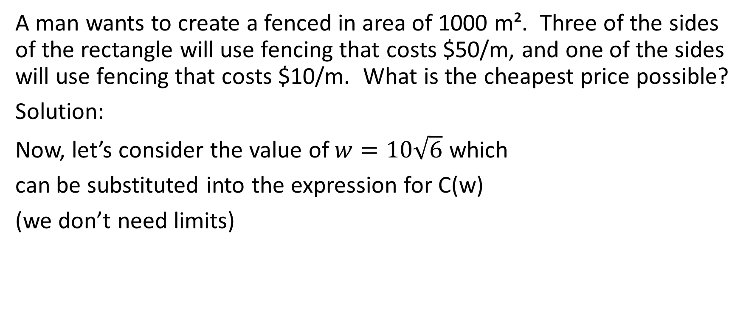
A man wants to create a fenced in area of 1000 m². Three of the sides of the rectangle will use fencing that costs $50/m, and one of the sides will use fencing that costs $10/m. What is the cheapest price possible?
Solution:
Now, let’s consider the value of $w=10\sqrt{6}$ which
can be substituted into the expression for C(w)
(we don’t need limits)
length
width
width
length

Slide 68
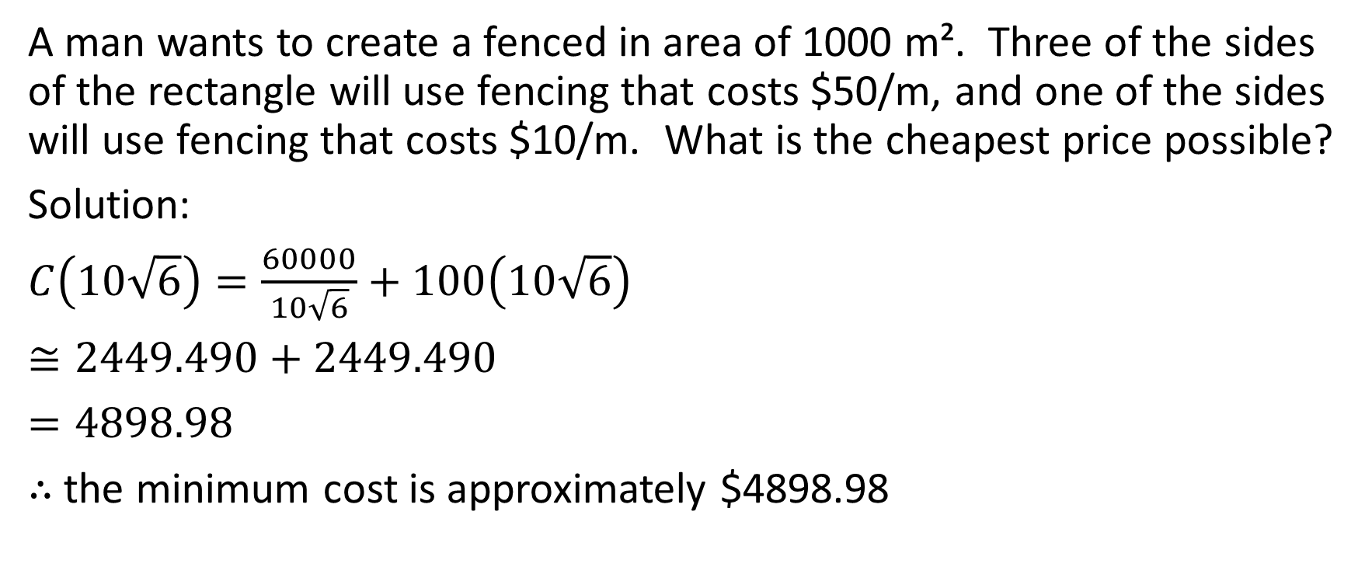
A man wants to create a fenced in area of 1000 m². Three of the sides of the rectangle will use fencing that costs $50/m, and one of the sides will use fencing that costs $10/m. What is the cheapest price possible?
Solution:
$C\left(10\sqrt{6}\right)=\frac{60000}{10\sqrt{6}}+100\left(10\sqrt{6}\right)$
$≅2449.490+2449.490$
$=4898.98$
$∴$ the minimum cost is approximately $4898.98
length
width
width
length

Slide 69
Example
A rectangular poster (which includes a rectangular printing area and margins all around) has an area of 1014 m². The top and bottom margins are each 2 metres and the side margins are each 3 metres. Find the dimensions of the poster that give the maximum printing area.

Slide 70
A rectangular poster (which includes a rectangular printing area and margins all around) has an area of 1014 m². The top and bottom margins are each 2 metres and the side margins are each 3 metres. Find the dimensions of the poster that give the maximum printing area.
Solution:
length
2
3
Printed area
3
width
2

Slide 71




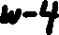
A rectangular poster (which includes a rectangular printing area and margins all around) has an area of 1014 m². The top and bottom margins are each 2 metres and the side margins are each 3 metres. Find the dimensions of the poster that give the maximum printing area.
Solution:
length
2
3
3
width
2

Slide 72
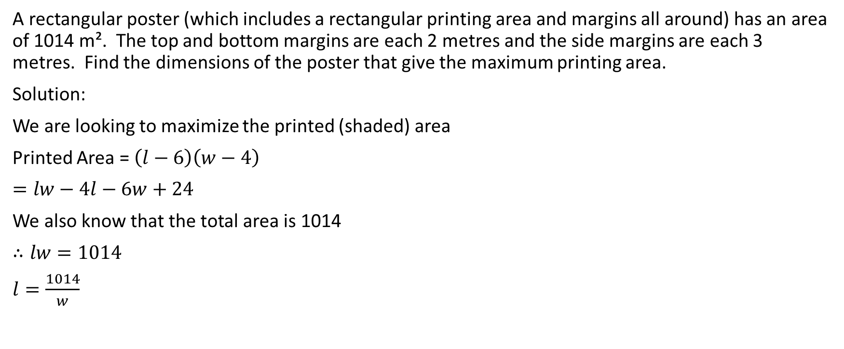
A rectangular poster (which includes a rectangular printing area and margins all around) has an area of 1014 m². The top and bottom margins are each 2 metres and the side margins are each 3 metres. Find the dimensions of the poster that give the maximum printing area.
Solution:
We are looking to maximize the printed (shaded) area
Printed Area = $\left(l−6\right)\left(w−4\right)$
$=lw−4l−6w+24$
We also know that the total area is 1014
$∴lw=1014$
$l=\frac{1014}{w}$
length
2
3
3
width
2

Slide 73
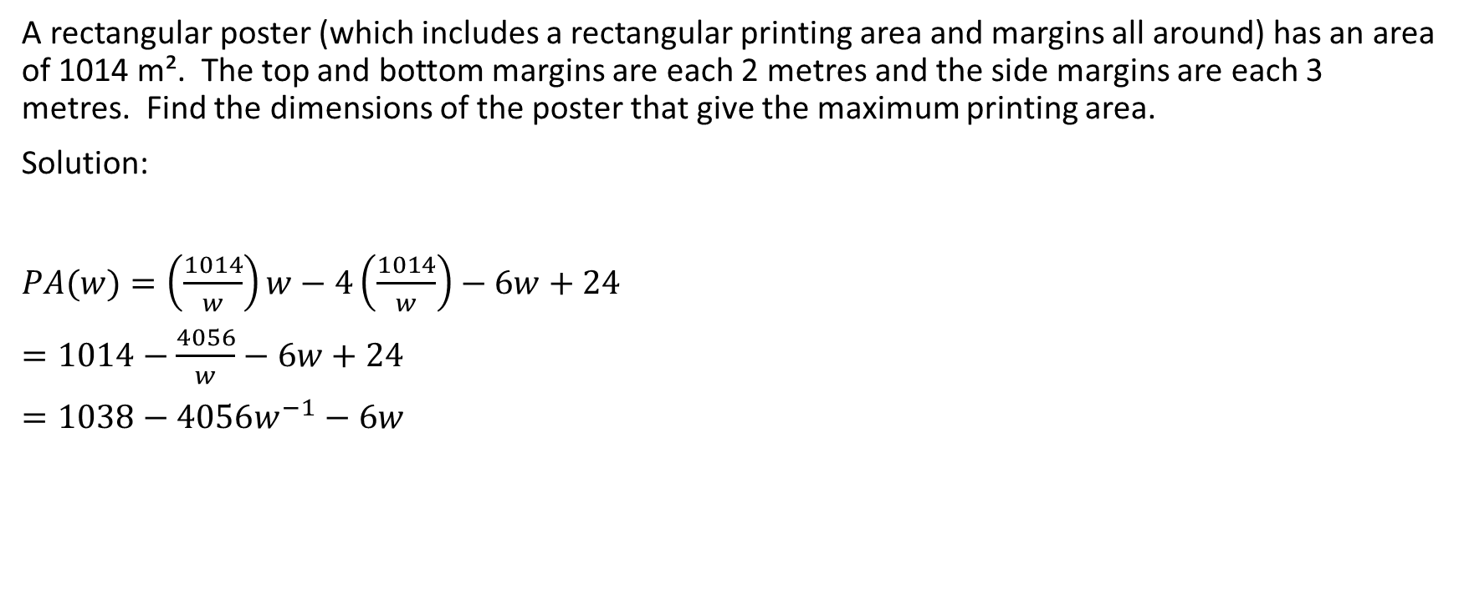
A rectangular poster (which includes a rectangular printing area and margins all around) has an area of 1014 m². The top and bottom margins are each 2 metres and the side margins are each 3 metres. Find the dimensions of the poster that give the maximum printing area.
Solution:
$PA(w)=\left(\frac{1014}{w}\right)w−4\left(\frac{1014}{w}\right)−6w+24$
$=1014−\frac{4056}{w}−6w+24$
$=1038−4056w^{−1}−6w$
length
2
3
3
width
2

Slide 74
A rectangular poster (which includes a rectangular printing area and margins all around) has an area of 1014 m². The top and bottom margins are each 2 metres and the side margins are each 3 metres. Find the dimensions of the poster that give the maximum printing area.
Solution:
To determine the domain in this question is pretty interesting
We know that the minimum possible width of the rectangle
is 4 (because even if the width of the printed area is 0, there
have to be margins on each side of 2).
Similarly, we know that the minimum possible length of the
rectangle is 6 (because even if the w
length
2
3
3
width
2

Slide 75
A rectangular poster (which includes a rectangular printing area and margins all around) has an area of 1014 m². The top and bottom margins are each 2 metres and the side margins are each 3 metres. Find the dimensions of the poster that give the maximum printing area.
Solution:
To determine the maximum possible width, we should
determine the minimum possible length and then determine
the width associated with that length (the reason for this is
that we know the area is constant so the width and length
will be inversely related). The minimum possible length of the
rectangle is 6 (because even if the length of printed area is 0, there are margins of 3 on each side)
length
2
3
3
width
2

Slide 76
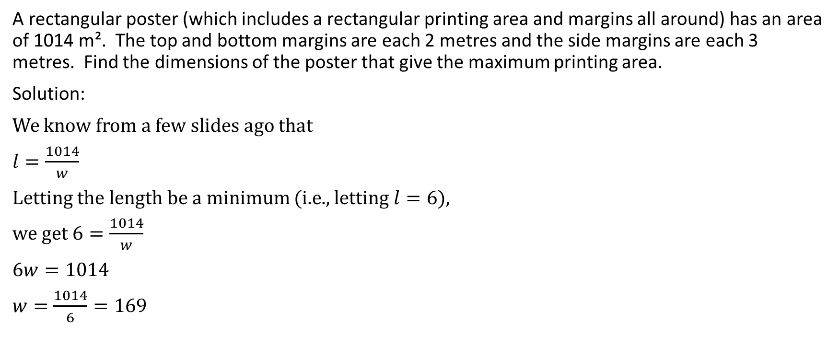
A rectangular poster (which includes a rectangular printing area and margins all around) has an area of 1014 m². The top and bottom margins are each 2 metres and the side margins are each 3 metres. Find the dimensions of the poster that give the maximum printing area.
Solution:
We know from a few slides ago that
$l=\frac{1014}{w}$
Letting the length be a minimum (i.e., letting $l=6$),
we get $6=\frac{1014}{w}$
$6w=1014$
$w=\frac{1014}{6}=169$
length
2
3
3
width
2

Slide 77
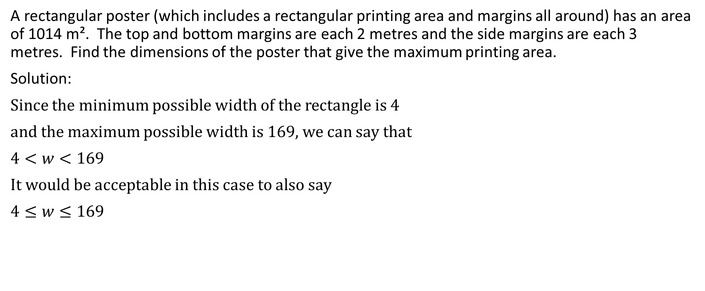
A rectangular poster (which includes a rectangular printing area and margins all around) has an area of 1014 m². The top and bottom margins are each 2 metres and the side margins are each 3 metres. Find the dimensions of the poster that give the maximum printing area.
Solution:
Since the minimum possible width of the rectangle is 4
and the maximum possible width is 169, we can say that
$4<w<169$
It would be acceptable in this case to also say
$4≤w≤169$
length
2
3
3
width
2

Slide 78

A rectangular poster (which includes a rectangular printing area and margins all around) has an area of 1014 m². The top and bottom margins are each 2 metres and the side margins are each 3 metres. Find the dimensions of the poster that give the maximum printing area.
Solution:
$PA^{′}\left(w\right)=0$ implies $4056w^{−2}−6=0$
Multiply both sides by $w^{2}$
$w^{2}\left(4056w^{−2}−6\right)=w^{2}\left(0\right)$
$4056w^{0}−6w^{2}=0$
length
2
3
3
width
2

Slide 79

A rectangular poster (which includes a rectangular printing area and margins all around) has an area of 1014 m². The top and bottom margins are each 2 metres and the side margins are each 3 metres. Find the dimensions of the poster that give the maximum printing area.
Solution:
$4056\left(1\right)−6w^{2}=0$
$4056−6w^{2}=0$
$4056=6w^{2}$
$\frac{4056}{6}=w^{2}$
$676=w^{2}$
$w=±26$
length
2
3
3
width
2

Slide 80

A rectangular poster (which includes a rectangular printing area and margins all around) has an area of 1014 m². The top and bottom margins are each 2 metres and the side margins are each 3 metres. Find the dimensions of the poster that give the maximum printing area.
Solution:
Since the domain is $4≤w≤169$, therefore we will only
consider the value of $w=26$
$PA\left(4\right)=1038−\frac{4056}{4}−6\left(4\right)=1038−1014−24=0$
$PA\left(26\right)=1038−\frac{4056}{26}−6\left(26\right)=1038−156−156=726$
$PA\left(169\right)=1038−\frac{4056}{169}−6\left(169\right)=1038−24−1014=0$
Therefore the maximum printing area occurs when the width is 26
length
2
3
3
width
2

Slide 81

A rectangular poster (which includes a rectangular printing area and margins all around) has an area of 1014 m². The top and bottom margins are each 2 metres and the side margins are each 3 metres. Find the dimensions of the poster that give the maximum printing area.
Solution:
We know that the length is given by
$l=\frac{1014}{w}$
When w = 26, $l=\frac{1014}{26}=39$
Therefore the dimensions of the poster that give the maximum
printing area are a length of 39 m and a width of 26 m.
length
2
3
3
width
2

Slide 82
Example
Todd’s house is 30 km west of Eleanor’s house. At noon, Todd leaves his house and jogs 5km/h directly north. At the same time, Eleanor leaves her house and jogs directly west at a speed of 7 km/h. They each run for six hours before stopping. At what time, rounded to the nearest minute, are they closest together?

Slide 83
Todd’s house is 30 km west of Eleanor’s house. At noon, Todd leaves his house and jogs 5km/h directly north. At the same time, Eleanor leaves her house and jogs directly west at a speed of 7 km/h. They each run for six hours before stopping. At what time, rounded to the nearest minute, are they closest together?
Solution:
It’s a good idea to use a Cartesian plane for some of these questions.

Slide 84
Todd’s house is 30 km west of Eleanor’s house. At noon, Todd leaves his house and jogs 5km/h directly north. At the same time, Eleanor leaves her house and jogs directly west at a speed of 7 km/h. They each run for six hours before stopping. At what time, rounded to the nearest minute, are they closest together?
Solution:
It’s a good idea to use a Cartesian plane for some of these questions.
We can let Todd’s house be at the origin. Since Todd jogs north, he will never
leave the y-axis (all of his movement will be vertical). His x-coordinate will always
be 0. Since he jogs 5 km/h, we can state that Todd’s y-coordinate will be 5t.
Therefore, at any given time, Todd’s coordinates will be (0, 5t).

Slide 85

Todd’s house is 30 km west of Eleanor’s house. At noon, Todd leaves his house and jogs 5km/h directly north. At the same time, Eleanor leaves her house and jogs directly west at a speed of 7 km/h. They each run for six hours before stopping. At what time, rounded to the nearest minute, are they closest together?
Solution:
It’s a good idea to use a Cartesian plane for some of these questions.
We can let Todd’s house be at the origin. Since Todd jogs north, he will never
leave the y-axis (all of his movement will be vertical). His x-coordinate will always
be 0. Since he jogs 5 km/h, we can state that Todd’s y-coordinate will be 5t.
Therefore, at any given time, Todd’s coordinates will be (0, 5t).

Slide 86
Todd’s house is 30 km west of Eleanor’s house. At noon, Todd leaves his house and jogs 5km/h directly north. At the same time, Eleanor leaves her house and jogs directly west at a speed of 7 km/h. They each run for six hours before stopping. At what time, rounded to the nearest minute, are they closest together?
Solution:
Since Eleanor’s house is 30 km east of Todd’s house, we can say that it
is 30 km east of the origin. The coordinates of Eleanor’s house are (30, 0).
She then proceeds to jog west at 7 km/h. This means that her y-coordinate
never changes and her x-coordinate decreases 7 per hour. Therefore, her
x-coordinate at any given time is 30-7t. This means that at any given time,
the coordinates representing Eleanor’s position are (30-7t,0).

Slide 87

Todd’s house is 30 km west of Eleanor’s house. At noon, Todd leaves his house and jogs 5km/h directly north. At the same time, Eleanor leaves her house and jogs directly west at a speed of 7 km/h. They each run for six hours before stopping. At what time, rounded to the nearest minute, are they closest together?
Solution:
Since Eleanor’s house is 30 km east of Todd’s house, we can say that it
is 30 km east of the origin. The coordinates of Eleanor’s house are (30, 0).
She then proceeds to jog west at 7 km/h. This means that her y-coordinate
never changes and her x-coordinate decreases 7 per hour. Therefore, her
x-coordinate at any given time is 30-7t. This means that at any given time,
the coordinates representing Eleanor’s position are (30-7t,0).

Slide 88

Todd’s house is 30 km west of Eleanor’s house. At noon, Todd leaves his house and jogs 5km/h directly north. At the same time, Eleanor leaves her house and jogs directly west at a speed of 7 km/h. They each run for six hours before stopping. At what time, rounded to the nearest minute, are they closest together?
Solution:
We know that the distance between two given points is given by the formula
$d=\sqrt{{\left(x_{2}−x_{1}\right)}^{2}+{\left(y_{2}−y_{1}\right)}^{2}}$
Therefore, $d\left(t\right)=\sqrt{{\left(30−7t−0\right)}^{2}+{\left(0−5t\right)}^{2}}$
$=\sqrt{{(30−7t)}^{2}+{(−5t)}^{2}}$
$=\sqrt{\left(30−7t\right)\left(30−7t\right)+25t^{2}}$
$=\sqrt{900−210t−210t+49t^{2}+25t^{2}}$
$=\sqrt{74t^{2}−420t+900}$

Slide 89

Todd’s house is 30 km west of Eleanor’s house. At noon, Todd leaves his house and jogs 5km/h directly north. At the same time, Eleanor leaves her house and jogs directly west at a speed of 7 km/h. They each run for six hours before stopping. At what time, rounded to the nearest minute, are they closest together?
Solution:
$d\left(t\right)=\sqrt{74t^{2}−420t+900} ,0≤t≤6$
We can solve this two ways.
Method 1: Use the chain rule
$d^{′}\left(t\right)=0$ implies that
$\frac{1}{2}{\left(74t^{2}−420t+900\right)}^{\frac{−1}{2}}\left(148t−420\right)=0$
$\frac{148t−420}{2{\left(74t^{2}−420t+900\right)}^{\frac{1}{2}}}=0$
Now, multiply both sides by the denominator on the left.

Slide 90

Todd’s house is 30 km west of Eleanor’s house. At noon, Todd leaves his house and jogs 5km/h directly north. At the same time, Eleanor leaves her house and jogs directly west at a speed of 7 km/h. They each run for six hours before stopping. At what time, rounded to the nearest minute, are they closest together?
Solution:
$148t−420=0$
$148t=420$
$t=\frac{420}{148}≅2.838$ (we will use an approximation because the question
asks us to round to the nearest minute)
This is inside of the domain

Slide 91

Todd’s house is 30 km west of Eleanor’s house. At noon, Todd leaves his house and jogs 5km/h directly north. At the same time, Eleanor leaves her house and jogs directly west at a speed of 7 km/h. They each run for six hours before stopping. At what time, rounded to the nearest minute, are they closest together?
Solution:
$d\left(0\right)=\sqrt{74{(0)}^{2}−420(0)+900}=30$
$d\left(2.838\right)=\sqrt{74{(2.838)}^{2}−420(2.838)+900}≅17.44$
$d\left(6\right)=\sqrt{74{\left(6\right)}^{2}−420\left(6\right)+900}≅32.31$
Therefore, they are closest together at approximately 2.838 hours .
2.838 hours x 60 minutes/hour ≅ 170 minutes
170 minutes after noon is 2:50 pm
Therefore, they are closest together at approximately 2:50

Slide 92

Todd’s house is 30 km west of Eleanor’s house. At noon, Todd leaves his house and jogs 5km/h directly north. At the same time, Eleanor leaves her house and jogs directly west at a speed of 7 km/h. They each run for six hours before stopping. At what time, rounded to the nearest minute, are they closest together?
Solution:
Method 2: Square the function, then optimize that new function
$d\left(t\right)=\sqrt{74t^{2}−420t+900} ,0≤t≤\frac{30}{7}$
In situations like this, some people like to square the function. The reason
is that whatever value minimizes d(t) will necessarily also be the same
value that minimizes the interior of the square root.
In other words, whatever minimizes $\sqrt{74t^{2}−420t+900}$ also necessarily
minimizes $74t^{2}−420t+900$

Slide 93
Todd’s house is 30 km west of Eleanor’s house. At noon, Todd leaves his house and jogs 5km/h directly north. At the same time, Eleanor leaves her house and jogs directly west at a speed of 7 km/h. They each run for six hours before stopping. At what time, rounded to the nearest minute, are they closest together?
Solution:
If we square the square root, then we get rid of the need for the chain rule.
Just remember though that if the question asks for the minimum distance,
we need to plug the appropriate time into the function with the square root,
not the squared function.
This procedure is not always applicable, so if you are confused, just use
Method 1 (the chain rule approach).
Continuing with Method 2 …

Slide 94

Todd’s house is 30 km west of Eleanor’s house. At noon, Todd leaves his house and jogs 5km/h directly north. At the same time, Eleanor leaves her house and jogs directly west at a speed of 7 km/h. They each run for six hours before stopping. At what time, rounded to the nearest minute, are they closest together?
Solution:
Let $D\left(t\right)={\left[d(t)\right]}^{2}$
$D\left(t\right)={\left[\sqrt{74t^{2}−420t+900}\right]}^{2}$
$D\left(t\right)=74t^{2}−420t+900$
$D^{′}\left(t\right)=0$ implies that $148t−420=0$
$148t=420$
$t=\frac{420}{148}$
$t≅2.838$

Slide 95
Todd’s house is 30 km west of Eleanor’s house. At noon, Todd leaves his house and jogs 5km/h directly north. At the same time, Eleanor leaves her house and jogs directly west at a speed of 7 km/h. They each run for six hours before stopping. At what time, rounded to the nearest minute, are they closest together?
Solution:
$d\left(0\right)=\sqrt{74{(0)}^{2}−420(0)+900}=30$
$d\left(2.838\right)=\sqrt{74{(2.838)}^{2}−420(2.838)+900}≅17.44$
$d\left(6\right)=\sqrt{74{\left(6\right)}^{2}−420\left(6\right)+900}≅32.31$
Therefore, they are closest together at approximately 2.838 hours .
2.838 hours x 60 minutes/hour ≅ 170 minutes
170 minutes after noon is 2:50 pm
Therefore, they are closest together at approximately 2:50

Slide 96
Example
Skippy is flying an airplane that is currently right over his house. His altitude is 4000 m, and his velocity is 60 km/h, due north. At the same moment, Charmaine is 20 km due west of Skippy’s house. Charmaine’s altitude is 2000 m, and her velocity is 30 km/h due east. Charmaine is climbing at 50 m/min. At what time t will the planes be closest together, and what will be that distance?

Slide 97
Skippy is flying an airplane that is currently right over his house. His altitude is 4000 m, and his velocity is 60 km/h, due north. At the same moment, Charmaine is 20 km due west of Skippy’s house. Charmaine’s altitude is 2000 m, and her velocity is 30 km/h due east. Charmaine is climbing at 50 m/min. At what time t will the planes be closest together, and what will be that distance?
Solution:
This is much like the distance formula question earlier.
We can think of east and west movement as movement along the x-axis.
We can think of north and south movement as movement along the y-axis.
Movement to the east is positive movement along the x-axis and
movement to the west is negative. Movement to the north is positive along the
y-axis and movement to the south is negative along the y-axis.

Slide 98
Skippy is flying an airplane that is currently right over his house. His altitude is 4000 m, and his velocity is 60 km/h, due north. At the same moment, Charmaine is 20 km due west of Skippy’s house. Charmaine’s altitude is 2000 m, and her velocity is 30 km/h due east. Charmaine is climbing at 50 m/min. At what time t will the planes be closest together, and what will be that distance?
Solution:
The added dimension here is literally an added dimension ☺. We have movement along the z-axis. We can think of the ground as having a z-coordinate of 0 and movement up is positive along the z-axis and movement down is negative along the z-axis.
Instead of each point being an ordered pair, each point will be an ordered triple.

Slide 99
Skippy is flying an airplane that is currently right over his house. His altitude is 4000 m, and his velocity is 60 km/h, due north. At the same moment, Charmaine is 20 km due west of Skippy’s house. Charmaine’s altitude is 2000 m, and her velocity is 30 km/h due east. Charmaine is climbing at 50 m/min. At what time t will the planes be closest together, and what will be that distance?
Solution:
We need to determine what our units of measurement will be with respect to both distance and time. The distances in this question are measured in kilometres and metres, so we will measure in metres and the time is measured in minutes and hours, so we will measure in minutes (pick the smaller measurement each time)

Slide 100
Skippy is flying an airplane that is currently right over his house. His altitude is 4000 m, and his velocity is 60 km/h, due north. At the same moment, Charmaine is 20 km due west of Skippy’s house. Charmaine’s altitude is 2000 m, and her velocity is 30 km/h due east. Charmaine is climbing at 50 m/min. At what time t will the planes be closest together, and what will be that distance?
Solution:
Let the origin be Skippy’s house and time t = 0 be the moment that Skippy is right over his house.
Skippy’s initial position with respect to east and west is x = 0 (because he is right over his house).
Skippy’s initial position with respect to north and south is y = 0 (because he is right over his house).
Skippy’s initial position with respect to altitude is z = 4000 (because he is 4000 m above his house).
Therefore, Skippy’s initial position is (0, 0, 4000).

Slide 101

Skippy is flying an airplane that is currently right over his house. His altitude is 4000 m, and his velocity is 60 km/h, due north. At the same moment, Charmaine is 20 km due west of Skippy’s house. Charmaine’s altitude is 2000 m, and her velocity is 30 km/h due east. Charmaine is climbing at 50 m/min. At what time t will the planes be closest together, and what will be that distance?
Solution:
Skippy does not move east or west, so his x-coordinate remains unchanged.
Skippy does not increase or decrease altitude, so his z-coordinate remains unchanged.
Skippy is moving north however, so his y-coordinate will increase as a function of time.
60 km x 1000 m per km = 60000 m. Therefore, his y-coordinate is increasing at 600000 m/h.
60 000 m/hour = $\frac{60 000 m}{1 hour}=\frac{60 000 m}{60 minutes}=\frac{1000 m}{1 minute}$ = 1000 m/min
Therefore, Skippy’s y-coordinate is increasing at the rate of 1000 m/min
Therefore, Skippy’s location at any time t is given by (0, 1000 t, 4000)

Slide 102
Skippy is flying an airplane that is currently right over his house. His altitude is 4000 m, and his velocity is 60 km/h, due north. At the same moment, Charmaine is 20 km due west of Skippy’s house. Charmaine’s altitude is 2000 m, and her velocity is 30 km/h due east. Charmaine is climbing at 50 m/min. At what time t will the planes be closest together, and what will be that distance?
Solution:
The origin is Skippy’s house and Charmaine begins 20 km (which is the same as 20 000 m) west of that. Therefore, Charmaine’s initial x-coordinate is x = -20 000.
Charmaine is neither north nor south of Skippy’s house, so her initial y-coordinate is y = 0.
Charmaine begins at an altitude of 2000 m. so her initial z-coordinate is z = 2000.
Therefore, Charmaine’s initial location is (-20 000, 0, 2000).

Slide 103

Skippy is flying an airplane that is currently right over his house. His altitude is 4000 m, and his velocity is 60 km/h, due north. At the same moment, Charmaine is 20 km due west of Skippy’s house. Charmaine’s altitude is 2000 m, and her velocity is 30 km/h due east. Charmaine is climbing at 50 m/min. At what time t will the planes be closest together, and what will be that distance?
Solution:
Charmaine’s moves 30 km/h due east. This means that her x-coordinate is increasing.
30 km = 30 000 m. Therefore, Charmaine is moving 300000 m/hour
30 000 m/h = $\frac{30 000 m}{1 hour}=\frac{30 000 m}{60 minutes}=\frac{500 m}{1 minute}$ = 500 m/min.
Therefore, her x-coordinate is increasing at the rate of 500 m/min.
Since her initial x-coordinate is x = -20 000, therefore her x-coordinate at any given time is
x = -20 000 + 500 t, or in other words, x = 500t – 20 000

Slide 104
Skippy is flying an airplane that is currently right over his house. His altitude is 4000 m, and his velocity is 60 km/h, due north. At the same moment, Charmaine is 20 km due west of Skippy’s house. Charmaine’s altitude is 2000 m, and her velocity is 30 km/h due east. Charmaine is climbing at 50 m/min. At what time t will the planes be closest together, and what will be that distance?
Solution:
Charmaine’s y-coordinate never changes, so her y-coordinate stays constant at y = 0
Charmaine’s initial z – coordinate is 2000, and it is increasing at a rate of 50 m/min.
Therefore Charmaine’s z-coordinate at any time t is given by z = 2000 + 50 t.
Therefore, Charmaine’s location at any time t is given by (500t – 20 000, 0, 50t + 2000)

Slide 105

Skippy is flying an airplane that is currently right over his house. His altitude is 4000 m, and his velocity is 60 km/h, due north. At the same moment, Charmaine is 20 km due west of Skippy’s house. Charmaine’s altitude is 2000 m, and her velocity is 30 km/h due east. Charmaine is climbing at 50 m/min. At what time t will the planes be closest together, and what will be that distance?
Solution:
We want to determine the value of t when the points given by
S(0, 1000 t, 4000) and C(500t – 20000, 0, 50t + 2000) are closest together.
Thankfully, the formula for the distance between 2 points in 3 dimensions is very comparable to the formula for the distance between 2 points in 2 dimensions.
Specifically, $d=\sqrt{{\left(x_{2}−x_{1}\right)}^{2}+{\left(y_{2}−y_{1}\right)}^{2}+{\left(z_{2}−z_{1}\right)}^{2}}$
Therefore, in this case, $d\left(t\right)=\sqrt{{\left(500t−20 000−0\right)}^{2}+{\left(0−1000t\right)}^{2}+{\left(50t+2000−4000\right)}^{2}}$
$=\sqrt{{\left(500t−20 000\right)}^{2}+{\left(−1000t\right)}^{2}+{\left(50t−2000\right)}^{2}}$

Slide 106

Skippy is flying an airplane that is currently right over his house. His altitude is 4000 m, and his velocity is 60 km/h, due north. At the same moment, Charmaine is 20 km due west of Skippy’s house. Charmaine’s altitude is 2000 m, and her velocity is 30 km/h due east. Charmaine is climbing at 50 m/min. At what time t will the planes be closest together, and what will be that distance?
Solution:
$d\left(t\right)=\sqrt{(500t−20 000)(500t−20 000)+{\left(−1000t\right)}^{2}+(50t−2000)(50t−2000)}$
$d\left(t\right)=\sqrt{250 000t^{2}−10 000 0000t−10 000 000t+400 000 000+1 000 000t^{2}+2500t^{2}−100 000t−100 000t+4 000 000}$
$d\left(t\right)=\sqrt{1 252 500t^{2}−20 200 000t+404 000 000}$
Now, let’s consider the domain. We know that the time starts at t = 0. We will let the upper end of the domain be $∞$ and we will use limits notation in our domain analysis.

Slide 107

Skippy is flying an airplane that is currently right over his house. His altitude is 4000 m, and his velocity is 60 km/h, due north. At the same moment, Charmaine is 20 km due west of Skippy’s house. Charmaine’s altitude is 2000 m, and her velocity is 30 km/h due east. Charmaine is climbing at 50 m/min. At what time t will the planes be closest together, and what will be that distance?
Solution:
$d\left(t\right)=\sqrt{1 252 500t^{2}−20 200 000t+404 000 000} , 0≤t<∞$
Method 1: We will use the chain rule
$d\left(t\right)={\left[1 252 500t^{2}−20 200 000t+404 000 000\right]}^{\frac{1}{2}}$
$d^{′}\left(t\right)=0$ implies that
$\frac{1}{2}{\left[1 252 500t^{2}−20 200 000t+404 000 000\right]}^{\frac{−1}{2}}\left(2 505 000t−20 200 000\right)=0$

Slide 108

Skippy is flying an airplane that is currently right over his house. His altitude is 4000 m, and his velocity is 60 km/h, due north. At the same moment, Charmaine is 20 km due west of Skippy’s house. Charmaine’s altitude is 2000 m, and her velocity is 30 km/h due east. Charmaine is climbing at 50 m/min. At what time t will the planes be closest together, and what will be that distance?
Solution:
$\frac{2 505 000t−20 200 000}{2\sqrt{1 252 500t^{2}−20 200 000t+404 000 000}}=0$
Multiply both sides by $2\sqrt{1 252 500t^{2}−20 200 000t+404 000 000}$
$2 505 000t−20 200 000=0$
$2 505 000t=20 200 000$
$t=\frac{20 200 000}{2 505 000}≅8.064$

Slide 109

Skippy is flying an airplane that is currently right over his house. His altitude is 4000 m, and his velocity is 60 km/h, due north. At the same moment, Charmaine is 20 km due west of Skippy’s house. Charmaine’s altitude is 2000 m, and her velocity is 30 km/h due east. Charmaine is climbing at 50 m/min. At what time t will the planes be closest together, and what will be that distance?
Solution:
$d\left(t\right)=\sqrt{1 252 500t^{2}−20 200 000t+404 000 000}$
$d\left(0\right)=\sqrt{1 252 500{(0)}^{2}−20 200 000(0)+404 000 000}=\sqrt{404 000 000} ≅20 100$
$d\left(8.064\right)=\sqrt{1 252 500{(8.064)}^{2}−20 200 000(8.064)+404 000 000}≅\sqrt{322 554 890} ≅17 960$

Slide 110

Skippy is flying an airplane that is currently right over his house. His altitude is 4000 m, and his velocity is 60 km/h, due north. At the same moment, Charmaine is 20 km due west of Skippy’s house. Charmaine’s altitude is 2000 m, and her velocity is 30 km/h due east. Charmaine is climbing at 50 m/min. At what time t will the planes be closest together, and what will be that distance?
Solution:
Consider the expression inside of the square root. It is a quadratic function with a positive leading coefficient. We know from the end behaviour that
$\begin{matrix}lim⁡ \\ t→∞\end{matrix}\left(1 252 500t^{2}−20 200 000t+404 000 000\right)=∞$.
Square rooting that won’t change the fact that it’s end behaviour is still heading towards infinity.
Therefore,
$\begin{matrix}lim⁡ \\ t→∞\end{matrix} \sqrt{1 252 500t^{2}−20 200 000t+404 000 000}=∞$

Slide 111
Skippy is flying an airplane that is currently right over his house. His altitude is 4000 m, and his velocity is 60 km/h, due north. At the same moment, Charmaine is 20 km due west of Skippy’s house. Charmaine’s altitude is 2000 m, and her velocity is 30 km/h due east. Charmaine is climbing at 50 m/min. At what time t will the planes be closest together, and what will be that distance?
Solution:
Based on all of the above, the planes will be the closest together at approximately 8.06 minutes.
The shortest distance between the two planes will be approximately 17 960 metres.

Slide 112

Skippy is flying an airplane that is currently right over his house. His altitude is 4000 m, and his velocity is 60 km/h, due north. At the same moment, Charmaine is 20 km due west of Skippy’s house. Charmaine’s altitude is 2000 m, and her velocity is 30 km/h due east. Charmaine is climbing at 50 m/min. At what time t will the planes be closest together, and what will be that distance?
Solution:
Method 2: We will square the distance function and determine the value of t that minimizes that.
Let $D\left(t\right)={\left[d(t)\right]}^{2}$
$∴D\left(t\right)={\left[\sqrt{1 252 500t^{2}−20 200 000t+404 000 000}\right]}^{2}$
$=1 252 500 t^{2}−20 200 000 t+404 000 000$
$D^{′}\left(t\right)=0$ implies $2 505 000 t −20 200 000=0$
$2 505 000 t=20 200 000$

Slide 113

Skippy is flying an airplane that is currently right over his house. His altitude is 4000 m, and his velocity is 60 km/h, due north. At the same moment, Charmaine is 20 km due west of Skippy’s house. Charmaine’s altitude is 2000 m, and her velocity is 30 km/h due east. Charmaine is climbing at 50 m/min. At what time t will the planes be closest together, and what will be that distance?
Solution:
$t=\frac{20 200 000}{2 505 000}≅8.064$
Now remember that we have to plug these values into the original distance formula to determine the minimum possible distance.
$d\left(t\right)=\sqrt{1 252 500t^{2}−20 200 000t+404 000 000}$
$d\left(0\right)=\sqrt{1 252 500{(0)}^{2}−20 200 000(0)+404 000 000}=\sqrt{404 000 000} ≅20 100$
$d\left(8.064\right)=\sqrt{1 252 500{(8.064)}^{2}−20 200 000(8.064)+404 000 000}≅\sqrt{322 554 890} ≅17 960$

Slide 114
Skippy is flying an airplane that is currently right over his house. His altitude is 4000 m, and his velocity is 60 km/h, due north. At the same moment, Charmaine is 20 km due west of Skippy’s house. Charmaine’s altitude is 2000 m, and her velocity is 30 km/h due east. Charmaine is climbing at 50 m/min. At what time t will the planes be closest together, and what will be that distance?
Solution:
Consider the expression inside of the square root. It is a quadratic function with a positive leading coefficient. We know from the end behaviour that
$\begin{matrix}lim⁡ \\ t→∞\end{matrix}\left(1 252 500t^{2}−20 200 000t+404 000 000\right)=∞$.
Square rooting that won’t change the fact that it’s end behaviour is still heading towards infinity.
Therefore,
$\begin{matrix}lim⁡ \\ t→∞\end{matrix} \sqrt{1 252 500t^{2}−20 200 000t+404 000 000}=∞$

Slide 115
Skippy is flying an airplane that is currently right over his house. His altitude is 4000 m, and his velocity is 60 km/h, due north. At the same moment, Charmaine is 20 km due west of Skippy’s house. Charmaine’s altitude is 2000 m, and her velocity is 30 km/h due east. Charmaine is climbing at 50 m/min. At what time t will the planes be closest together, and what will be that distance?
Solution:
Based on all of the above, the planes will be the closest together at approximately 8.06 minutes.
The shortest distance between the two planes will be approximately 17 960 metres.

Slide 116
Example
Joey is on an island that is 1000 m from a straight shoreline. There is a grocery store 2000 m down the straight shoreline from the island. Joey can swim 3 m/s and he can walk 5 m/s. What is the minimum length of time that it will take Joey to get to the store?

Slide 117
Joey is on an island that is 1000 m from a straight shoreline. There is a grocery store 2000 m down the straight shoreline from the island. Joey can swim 3 m/s and he can walk 5 m/s. What is the minimum length of time that it will take Joey to get to the store?
Solution:
island
store

Slide 118

Joey is on an island that is 1000 m from a straight shoreline. There is a grocery store 2000 m down the straight shoreline from the island. Joey can swim 3 m/s and he can walk 5 m/s. What is the minimum length of time that it will take Joey to get to the store?
Solution:
Perhaps Joey will swim directly to the shore, and then walk
island
store

Slide 119



Joey is on an island that is 1000 m from a straight shoreline. There is a grocery store 2000 m down the straight shoreline from the island. Joey can swim 3 m/s and he can walk 5 m/s. What is the minimum length of time that it will take Joey to get to the store?
Solution:
Perhaps Joey will swim directly to the shore, and then walk
Or, perhaps Joey will swim straight to the store.
island
store

Slide 120

Joey is on an island that is 1000 m from a straight shoreline. There is a grocery store 2000 m down the straight shoreline from the island. Joey can swim 3 m/s and he can walk 5 m/s. What is the minimum length of time that it will take Joey to get to the store?
Solution:
Perhaps Joey will swim directly to the shore, and then walk
Or, perhaps Joey will swim straight to the store.
With no loss in generality, we can imagine Joey taking a path
like this.
island
store

Slide 121


Joey is on an island that is 1000 m from a straight shoreline. There is a grocery store 2000 m down the straight shoreline from the island. Joey can swim 3 m/s and he can walk 5 m/s. What is the minimum length of time that it will take Joey to get to the store?
Solution:
island
store

Slide 122

Joey is on an island that is 1000 m from a straight shoreline. There is a grocery store 2000 m down the straight shoreline from the island. Joey can swim 3 m/s and he can walk 5 m/s. What is the minimum length of time that it will take Joey to get to the store?
Solution:
Let x be the distance indicated.
island
store

Slide 123

Joey is on an island that is 1000 m from a straight shoreline. There is a grocery store 2000 m down the straight shoreline from the island. Joey can swim 3 m/s and he can walk 5 m/s. What is the minimum length of time that it will take Joey to get to the store?
Solution:
Let x be the distance indicated.
$h^{2}={(1000)}^{2}+x^{2}$
$h=\sqrt{1000000+x^{2}}$
island
store

Slide 124

Joey is on an island that is 1000 m from a straight shoreline. There is a grocery store 2000 m down the straight shoreline from the island. Joey can swim 3 m/s and he can walk 5 m/s. What is the minimum length of time that it will take Joey to get to the store?
Solution:
Let x be the distance indicated.
$h^{2}={(1000)}^{2}+x^{2}$
$h=\sqrt{1000000+x^{2}}$
$d=2000−x$
island
store

Slide 125


Joey is on an island that is 1000 m from a straight shoreline. There is a grocery store 2000 m down the straight shoreline from the island. Joey can swim 3 m/s and he can walk 5 m/s. What is the minimum length of time that it will take Joey to get to the store?
Solution:
island
store

Slide 126

Joey is on an island that is 1000 m from a straight shoreline. There is a grocery store 2000 m down the straight shoreline from the island. Joey can swim 3 m/s and he can walk 5 m/s. What is the minimum length of time that it will take Joey to get to the store?
Solution:
We know that $time=\frac{distance}{speed}$
$∴time rowing=\frac{\sqrt{1000000+x^{2}}}{3}$
$∴time walking= \frac{2000−x}{5}$
Total time = time rowing + time walking
island
store

Slide 127

Joey is on an island that is 1000 m from a straight shoreline. There is a grocery store 2000 m down the straight shoreline from the island. Joey can swim 3 m/s and he can walk 5 m/s. What is the minimum length of time that it will take Joey to get to the store?
Solution:
$t\left(x\right)=\frac{1}{3}\sqrt{1000000+x^{2}}+\frac{1}{5}\left(2000−x\right)$
$=\frac{1}{3}{\left(1000000+x^{2}\right)}^{\frac{1}{2}}+400−\frac{1}{5}x$
Now, let’s consider the domain. Perhaps you can tell just by
looking that the domain is $0≤x≤2000$
island
store

Slide 128

Joey is on an island that is 1000 m from a straight shoreline. There is a grocery store 2000 m down the straight shoreline from the island. Joey can swim 3 m/s and he can walk 5 m/s. What is the minimum length of time that it will take Joey to get to the store?
Solution:
$t\left(x\right)=\frac{1}{3}{\left(1000000+x^{2}\right)}^{\frac{1}{2}}+400−\frac{1}{5}x, 0≤x≤2000$
$t^{′}\left(x\right)=0$ implies that
$\frac{1}{6}{\left(1000000+x^{2}\right)}^{\frac{−1}{2}}(2x)−\frac{1}{5}=0$
$\frac{2x}{6{\left(1000000+x^{2}\right)}^{\frac{1}{2}}}=\frac{1}{5}$
$10x=6{\left(1000000+x^{2}\right)}^{\frac{1}{2}}$
island
store

Slide 129
Joey is on an island that is 1000 m from a straight shoreline. There is a grocery store 2000 m down the straight shoreline from the island. Joey can swim 3 m/s and he can walk 5 m/s. What is the minimum length of time that it will take Joey to get to the store?
Solution:
$t\left(x\right)=\frac{1}{3}{\left(1000000+x^{2}\right)}^{\frac{1}{2}}+400−\frac{1}{5}x, 0≤x≤2000$
$t^{′}\left(x\right)=0$ implies that
$\frac{1}{6}{\left(1000000+x^{2}\right)}^{\frac{−1}{2}}(2x)−\frac{1}{5}=0$
$\frac{2x}{6{\left(1000000+x^{2}\right)}^{\frac{1}{2}}}=\frac{1}{5}$
$10x=6{\left(1000000+x^{2}\right)}^{\frac{1}{2}}$
island
store
Divide both sides by 2

Slide 130

Joey is on an island that is 1000 m from a straight shoreline. There is a grocery store 2000 m down the straight shoreline from the island. Joey can swim 3 m/s and he can walk 5 m/s. What is the minimum length of time that it will take Joey to get to the store?
Solution:
$5x=3{\left(1000000+x^{2}\right)}^{\frac{1}{2}}$
${\left(5x\right)}^{2}={\left(3\right)}^{2}{\left[{\left(1000000+x^{2}\right)}^{\frac{1}{2}}\right]}^{2}$
$25x^{2}=9\left(1000000+x^{2}\right)$
$25x^{2}=9000000+9x^{2}$
$16x^{2}=9000000$
island
Square both sides
store

Slide 131


Joey is on an island that is 1000 m from a straight shoreline. There is a grocery store 2000 m down the straight shoreline from the island. Joey can swim 3 m/s and he can walk 5 m/s. What is the minimum length of time that it will take Joey to get to the store?
Solution:
$x^{2}=\frac{9000000}{16}$
$x=±\sqrt{\frac{9000000}{16}}$
$x=\frac{±\sqrt{9000000}}{\sqrt{16}}$
$x=\frac{±3000}{4}$
$x=±750$
island
store
Since the domain is $0≤x≤2000$, therefore we will ignore x = -750 and focus only on the possibility that x = 750.

Slide 132

Joey is on an island that is 1000 m from a straight shoreline. There is a grocery store 2000 m down the straight shoreline from the island. Joey can swim 3 m/s and he can walk 5 m/s. What is the minimum length of time that it will take Joey to get to the store?
Solution:
$t\left(0\right)=\frac{1}{3}{\left(1000000+(0)²\right)}^{\frac{1}{2}}+400−\frac{1}{5}\left(0\right)=\frac{2200}{3}≅733.3$
$t\left(750\right)=\frac{1}{3}{\left(1000000+(750)²\right)}^{\frac{1}{2}}+400−\frac{1}{5}\left(750\right)$
$=\frac{2000}{3}≅666.7$
$t\left(2000\right)=\frac{1}{3}{\left(1000000+(2000)²\right)}^{\frac{1}{2}}+400−\frac{1}{5}\left(2000\right)$
$≅745.4$
island
store

Slide 133

Joey is on an island that is 1000 m from a straight shoreline. There is a grocery store 2000 m down the straight shoreline from the island. Joey can swim 3 m/s and he can walk 5 m/s. What is the minimum length of time that it will take Joey to get to the store?
Solution:
Therefore the minimum length of time that it will take
Joey to get there is $666\frac{2}{3}$ seconds, or in other words,
11 minutes and $6\frac{2}{3}$ seconds.
island
store

Slide 134
Example
A wire of length ten metres is divided into two parts. One forms a right isosceles triangle, and the other forms a rectangle with length twice as long as width. How should the wire be cut so that the total area is
a) a minimum b) a maximum

Slide 135
A wire of length ten metres is divided into two parts. One forms a right isosceles triangle, and the other forms a rectangle with length twice as long as width. How should the wire be cut so that the total area is
a) a minimum b) a maximum
Solution:
We need to “let x be” something. There are many different options
available to us. This solution will only investigate one of the options.
Let x be the base and the height of the isosceles right triangle

Slide 136

A wire of length ten metres is divided into two parts. One forms a right isosceles triangle, and the other forms a rectangle with length twice as long as width. How should the wire be cut so that the total area is
a) a minimum b) a maximum
Solution:
We can determine the length of the hypotenuse of the right triangle by
using the Pythagorean Theorem.
$h^{2}=x^{2}+x^{2}$
$=2x^{2}$
$h=\sqrt{2x^{2}}$
$=\sqrt{2} \sqrt{x^{2}}$
$=\sqrt{2} x$ (we don’t have to use absolute value notation because we know x is positive)

Slide 137


A wire of length ten metres is divided into two parts. One forms a right isosceles triangle, and the other forms a rectangle with length twice as long as width. How should the wire be cut so that the total area is
a) a minimum b) a maximum
Solution:
Therefore, the perimeter of the right isosceles triangle is
$x+x+\sqrt{2} x=2x+\sqrt{2} x=\left(2+\sqrt{2}\right)x$
Since the perimeter of the triangle and the perimeter of the rectangle
add to 10, therefore the perimeter of the rectangle is equal to
$10−\left(2+\sqrt{2} x\right)$

Slide 138

A wire of length ten metres is divided into two parts. One forms a right isosceles triangle, and the other forms a rectangle with length twice as long as width. How should the wire be cut so that the total area is
a) a minimum b) a maximum
Solution:
Now, let’s look at the rectangle. The length is twice as long as the width.
Therefore, we can denote the length as $2w$ and the width as $w$.
We know that the perimeter of the rectangle is therefore equal to
$w+2w+w+2w=6w$
This means that $6w=10−\left(2+\sqrt{2}\right)x$
$w=\frac{10−\left(2+\sqrt{2}\right)x}{6}$ and $2w=\frac{2\left[10−\left(2+\sqrt{2}\right)x\right]}{6}=\frac{10−\left(2+\sqrt{2} x\right)}{3}$

Slide 139


A wire of length ten metres is divided into two parts. One forms a right isosceles triangle, and the other forms a rectangle with length twice as long as width. How should the wire be cut so that the total area is
a) a minimum b) a maximum
Solution:
Now, we can consider the domain. It is possible that we use all of the wire
to build the rectangle. This would mean that the area of the triangle is 0,
meaning that the base and the height of the rectangle are 0 (since they are
equal). Therefore, the minimum possible value of x is 0.

Slide 140

A wire of length ten metres is divided into two parts. One forms a right isosceles triangle, and the other forms a rectangle with length twice as long as width. How should the wire be cut so that the total area is
a) a minimum b) a maximum
Solution:
On the other hand, the maximum possible value of x will occur if the
entire wire is used to create the triangle. This would mean that the
perimeter of the wire is 10. In other words, this would mean that
$\left(2+\sqrt{2}\right)x=10$
$x=\frac{10}{2+\sqrt{2}}$

Slide 141
A wire of length ten metres is divided into two parts. One forms a right isosceles triangle, and the other forms a rectangle with length twice as long as width. How should the wire be cut so that the total area is
a) a minimum b) a maximum
Solution:
On the other hand, the maximum possible value of x will occur if the
entire wire is used to create the triangle. This would mean that the
perimeter of the wire is 10. In other words, this would mean that
$\left(2+\sqrt{2}\right)x=10$
$x=\frac{10}{2+\sqrt{2}}$
We can rationalize this denominator by multiplying the numerator and denominator by the conjugate of the denominator (we did some work like this in the limits section)

Slide 142

A wire of length ten metres is divided into two parts. One forms a right isosceles triangle, and the other forms a rectangle with length twice as long as width. How should the wire be cut so that the total area is
a) a minimum b) a maximum
Solution:
$x=\frac{10}{2+\sqrt{2}}×\frac{2−\sqrt{2}}{2−\sqrt{2}}=\frac{10\left(2−\sqrt{2}\right)}{4−2\sqrt{2}+2\sqrt{2}−\sqrt{4}}=\frac{10\left(2−\sqrt{2}\right)}{4−2}=\frac{10\left(2−\sqrt{2}\right)}{2}=5\left(2−\sqrt{2}\right)$
Therefore the domain is $0≤x≤5\left(2−\sqrt{2}\right)$
It would also be acceptable to say $0<x<5\left(2−\sqrt{2}\right)$

Slide 143

A wire of length ten metres is divided into two parts. One forms a right isosceles triangle, and the other forms a rectangle with length twice as long as width. How should the wire be cut so that the total area is
a) a minimum b) a maximum
Solution:
$Area=\frac{1}{2}bh+lw$
$A\left(x\right)=\frac{1}{2}\left(x\right)\left(x\right)+\left(\frac{10−\left(2+\sqrt{2}\right)x}{3}\right)\left(\frac{10−\left(2+\sqrt{2}\right)x}{6}\right),0≤x≤5\left(2−\sqrt{2}\right)$

Slide 144

A wire of length ten metres is divided into two parts. One forms a right isosceles triangle, and the other forms a rectangle with length twice as long as width. How should the wire be cut so that the total area is
a) a minimum b) a maximum
Solution:
$Area=\frac{1}{2}bh+lw$
$A\left(x\right)=\frac{1}{2}\left(x\right)\left(x\right)+\left(\frac{10−\left(2+\sqrt{2}\right)x}{3}\right)\left(\frac{10−\left(2+\sqrt{2}\right)x}{6}\right),0≤x≤5\left(2−\sqrt{2}\right)$
Often, in a question like this, we might be given the option to round our
answer. We will do a method 1 with rounding and a method 2 without
rounding.

Slide 145

A wire of length ten metres is divided into two parts. One forms a right isosceles triangle, and the other forms a rectangle with length twice as long as width. How should the wire be cut so that the total area is
a) a minimum b) a maximum
Solution:
Method 1: With rounding
$A\left(x\right)=\frac{1}{2}\left(x\right)\left(x\right)+\left(\frac{10−\left(2+\sqrt{2}\right)x}{3}\right)\left(\frac{10−\left(2+\sqrt{2}\right)x}{6}\right),0≤x≤5\left(2−\sqrt{2}\right)$
$≅0.5x^{2}+5.556−3.795x+0.648x^{2}, 0≤x≤2.929$
$=1.148x^{2}−3.795x+5.5556, 0≤x≤2.929$
$A^{′}\left(x\right)=0$ implies $2.296x−3.795≅0$
$2.296x≅3.795$
$x≅\frac{3.795}{2.296}≅1.65$

Slide 146

A wire of length ten metres is divided into two parts. One forms a right isosceles triangle, and the other forms a rectangle with length twice as long as width. How should the wire be cut so that the total area is
a) a minimum b) a maximum
Solution:
$A\left(x\right)≅1.148x^{2}−3.795x+5.5556, 0≤x≤2.929$
$A\left(0\right)≅1.148{\left(0\right)}^{2}−3.795\left(0\right)+5.5556=5.5556$
$A\left(1.65\right)≅1.148{\left(1.65\right)}^{2}−3.795\left(1.65\right)+5.5556≅2.42$
$A\left(2.929\right)≅1.148{\left(2.929\right)}^{2}−3.795\left(2.929\right)+5.5556≅4.29$
The minimum area occurs when $x≅1.65.$ Since the perimeter of the
triangle is approximately $3.41x$, therefore the perimeter of this
triangle would be approximately $3.41(1.65)≅5.63$

Slide 147
A wire of length ten metres is divided into two parts. One forms a right isosceles triangle, and the other forms a rectangle with length twice as long as width. How should the wire be cut so that the total area is
a) a minimum b) a maximum
Solution:
Therefore, the minimum area occurs when the wire is cut such that
approximately 5.63 m are used for the triangle and 4.37 m are used for
the rectangle.

Slide 148

A wire of length ten metres is divided into two parts. One forms a right isosceles triangle, and the other forms a rectangle with length twice as long as width. How should the wire be cut so that the total area is
a) a minimum b) a maximum
Solution:
The maximum area occurs when $x=0$.
Therefore, the maximum area occurs when the wire is not cut
at all; no triangle is formed but instead the entire 10 m is used to
create a rectangle.

Slide 149

A wire of length ten metres is divided into two parts. One forms a right isosceles triangle, and the other forms a rectangle with length twice as long as width. How should the wire be cut so that the total area is
a) a minimum b) a maximum
Solution:
Method 2: Without rounding
$A\left(x\right)=\frac{1}{2}\left(x\right)\left(x\right)+\left(\frac{10−\left(2+\sqrt{2}\right)x}{3}\right)\left(\frac{10−\left(2+\sqrt{2}\right)x}{6}\right),0≤x≤5\left(2−\sqrt{2}\right)$
$=\frac{x^{2}}{2}+\left(\frac{100−10\left(2+\sqrt{2} x\right)−10\left(2+\sqrt{2} \right)x+\left(4+2\sqrt{2} +2\sqrt{2} +\sqrt{4}\right)x^{2}}{18}\right)$
$=\frac{9x^{2}}{18}+\left(\frac{100−20\left(2+\sqrt{2} \right)x+\left(4+4\sqrt{2} +2\right)x^{2}}{18}\right)$
$=\frac{9x^{2}}{18}+\left(\frac{100−20\left(2+\sqrt{2} \right)x+\left(6+4\sqrt{2} \right)x^{2}}{18}\right)$

Slide 150

A wire of length ten metres is divided into two parts. One forms a right isosceles triangle, and the other forms a rectangle with length twice as long as width. How should the wire be cut so that the total area is
a) a minimum b) a maximum
Solution:
$Area=\frac{1}{2}bh+lw$
$A\left(x\right)=\frac{1}{2}\left(x\right)\left(x\right)+\left(\frac{10−\left(2+\sqrt{2}\right)x}{3}\right)\left(\frac{10−\left(2+\sqrt{2}\right)x}{6}\right),0≤x≤5\left(2−\sqrt{2}\right)$
$=\frac{x^{2}}{2}+\left(\frac{100−10\left(2+\sqrt{2} x\right)−10\left(2+\sqrt{2} \right)x+\left(4+2\sqrt{2} +2\sqrt{2} +\sqrt{4}\right)x^{2}}{18}\right)$
$=\frac{9x^{2}}{18}+\left(\frac{100−20\left(2+\sqrt{2} \right)x+\left(4+4\sqrt{2} +2\right)x^{2}}{18}\right)$
$=\frac{9x^{2}}{18}+\left(\frac{100−20\left(2+\sqrt{2} \right)x+\left(6+4\sqrt{2} \right)x^{2}}{18}\right)$
Note that the terms in red are like terms so we can add them together

Slide 151

A wire of length ten metres is divided into two parts. One forms a right isosceles triangle, and the other forms a rectangle with length twice as long as width. How should the wire be cut so that the total area is
a) a minimum b) a maximum
Solution:
$Area=\frac{1}{2}bh+lw$
$A\left(x\right)=\frac{1}{2}\left(x\right)\left(x\right)+\left(\frac{10−\left(2+\sqrt{2}\right)x}{3}\right)\left(\frac{10−\left(2+\sqrt{2}\right)x}{6}\right),0≤x≤5\left(2−\sqrt{2}\right)$
$=\frac{x^{2}}{2}+\left(\frac{100−10\left(2+\sqrt{2} x\right)−10\left(2+\sqrt{2} \right)x+\left(4+2\sqrt{2} +2\sqrt{2} +\sqrt{4}\right)x^{2}}{18}\right)$
$=\frac{9x^{2}}{18}+\left(\frac{100−20\left(2+\sqrt{2} \right)x+\left(4+4\sqrt{2} +2\right)x^{2}}{18}\right)$
$=\frac{9x^{2}}{18}+\left(\frac{100−20\left(2+\sqrt{2} \right)x+\left(6+4\sqrt{2} \right)x^{2}}{18}\right)$
$9+6+4\sqrt{2}=15+4\sqrt{2}$

Slide 152

A wire of length ten metres is divided into two parts. One forms a right isosceles triangle, and the other forms a rectangle with length twice as long as width. How should the wire be cut so that the total area is
a) a minimum b) a maximum
Solution:
$A\left(x\right)=\frac{100−20\left(2+\sqrt{2}\right)x+\left(15+4\sqrt{2}\right)x^{2}}{18}$
$A\left(x\right)=\frac{\left(15+4\sqrt{2}\right)}{18} x^{2}−\frac{20\left(2+\sqrt{2}\right)x}{18}+\frac{100}{18}$
$=\left(\frac{15+4\sqrt{2}}{18}\right)x^{2}−\left(\frac{10\left(2+\sqrt{2}\right)}{9}\right)x+\frac{50}{9}$
$A^{′}\left(x\right)=0$ implies $\left(\frac{2\left(15+4\sqrt{2}\right)}{18}\right)x−\frac{10\left(2+\sqrt{2}\right)}{9}=0$
$\left(\frac{15+4\sqrt{2}}{9}\right)x=\frac{10\left(2+\sqrt{2}\right)}{9}$

Slide 153
A wire of length ten metres is divided into two parts. One forms a right isosceles triangle, and the other forms a rectangle with length twice as long as width. How should the wire be cut so that the total area is
a) a minimum b) a maximum
Solution:
$A\left(x\right)=\frac{100−20\left(2+\sqrt{2}\right)x+\left(15+4\sqrt{2}\right)x^{2}}{18}$
$A\left(x\right)=\frac{\left(15+4\sqrt{2}\right)}{18} x^{2}−\frac{20\left(2+\sqrt{2}\right)x}{18}+\frac{100}{18}$
$=\left(\frac{15+4\sqrt{2}}{18}\right)x^{2}−\left(\frac{10\left(2+\sqrt{2}\right)}{9}\right)x+\frac{50}{9}$
$A^{′}\left(x\right)=0$ implies $\left(\frac{2\left(15+4\sqrt{2}\right)}{18}\right)x−\frac{10\left(2+\sqrt{2}\right)}{9}=0$
$\left(\frac{15+4\sqrt{2}}{9}\right)x=\frac{10\left(2+\sqrt{2}\right)}{9}$
Multiply both sides by 9

Slide 154

A wire of length ten metres is divided into two parts. One forms a right isosceles triangle, and the other forms a rectangle with length twice as long as width. How should the wire be cut so that the total area is
a) a minimum b) a maximum
Solution:
$\left(15+4\sqrt{2}\right)x=10\left(2+\sqrt{2}\right)$
$x=\frac{10\left(2+\sqrt{2}\right)}{15+4\sqrt{2}}$
$x=\frac{10\left(2+\sqrt{2}\right)}{15+4\sqrt{2}}×\frac{15−4\sqrt{2}}{15−4\sqrt{2}}$
$x=\frac{10\left(30−8\sqrt{2}+15\sqrt{2}−4\sqrt{4}\right)}{225−60\sqrt{2}+60\sqrt{2}−16\sqrt{4}}$
Multiply numerator and denominator by the conjugate of the denominator to rationalize the denominator

Slide 155

A wire of length ten metres is divided into two parts. One forms a right isosceles triangle, and the other forms a rectangle with length twice as long as width. How should the wire be cut so that the total area is
a) a minimum b) a maximum
Solution:
$x=\frac{10\left(30+7\sqrt{2}−8\right)}{225−32}$
$x=\frac{10\left(22+7\sqrt{2}\right)}{193}≅1.65$
This fits within the domain given earlier

Slide 156

A wire of length ten metres is divided into two parts. One forms a right isosceles triangle, and the other forms a rectangle with length twice as long as width. How should the wire be cut so that the total area is
a) a minimum b) a maximum
Solution:
$A\left(0\right)=\left(\frac{15+4\sqrt{2}}{18}\right){(0)}^{2}−\left(\frac{10\left(2+\sqrt{2}\right)}{9}\right)\left(0\right)+\frac{50}{9}=\frac{50}{9}$
$A\left(\frac{10\left(22+7\sqrt{2}\right)}{193}\right)=\left(\frac{15+4\sqrt{2}}{18}\right){\left(\frac{10\left(22+7\sqrt{2}\right)}{193}\right)}^{2}−\left(\frac{10\left(2+\sqrt{2}\right)}{9}\right)\left(\frac{10\left(22+7\sqrt{2}\right)}{193}\right)+\frac{50}{9}$
$=\left(\frac{15+4\sqrt{2}}{18}\right)\left(\frac{10\left(22+7\sqrt{2}\right)}{193}\right)\left(\frac{10\left(22+7\sqrt{2}\right)}{193}\right)−\left(\frac{10\left(2+\sqrt{2}\right)}{9}\right)\left(\frac{10\left(22+7\sqrt{2}\right)}{193}\right)+\frac{50}{9}$
$=\left(\frac{15+4\sqrt{2}}{18}\right)\left(\frac{100\left(484+308\sqrt{2}+98\right)}{37249}\right)−\left(\frac{100\left(44+36\sqrt{2}+14\right)}{1737}\right)+\frac{50}{9}$
$=\left(\frac{15+4\sqrt{2}}{18}\right)\left(\frac{58200+30800\sqrt{2}}{37249}\right)−\left(\frac{5800+3600\sqrt{2}}{1737}\right)+\frac{50}{9}$

Slide 157

A wire of length ten metres is divided into two parts. One forms a right isosceles triangle, and the other forms a rectangle with length twice as long as width. How should the wire be cut so that the total area is
a) a minimum b) a maximum
Solution:
$A\left(\frac{10\left(22+7\sqrt{2}\right)}{193}\right)=\left(\frac{873000+462000\sqrt{2}+232800\sqrt{2}+123200\sqrt{4}}{670482}\right)−\left(\frac{5800+3600\sqrt{2}}{1737}\right)+\frac{50}{9}$
$=\left(\frac{1119400+694800\sqrt{2}}{670482}\right)−\left(\frac{2238800+1389600\sqrt{2}}{670482}\right)+\frac{3724900}{670482}$
$=\frac{1119400+694800\sqrt{2}−2238800−1389600\sqrt{2}+3724900}{670482}$
$=\frac{2605500−694800\sqrt{2}}{670482}$ $≅2.42$

Slide 158

A wire of length ten metres is divided into two parts. One forms a right isosceles triangle, and the other forms a rectangle with length twice as long as width. How should the wire be cut so that the total area is
a) a minimum b) a maximum
Solution:
$A\left(5\left(2−\sqrt{2}\right)\right)$ $=A(10−5\sqrt{2})$
$=\left(\frac{15+4\sqrt{2}}{18}\right){(10−5\sqrt{2})}^{2}−\left(\frac{10\left(2+\sqrt{2}\right)}{9}\right)\left(10−5\sqrt{2}\right)+\frac{50}{9}$
$=\left(\frac{15+4\sqrt{2}}{18}\right)\left(10−5\sqrt{2}\right)\left(10−5\sqrt{2}\right)−\left(\frac{10\left(2+\sqrt{2}\right)}{9}\right)\left(10−5\sqrt{2}\right)+\frac{50}{9}$
$=\left(\frac{15+4\sqrt{2}}{18}\right)\left(100−50\sqrt{2}−50\sqrt{2}+25\sqrt{4}\right)−\left(\frac{10\left(20−10\sqrt{2}+10\sqrt{2}−5\sqrt{4}\right)}{9}\right)+\frac{50}{9}$
$=\left(\frac{15+4\sqrt{2}}{18}\right)\left(100−100\sqrt{2}+25(2) \right)−\left(\frac{10\left(20−5(2)\right)}{9}\right)+\frac{50}{9}$

Slide 159

A wire of length ten metres is divided into two parts. One forms a right isosceles triangle, and the other forms a rectangle with length twice as long as width. How should the wire be cut so that the total area is
a) a minimum b) a maximum
Solution:
$A\left(5\left(2−\sqrt{2}\right)\right)$ $=\left(\frac{15+4\sqrt{2}}{18}\right)\left(150−100\sqrt{2} \right)−\left(\frac{100}{9}\right)+\frac{50}{9}$
$=\frac{2250−1500\sqrt{2}+600\sqrt{2}−400\sqrt{4}}{18}−\frac{100}{9}+\frac{50}{9}$
$=\frac{2250−900\sqrt{2}−400(2) }{18}−\frac{100}{9}+\frac{50}{9}$
$=\frac{1450−900\sqrt{2} }{18}−\frac{100}{9}+\frac{50}{9}$
$=\frac{725−450\sqrt{2} }{9}−\frac{100}{9}+\frac{50}{9}$
$=\frac{675−450\sqrt{2} }{9}≅4.29$

Slide 160

A wire of length ten metres is divided into two parts. One forms a right isosceles triangle, and the other forms a rectangle with length twice as long as width. How should the wire be cut so that the total area is
a) a minimum b) a maximum
Solution:
To summarize,
$A\left(0\right)=\frac{50}{9}≅5.56$
$A\left(\frac{10\left(22+7\sqrt{2}\right)}{193}\right)=\frac{2605500−694800\sqrt{2}}{670482}$ $≅2.42$
$A\left(5\left(2−\sqrt{2}\right)\right)$ $=\frac{675−450\sqrt{2} }{9}≅4.29$
The minimum area is the second case and the maximum area is the first case.

Slide 161

A wire of length ten metres is divided into two parts. One forms a right isosceles triangle, and the other forms a rectangle with length twice as long as width. How should the wire be cut so that the total area is
a) a minimum b) a maximum
Solution:
The minimum area occurs when $x=\frac{10\left(22+7\sqrt{2}\right)}{193}$
We know that the perimeter of the triangle is $\left(2+\sqrt{2}\right)x$
$\left(2+\sqrt{2}\right)\left(\frac{10\left(22+7\sqrt{2}\right)}{193}\right)=\frac{10\left(44+14\sqrt{2}+22\sqrt{2}+7\sqrt{4}\right)}{193}$
$=\frac{10\left(44+36\sqrt{2}+7(2) \right)}{193}$
$=\frac{10\left(58+36\sqrt{2} \right)}{193}$

Slide 162

A wire of length ten metres is divided into two parts. One forms a right isosceles triangle, and the other forms a rectangle with length twice as long as width. How should the wire be cut so that the total area is
a) a minimum b) a maximum
Solution:
The perimeter of the rectangle would therefore be
$10−\frac{10\left(58+36\sqrt{2} \right)}{193}$
$=\frac{1930}{193}−\frac{\left(580+360\sqrt{2} \right)}{193}$
$=\frac{1930−580−360\sqrt{2}}{193}$
$=\frac{1350−360\sqrt{2}}{193}$

Slide 163

A wire of length ten metres is divided into two parts. One forms a right isosceles triangle, and the other forms a rectangle with length twice as long as width. How should the wire be cut so that the total area is
a) a minimum b) a maximum
Solution:
Therefore, to minimize the overall area, we will cut the wire
such that we use $\frac{10\left(58+36\sqrt{2} \right)}{193}$ m for the triangle and
$\frac{1350−360\sqrt{2}}{193}$ m for the rectangle

Slide 164
A wire of length ten metres is divided into two parts. One forms a right isosceles triangle, and the other forms a rectangle with length twice as long as width. How should the wire be cut so that the total area is
a) a minimum b) a maximum
Solution:
b) We notice also that the maximum area occurs when x = 0
Therefore, the maximum area will occur when we use all 10 m
to build the rectangle and we do not build a triangle at all.

Slide 165
Example
A window has a perimeter of 20 m, and it consists of a rectangular window surmounted on one end by a semicircle. The rectangular portion allows twice as much sunlight in as the semicircular (tinted) portion. Determine the length and width of the rectangle that will allow the maximum sunlight in.

Slide 166

A window has a perimeter of 20 m, and it consists of a rectangular window surmounted on one end by a semicircle. The rectangular portion allows twice as much sunlight in as the semicircular (tinted) portion. Determine the length and width of the rectangle that will allow the maximum sunlight in.
Solution:

Slide 167


A window has a perimeter of 20 m, and it consists of a rectangular window surmounted on one end by a semicircle. The rectangular portion allows twice as much sunlight in as the semicircular (tinted) portion. Determine the length and width of the rectangle that will allow the maximum sunlight in.
Solution:
The top part is tinted, so it only allows in half as much light.
Another way of saying that is that the bottom part lets in twice as much light.
If there are no issues related to tinting, then the amount of sunlight allowed in
is directly proportional to the surface area.
Since the bottom part (the rectangle) let’s in twice as much light, we can develop
a formula
$Sunlight=2\left(area of rectangle\right)+1(area of semicircle)$

Slide 168

A window has a perimeter of 20 m, and it consists of a rectangular window surmounted on one end by a semicircle. The rectangular portion allows twice as much sunlight in as the semicircular (tinted) portion. Determine the length and width of the rectangle that will allow the maximum sunlight in.
Solution:
The area of the rectangle is given by $lw$. The area of the circle is given by $πr^{2}$
Therefore, the area of the semi-circle is $\frac{1}{2}πr^{2}$
Therefore, $Sunlight=2lw+\frac{1}{2}πr^{2}$
We have three variables on the right hand side. We only want one. It is very
common in situations where one of the variables is radius and where we
want to get all of the variables in terms of one variable that we get every variable
in terms of r.

Slide 169

A window has a perimeter of 20 m, and it consists of a rectangular window surmounted on one end by a semicircle. The rectangular portion allows twice as much sunlight in as the semicircular (tinted) portion. Determine the length and width of the rectangle that will allow the maximum sunlight in.
Solution:
Looking at the diagram, we see that the width of rectangle is equal to the
diameter of the semi-circle. Therefore, $w=2r$
We know that the entire perimeter is equal to 20
Therefore, $20=2l+w+\frac{1}{2}(circumference)$
Recall that $circumference=2πr$
$∴20=2l+2r+\frac{1}{2}\left(2πr\right)$
$20=2l+2r+πr$
length
length
width

Slide 170

A window has a perimeter of 20 m, and it consists of a rectangular window surmounted on one end by a semicircle. The rectangular portion allows twice as much sunlight in as the semicircular (tinted) portion. Determine the length and width of the rectangle that will allow the maximum sunlight in.
Solution:
$20=2l+(2+π)r$
$20−\left(2+π\right)r=2l$
$\frac{20−\left(2+π\right)r}{2}=l$
$\frac{20}{2} − \frac{\left(2+π\right)r}{2}=l$
$∴l=10−\left(\frac{2+π}{2}\right)r$
Sometimes a question like this will permit rounding and sometimes it will not. We will do Method 1 with rounding and Method 2 without rounding.
length
length
width

Slide 171

A window has a perimeter of 20 m, and it consists of a rectangular window surmounted on one end by a semicircle. The rectangular portion allows twice as much sunlight in as the semicircular (tinted) portion. Determine the length and width of the rectangle that will allow the maximum sunlight in.
Solution:
Method 1: With rounding
Recall that $Sunlight=2lw+\frac{1}{2}πr^{2}$
$S\left(r\right)=2\left[10−\left(\frac{2+π}{2}\right)r\right]\left(2r\right)+\frac{1}{2}πr^{2}$
$≅40r−10.283r^{2}+1.571r^{2}$
$=−8.712r^{2}+40r$
length
length
width

Slide 172

A window has a perimeter of 20 m, and it consists of a rectangular window surmounted on one end by a semicircle. The rectangular portion allows twice as much sunlight in as the semicircular (tinted) portion. Determine the length and width of the rectangle that will allow the maximum sunlight in.
Solution:
$S^{′}\left(r\right)=0$
$∴−17.424r+40≅0$
$−17.424r≅−40$
$r≅2.296$
length
length
width

Slide 173
A window has a perimeter of 20 m, and it consists of a rectangular window surmounted on one end by a semicircle. The rectangular portion allows twice as much sunlight in as the semicircular (tinted) portion. Determine the length and width of the rectangle that will allow the maximum sunlight in.
Solution:
Now, let’s consider the domain. The minimum r would occur if the circle
is minimized. It is conceivable to have a semi-circle on top with an area of
virtually 0 (making the width of the rectangle incredibly small) but
with an extremely long length. In other words, the lower limit of the
radius of the circle is 0.
length
length
width

Slide 174



A window has a perimeter of 20 m, and it consists of a rectangular window surmounted on one end by a semicircle. The rectangular portion allows twice as much sunlight in as the semicircular (tinted) portion. Determine the length and width of the rectangle that will allow the maximum sunlight in.
Solution:
It is possible, on the other hand, to maximize the semi-circle. This would
mean that the semi-circle has a perimeter of 20.
In other words, the lengths would be 0, and we could say that
$w+\frac{1}{2}\left(circumference\right)=20$
$2r+\frac{1}{2}\left(2πr\right)=20$
$2r+πr=20$
$\left(2+π\right)r=20$
length
length
$r=\frac{20}{2+π}$
Therefore, the lower limit of the domain is $r=\frac{20}{2+π} ≅3.89$
width

Slide 175

A window has a perimeter of 20 m, and it consists of a rectangular window surmounted on one end by a semicircle. The rectangular portion allows twice as much sunlight in as the semicircular (tinted) portion. Determine the length and width of the rectangle that will allow the maximum sunlight in.
Solution:
Therefore the domain is approximately $0≤r≤3.89$
The value of r that made S’(r) = 0 was $r≅2.296$
length
length
width

Slide 176

A window has a perimeter of 20 m, and it consists of a rectangular window surmounted on one end by a semicircle. The rectangular portion allows twice as much sunlight in as the semicircular (tinted) portion. Determine the length and width of the rectangle that will allow the maximum sunlight in.
Solution:
$S(r)≅−8.712r^{2}+40r$
$S\left(0\right)≅−8,712{\left(0\right)}^{2}+40\left(0\right)=0+0=0$
$S\left(2.296\right)≅−8.712{\left(2.296\right)}^{2}+40\left(2.296\right)$
$≅−45.926+91.84=45.914$
$S\left(3.89\right)≅−8.712{\left(3.89\right)}^{2}+40\left(3.89\right)$
$≅−131.83+155.6=23.77$
Therefore, the most sunlight is let in when the radius is approximately 2.296 metres
length
length
width

Slide 177

A window has a perimeter of 20 m, and it consists of a rectangular window surmounted on one end by a semicircle. The rectangular portion allows twice as much sunlight in as the semicircular (tinted) portion. Determine the length and width of the rectangle that will allow the maximum sunlight in.
Solution:
We know that the width is equal to 2 times the radius. Therefore, the most
sunlight is let in when the width is approximately 4.592 m.
We know that the length is given by the formula $l=10−\left(\frac{2+π}{2}\right)r$
$l≅10−\left(2.571\right)\left(2.296\right)≅4.097$
Therefore, the most sunlight is let in when the width is approximately
4.59 m and the length is approximately 4.10 m.
length
length
width

Slide 178

A window has a perimeter of 20 m, and it consists of a rectangular window surmounted on one end by a semicircle. The rectangular portion allows twice as much sunlight in as the semicircular (tinted) portion. Determine the length and width of the rectangle that will allow the maximum sunlight in.
Solution:
Method 2: Without rounding
Recall that $Sunlight=2lw+\frac{1}{2}πr^{2}$
$S\left(r\right)=2\left[10−\left(\frac{2+π}{2}\right)r\right]\left(2r\right)+\frac{1}{2}πr^{2}$
$=4r\left[10−\left(\frac{2+π}{2}\right)r\right]+\frac{1}{2}πr^{2}$
$=40r−\left(4r\right)\left(\frac{2+π}{2}\right)r+\frac{1}{2}πr^{2}$
$=40r−\left(2r\right)\left(2+π\right)r+\frac{1}{2}πr^{2}$
length
length
width

Slide 179


A window has a perimeter of 20 m, and it consists of a rectangular window surmounted on one end by a semicircle. The rectangular portion allows twice as much sunlight in as the semicircular (tinted) portion. Determine the length and width of the rectangle that will allow the maximum sunlight in.
Solution:
$S\left(r\right)=40r−\left(4+2π\right)r^{2}+\frac{1}{2}πr^{2}$
$S\left(r\right)=40r+\frac{π}{2}r^{2}−\left(4+2π\right)r^{2}$
$S\left(r\right)=40r+\frac{π}{2}r^{2}−\left(\frac{8 + 4π}{2}\right)r^{2}$
We need a common denominator to add our r² terms. First, we will rearrange the terms and show $\frac{1}{2}πr^{2}$ as $\frac{π}{2}r^{2}$
length
length
Next, we will collect r² terms, and remember to distribute the minus sign into the second r² term.
width

Slide 180

A window has a perimeter of 20 m, and it consists of a rectangular window surmounted on one end by a semicircle. The rectangular portion allows twice as much sunlight in as the semicircular (tinted) portion. Determine the length and width of the rectangle that will allow the maximum sunlight in.
Solution:
$S\left(r\right)=40r+\left(\frac{π − 8 − 4π}{2}\right)r^{2}$
$S\left(r\right)=40r+\left(\frac{−3π−8}{2}\right)r^{2}$
$S\left(r\right)=40r−\left(\frac{3π + 8}{2}\right)r^{2}$
length
length
width

Slide 181
A window has a perimeter of 20 m, and it consists of a rectangular window surmounted on one end by a semicircle. The rectangular portion allows twice as much sunlight in as the semicircular (tinted) portion. Determine the length and width of the rectangle that will allow the maximum sunlight in.
Solution:
Now, let’s consider the domain. The minimum r would occur if the circle
is minimized. It is conceivable to have a semi-circle on top with an area of
virtually 0 (making the width of the rectangle incredibly small) but
with an extremely long length. In other words, the lower limit of the
radius of the circle is 0.
length
length
width

Slide 182
A window has a perimeter of 20 m, and it consists of a rectangular window surmounted on one end by a semicircle. The rectangular portion allows twice as much sunlight in as the semicircular (tinted) portion. Determine the length and width of the rectangle that will allow the maximum sunlight in.
Solution:
It is possible, on the other hand, to maximize the semi-circle. This would
mean that the semi-circle has a perimeter of 20.
In other words, the lengths would be 0, and we could say that
$w+\frac{1}{2}\left(circumference\right)=20$
$2r+\frac{1}{2}\left(2πr\right)=20$
$2r+πr=20$
$\left(2+π\right)r=20$
length
length
$r=\frac{20}{2+π}$
Therefore, the lower limit of the domain is $r=\frac{20}{2+π} ≅3.89$
width

Slide 183

A window has a perimeter of 20 m, and it consists of a rectangular window surmounted on one end by a semicircle. The rectangular portion allows twice as much sunlight in as the semicircular (tinted) portion. Determine the length and width of the rectangle that will allow the maximum sunlight in.
Solution:
$∴S\left(r\right)=40r−\left(\frac{3π + 8}{2}\right)r^{2},0≤r≤\frac{20}{2+π}$
$S^{′}\left(r\right)=0$ implies $40−2\left(\frac{3π + 8}{2}\right)r=0$
$40−\left(3π+8\right)r=0$
$40=\left(3π+8\right)r$
$\frac{40}{3π+8}=r$
$r≅2.30$ This is inside the domain
length
length
width

Slide 184

A window has a perimeter of 20 m, and it consists of a rectangular window surmounted on one end by a semicircle. The rectangular portion allows twice as much sunlight in as the semicircular (tinted) portion. Determine the length and width of the rectangle that will allow the maximum sunlight in.
Solution:
$S\left(r\right)=40r−\left(\frac{3π + 8}{2}\right)r^{2}$
$S\left(0\right)=40\left(0\right)−\left(\frac{3π + 8}{2}\right){\left(0\right)}^{2}$
$=0−0$
$=0$
length
length
width

Slide 185

A window has a perimeter of 20 m, and it consists of a rectangular window surmounted on one end by a semicircle. The rectangular portion allows twice as much sunlight in as the semicircular (tinted) portion. Determine the length and width of the rectangle that will allow the maximum sunlight in.
Solution:
$S\left(\frac{40}{3π + 8}\right)=40\left(\frac{40}{3π +8}\right)−\left(\frac{3π + 8}{2}\right){\left(\frac{40}{3π + 8}\right)}^{2}$
$=\frac{1600}{3π + 8}−\frac{1600 (3π + 8)}{2{(3π + 8)}^{2}}$
$=\frac{1600}{3π + 8}−\frac{800}{3π + 8}$
$=\frac{800}{3π + 8}≅45.91$
length
length
width

Slide 186

A window has a perimeter of 20 m, and it consists of a rectangular window surmounted on one end by a semicircle. The rectangular portion allows twice as much sunlight in as the semicircular (tinted) portion. Determine the length and width of the rectangle that will allow the maximum sunlight in.
Solution:
$S\left(\frac{20}{2 + π}\right)=40\left(\frac{20}{2 + π }\right)−\left(\frac{3π + 8}{2}\right){\left(\frac{20}{2 + π}\right)}^{2}$
$=\frac{800}{2 + π}−\frac{400 (3π + 8)}{2{(2 + π)}^{2}}$
$=\frac{800}{2 + π}−\frac{200 (3π + 8)}{{(2 + π)}^{2}}$
Now, let’s get a common denominator of ${(2+π)}^{2}$
length
length
width

Slide 187

A window has a perimeter of 20 m, and it consists of a rectangular window surmounted on one end by a semicircle. The rectangular portion allows twice as much sunlight in as the semicircular (tinted) portion. Determine the length and width of the rectangle that will allow the maximum sunlight in.
Solution:
$S\left(\frac{20}{2 + π}\right)=\frac{800(2 + π)}{(2 + π)²}−\frac{200 (3π + 8)}{{(2 + π)}^{2}}$
$=\frac{1600 +800π}{(2 + π)²}−\frac{600π +1600}{{(2 + π)}^{2}}$
Distribute the minus sign
$=\frac{1600 +800π−600π−1600}{(2 + π)²}$
$=\frac{200π}{{(2+π)}^{2}}≅23.77$
length
length
width

Slide 188

A window has a perimeter of 20 m, and it consists of a rectangular window surmounted on one end by a semicircle. The rectangular portion allows twice as much sunlight in as the semicircular (tinted) portion. Determine the length and width of the rectangle that will allow the maximum sunlight in.
Solution:
Therefore, we get the maximum sunlight when $r=\frac{40}{3π + 8}$
This means that the width of the rectangle is double that.
Therefore the width of the rectangle is $\frac{80}{3π + 8}$
We know that $l=10−\left(\frac{2+π}{2}\right)r$
length
length
width

Slide 189

A window has a perimeter of 20 m, and it consists of a rectangular window surmounted on one end by a semicircle. The rectangular portion allows twice as much sunlight in as the semicircular (tinted) portion. Determine the length and width of the rectangle that will allow the maximum sunlight in.
Solution:
In other words,
$l=10−\left(\frac{2+π}{2}\right)\left(\frac{40}{3π + 8}\right)$
$=10−\frac{(40)(2 + π)}{(2)(3π + 8)}$
$=10−\frac{(20)(2 + π)}{(3π + 8)}$
length
length
We need to get a common denominator
width

Slide 190

A window has a perimeter of 20 m, and it consists of a rectangular window surmounted on one end by a semicircle. The rectangular portion allows twice as much sunlight in as the semicircular (tinted) portion. Determine the length and width of the rectangle that will allow the maximum sunlight in.
Solution:
$l=10−\frac{(20)(2 + π)}{(3π + 8)}$
$=\frac{10(3π + 8)}{3π + 8}−\frac{40 +20π}{3π + 8}$
$=\frac{30π + 80}{3π + 8}−\frac{40 +20π}{3π + 8}$
Distribute the minus sign
$=\frac{30π + 80−40−20π}{3π + 8}$
$=\frac{10π+40}{3π+8}$
length
length
width

Slide 191

A window has a perimeter of 20 m, and it consists of a rectangular window surmounted on one end by a semicircle. The rectangular portion allows twice as much sunlight in as the semicircular (tinted) portion. Determine the length and width of the rectangle that will allow the maximum sunlight in.
Solution:
Therefore, the maximum sunlight is allowed in when the length of
the rectangle is $\frac{10π+40}{3π+8}$ metres, and the width is $\frac{80}{3π + 8}$ metres.
length
length
width

Slide 192
Example
A cylindrical shaped aluminum can must have a capacity of 500 cm³. Determine the dimensions that will create the can but use the least aluminum possible.

Slide 193


A cylindrical shaped aluminum can must have a capacity of 500 cm³. Determine the dimensions that will create the can but use the least aluminum possible.
Solution:
We’re trying to maximize surface area
Surface area = (2 x area of circle) + (area of sides)
The side of the can is a rectangle rolled in a circle.
The length of the can around the top is equal to one circumference
$C=2πr$
Therefore, the area of the sides is $l×w=2πrh$
Therefore, total area = $2πr^{2}+2πrh$

Slide 194
A cylindrical shaped aluminum can must have a capacity of 500 cm³. Determine the dimensions that will create the can but use the least aluminum possible.
Solution:
A pattern that arises in these cases is that when
one of the variables in the formula for the quantity
being optimized is radius, we usually get the other
variables in terms of radius and use radius as the
independent variable.

Slide 195

A cylindrical shaped aluminum can must have a capacity of 500 cm³. Determine the dimensions that will create the can but use the least aluminum possible.
Solution:
$V=πr^{2}h$
Since $V=500$
Therefore, $500=πr^{2}h$
$\frac{500}{πr^{2}}=h$

Slide 196

A cylindrical shaped aluminum can must have a capacity of 500 cm³. Determine the dimensions that will create the can but use the least aluminum possible.
Solution:
$SA\left(r\right)=2πr^{2}+2πr\left(\frac{500}{πr^{2}}\right)$
$SA\left(r\right)=2πr^{2}+\frac{1000πr}{πr^{2}}$
$SA\left(r\right)=2πr^{2}+\frac{1000}{r}$
$SA\left(r\right)=2πr^{2}+1000r^{−1}$

Slide 197
A cylindrical shaped aluminum can must have a capacity of 500 cm³. Determine the dimensions that will create the can but use the least aluminum possible.
Solution:
Now, let’s talk about the domain. It’s possible for a
cylinder to have a radius of practically 0 and an
extremely tall height and have a given non-zero volume.
It’s also possible for a cylinder to have an extremely
huge radius and a height of virtually 0 and have a given
non-zero volume.

Slide 198

A cylindrical shaped aluminum can must have a capacity of 500 cm³. Determine the dimensions that will create the can but use the least aluminum possible.
Solution:
Therefore the domain is $0<r<∞$

Slide 199

A cylindrical shaped aluminum can must have a capacity of 500 cm³. Determine the dimensions that will create the can but use the least aluminum possible.
Solution:
$SA^{′}\left(r\right)=4πr−1000r^{−2}, 0<r<∞$
Let $SA^{′}\left(r\right)=0$
$0=4πr−1000r^{−2}$
Multiply each term by $r^{2}$
$0\left(r^{2}\right)=4πr\left(r^{2}\right)−1000r^{−2}\left(r^{2}\right)$
$0=4πr^{3}−1000r^{0}$

Slide 200

A cylindrical shaped aluminum can must have a capacity of 500 cm³. Determine the dimensions that will create the can but use the least aluminum possible.
Solution:
$0=4πr^{3}−1000(1)$
$0=4πr^{3}−1000$
$1000=4πr^{3}$
$\frac{1000}{4π}=r^{3}→r^{3}=\frac{250}{π}$
$r=\sqrt[3]{\frac{250}{π}}$

Slide 201
A cylindrical shaped aluminum can must have a capacity of 500 cm³. Determine the dimensions that will create the can but use the least aluminum possible.
Solution:
Sometimes a question will indicate that you can use
decimal approximations and we can round this result.
However, we will avoid doing that here because it’s
more fun not to use approximations, and also because
there is a pretty cool result at the end of this solution.

Slide 202

A cylindrical shaped aluminum can must have a capacity of 500 cm³. Determine the dimensions that will create the can but use the least aluminum possible.
Solution:
$SA\left(r\right)=2πr^{2}+\frac{1000}{r}$
Two endpoints of the domain are 0 and $∞$.
We can’t sub in 0 directly because there is an r in
the denominator so we need to use limits.
Also, we can’t sub in $∞$ directly (mathematically
impossible) so we need to use limits.

Slide 203

A cylindrical shaped aluminum can must have a capacity of 500 cm³. Determine the dimensions that will create the can but use the least aluminum possible.
Solution:
$SA\left(r\right)=2πr^{2}+\frac{1000}{r}$
We’ll deal with the end values of the domain first,
and then we’ll deal with the value of r that we obtained
when we set the derivative equal to 0 and solved.

Slide 204

A cylindrical shaped aluminum can must have a capacity of 500 cm³. Determine the dimensions that will create the can but use the least aluminum possible.
Solution:
$SA\left(r\right)=2πr^{2}+\frac{1000}{r}$
$\begin{matrix}lim⁡ \\ r→0\end{matrix}\left(2πr^{2}+\frac{1000}{r}\right)$
$=\begin{matrix}lim⁡ \\ r→0\end{matrix} 2πr^{2} + \begin{matrix}lim⁡ \\ r→0\end{matrix} \frac{1000}{r}$
$=0 + \begin{matrix}lim⁡ \\ r→0\end{matrix} \frac{1000}{r}$
$=∞$

Slide 205

A cylindrical shaped aluminum can must have a capacity of 500 cm³. Determine the dimensions that will create the can but use the least aluminum possible.
Solution:
$SA\left(r\right)=2πr^{2}+\frac{1000}{r}$
$\begin{matrix}lim⁡ \\ r→∞\end{matrix}\left(2πr^{2}+\frac{1000}{r}\right)$
$=\begin{matrix}lim⁡ \\ r→∞\end{matrix} 2πr^{2} + \begin{matrix}lim⁡ \\ r→∞\end{matrix} \frac{1000}{r}$
$=\begin{matrix}lim⁡ \\ r→∞\end{matrix} 2πr^{2} +0$
$=∞$

Slide 206

A cylindrical shaped aluminum can must have a capacity of 500 cm³. Determine the dimensions that will create the can but use the least aluminum possible.
Solution:
$SA\left(r\right)=2πr^{2}+\frac{1000}{r}$
However, we don’t need to use limits to sub in a
value of $r=\sqrt[3]{\frac{250}{π}}$
$SA\left(\sqrt[3]{\frac{250}{π}}\right)=2π{\left[{\left(\frac{250}{π}\right)}^{\frac{1}{3}}\right]}^{2}+\frac{1000}{{\left(\frac{250}{π}\right)}^{\frac{1}{3}}}$

Slide 207


A cylindrical shaped aluminum can must have a capacity of 500 cm³. Determine the dimensions that will create the can but use the least aluminum possible.
Solution:
$SA\left(\sqrt[3]{\frac{250}{π}}\right)=2π{\left(\frac{250}{π}\right)}^{\frac{2}{3}}+1000{\left(\frac{π}{250}\right)}^{\frac{1}{3}}$
$=\left(2\right){\left(π\right)}^{1}{\left(250\right)}^{\frac{2}{3}}{\left(π\right)}^{\frac{−2}{3}}+\left(1000\right){\left(π\right)}^{\frac{1}{3}}{\left(250\right)}^{\frac{−1}{3}}$
$=\left(2\right){\left(250\right)}^{\frac{2}{3}}{\left(π\right)}^{\frac{1}{3}}+{\left(4\right)}^{1}{\left(250\right)}^{1}{\left(π\right)}^{\frac{1}{3}}{\left(250\right)}^{\frac{−1}{3}}$
$=\left(2\right){\left(250\right)}^{\frac{2}{3}}{\left(π\right)}^{\frac{1}{3}}+{\left(4\right)}^{1}{\left(250\right)}^{\frac{2}{3}}{\left(π\right)}^{\frac{1}{3}}$
Keep in mind that 1000 = ${(4)}^{1}{(250)}^{1}$

Slide 208

A cylindrical shaped aluminum can must have a capacity of 500 cm³. Determine the dimensions that will create the can but use the least aluminum possible.
Solution:
$SA\left(\sqrt[3]{\frac{250}{π}}\right)=\left(6\right){\left(250\right)}^{\frac{2}{3}}{\left(π\right)}^{\frac{1}{3}}$

Slide 209

A cylindrical shaped aluminum can must have a capacity of 500 cm³. Determine the dimensions that will create the can but use the least aluminum possible.
Solution:
$SA\left(\sqrt[3]{\frac{250}{π}}\right)=\left(6\right){\left(250\right)}^{\frac{2}{3}}{\left(π\right)}^{\frac{1}{3}}$
Therefore, the minimum surface area occurs when
$r=\sqrt[3]{\frac{250}{π}}={\left(\frac{250}{π}\right)}^{\frac{1}{3}}$
Since $h=\frac{500}{πr^{2}}=\left(500\right){\left(π\right)}^{−1}{\left(r\right)}^{−2}$ , therefore …

Slide 210

A cylindrical shaped aluminum can must have a capacity of 500 cm³. Determine the dimensions that will create the can but use the least aluminum possible.
Solution:
$h=\frac{500}{πr^{2}}=\left(500\right){\left(π\right)}^{−1}{\left[{\left(\frac{250}{π}\right)}^{\frac{1}{3}}\right]}^{−2}$
$=\left(500\right){\left(π\right)}^{−1}{\left(\frac{250}{π}\right)}^{\frac{−2}{3}}$
$=(2)\left(250\right){\left(π\right)}^{−1}{\left(\frac{π}{250}\right)}^{\frac{2}{3}}$
$={(2)}^{1}{(250)}^{1}{\left(π\right)}^{−1}{\left(π\right)}^{\frac{2}{3}}{(250)}^{\frac{−2}{3}}$

Slide 211

A cylindrical shaped aluminum can must have a capacity of 500 cm³. Determine the dimensions that will create the can but use the least aluminum possible.
Solution:
$h={(2)}^{1}{\left(π\right)}^{\frac{−1}{3}}{(250)}^{\frac{1}{3}}$
$=2\left[\frac{{\left(250\right)}^{\frac{1}{3}}}{{\left(π\right)}^{\frac{1}{3}}}\right]$
$=2{\left(\frac{250}{π}\right)}^{\frac{1}{3}}$
$=2\sqrt[3]{\frac{250}{π}}$

Slide 212

A cylindrical shaped aluminum can must have a capacity of 500 cm³. Determine the dimensions that will create the can but use the least aluminum possible.
Solution:
Therefore the dimensions that create the can but use
the least aluminum possible are a
Radius of $\sqrt[3]{\frac{250}{π}}$ cm and height of $2\sqrt[3]{\frac{250}{π}}$ cm.
Note that the minimum area occurs when the
height is double the radius. Isn’t that cool? ☺

Slide 213
Example
A cylindrical chemical storage tank with a capacity of 1000 m³ is going to be constructed in a warehouse that is 12 m by 15 m, with a height of 11 m. the specifications call for the base to be made of sheet steel that costs $100/m², the top to be made of sheet steel that costs $50/m², and the wall to be made of sheet steel that costs $80/m².
Determine whether it is possible for a tank of this capacity to fit in the warehouse. If it is possible, state the restrictions on the radius.
If fitting the tank in the warehouse is possible, determine the proportions that meet the conditions and that minimize the cost of the steel for construction.

Slide 214

A cylindrical chemical storage tank with a capacity of 1000 m³ is going to be constructed in a warehouse that is 12 m by 15 m, with a height of 11 m. the specifications call for the base to be made of sheet steel that costs $100/m², the top to be made of sheet steel that costs $50/m², and the wall to be made of sheet steel that costs $80/m². You can round to two decimal
Determine whether it is possible for a tank of this capacity to fit in the warehouse. If it is possible, state the restrictions on the radius.
Determine the minimum cost.
Solution:
Therefore, $r^{2}=\frac{1000}{11π}$ which implies that $r=\sqrt{\frac{1000}{11π}}≅5.38$
Therefore, the minimum possible radius is approximately 5.38 m
Since the maximum possible radius is 6 m,
therefore we can state that the domain is approximately $5.38≤r≤6$

Slide 215

A cylindrical chemical storage tank with a capacity of 1000 m³ is going to be constructed in a warehouse that is 12 m by 15 m, with a height of 11 m. the specifications call for the base to be made of sheet steel that costs $100/m², the top to be made of sheet steel that costs $50/m², and the wall to be made of sheet steel that costs $80/m². You can round to two decimal
Determine whether it is possible for a tank of this capacity to fit in the warehouse. If it is possible, state the restrictions on the radius.
Determine the minimum cost.
Solution:
Cost = 100(area of base) + 50(area of top) + 80 (area of sides)
The base and the top are both circles with area given by $πr^{2}$
The side is a rolled up rectangle with a length of one circumference and a height of h
This means that the area of the side is circumference times height which is $2πrh$.
Therefore the cost of the side is $80(2πr)$
Therefore $Cost=100\left(πr^{2}\right)+50\left(πr^{2}\right)+80(2πrh)$

Slide 216

A cylindrical chemical storage tank with a capacity of 1000 m³ is going to be constructed in a warehouse that is 12 m by 15 m, with a height of 11 m. the specifications call for the base to be made of sheet steel that costs $100/m², the top to be made of sheet steel that costs $50/m², and the wall to be made of sheet steel that costs $80/m². You can round to two decimal
Determine whether it is possible for a tank of this capacity to fit in the warehouse. If it is possible, state the restrictions on the radius.
Determine the minimum cost.
Solution:
$Cost=150πr^{2}+160πrh$
We need to only have one variable on the right hand side.
We know that the volume is 1000
Therefore, $1000=πr^{2}h$
$\frac{1000}{πr^{2}}=h$
$Cost=150πr^{2}+160πr\left(\frac{1000}{πr^{2}}\right)$

Slide 217

A cylindrical chemical storage tank with a capacity of 1000 m³ is going to be constructed in a warehouse that is 12 m by 15 m, with a height of 11 m. the specifications call for the base to be made of sheet steel that costs $100/m², the top to be made of sheet steel that costs $50/m², and the wall to be made of sheet steel that costs $80/m². You can round to two decimal
Determine whether it is possible for a tank of this capacity to fit in the warehouse. If it is possible, state the restrictions on the radius.
Determine the minimum cost.
Solution:
$C(r)=150πr^{2}+\frac{160000πr}{πr^{2}}$
$C\left(r\right)=150πr^{2}+160000r^{−1}$, $5.38≤r≤6$
$C^{′}\left(r\right)=0$ implies $300πr−160000r^{−2}=0$
$300πr=\frac{160000}{r^{2}}$
$r^{3}=\frac{160000}{300π}$

Slide 218

A cylindrical chemical storage tank with a capacity of 1000 m³ is going to be constructed in a warehouse that is 12 m by 15 m, with a height of 11 m. the specifications call for the base to be made of sheet steel that costs $100/m², the top to be made of sheet steel that costs $50/m², and the wall to be made of sheet steel that costs $80/m². You can round to two decimal
Determine whether it is possible for a tank of this capacity to fit in the warehouse. If it is possible, state the restrictions on the radius.
Determine the minimum cost.
Solution:
$r^{3}=\frac{1600}{3π}$
$r=\sqrt[3]{\frac{1600}{3π}}≅5.54$

Slide 219

A cylindrical chemical storage tank with a capacity of 1000 m³ is going to be constructed in a warehouse that is 12 m by 15 m, with a height of 11 m. the specifications call for the base to be made of sheet steel that costs $100/m², the top to be made of sheet steel that costs $50/m², and the wall to be made of sheet steel that costs $80/m². You can round to two decimal
Determine whether it is possible for a tank of this capacity to fit in the warehouse. If it is possible, state the restrictions on the radius.
Determine the minimum cost.
Solution:
$C\left(5.38\right)=150π{(5.38)}^{2}+160000{(5.38)}^{−1}≅43379.50$
$C\left(5.54\right)=150π{(5.54)}^{2}+160000{(5.54)}^{−1}≅43343.94$
$C\left(6\right)=150π{(6)}^{2}+160000{(6)}^{−1}≅43631.27$
Therefore the minimum cost possible is approximately $ 43 343.94

Slide 220

Example
Determine the maximum area of a rectangle that can be inscribed inside of an ellipse with the equation $4x^{2}+25y^{2}=100$

Slide 221

Determine the maximum area of a rectangle that can be inscribed inside of an ellipse with the equation $4x^{2}+25y^{2}=100$
Solution:
An informal description of an ellipse is that it is an oval-shaped figure (this is very simplistic, but should suffice for our needs)
The equation $4x^{2}+25y^{2}=100$ represents an ellipse centered around the origin. An ellipse not centered around the origin would have terms with x and/or y raised to the exponent 1; since this ellipse only has $x^{2}$ and a $y^{2}$ term, it is centered around the origin. We will only deal with ellipses centered at the origin in this course.

Slide 222

Determine the maximum area of a rectangle that can be inscribed inside of an ellipse with the equation $4x^{2}+25y^{2}=100$
Solution:
To properly sketch the curve, we should determine the x and y intercepts of the ellipse.
x-intercept implies y = 0.
$4x^{2}+25{(0)}^{2}=100$
$4x^{2}=100$
$x^{2}=25→x=±5$

Slide 223

Determine the maximum area of a rectangle that can be inscribed inside of an ellipse with the equation $4x^{2}+25y^{2}=100$
Solution:
y-intercept implies x = 0.
$4{(0)}^{2}+25y^{2}=100$
$25y^{2}=100$
$y^{2}=4→y=±2$

Slide 224







Determine the maximum area of a rectangle that can be inscribed inside of an ellipse with the equation $4x^{2}+25y^{2}=100$
Solution:

Slide 225


Determine the maximum area of a rectangle that can be inscribed inside of an ellipse with the equation $4x^{2}+25y^{2}=100$
Solution:
We are trying to maximize the area
of that red rectangle.

Slide 226

Determine the maximum area of a rectangle that can be inscribed inside of an ellipse with the equation $4x^{2}+25y^{2}=100$
Solution:
Next, we need to establish an equation
(we need something to solve!).
In solutions like this, often we find a point
of intersection (in this case a point of intersection
between the rectangle and the ellipse)

Slide 227

Determine the maximum area of a rectangle that can be inscribed inside of an ellipse with the equation $4x^{2}+25y^{2}=100$
Solution:
There are four such points of intersection
(i.e., the four corners of the rectangle).
Let’s choose the point where we know
that both x and y are positive.

Slide 228

Determine the maximum area of a rectangle that can be inscribed inside of an ellipse with the equation $4x^{2}+25y^{2}=100$
Solution:

Slide 229

Determine the maximum area of a rectangle that can be inscribed inside of an ellipse with the equation $4x^{2}+25y^{2}=100$
Solution:
The length indicated in green is x

Slide 230

Determine the maximum area of a rectangle that can be inscribed inside of an ellipse with the equation $4x^{2}+25y^{2}=100$
Solution:
The length indicated in green is x
The length of the whole rectangle is
double that length.
Therefore the length of the rectangle is 2x

Slide 231

Determine the maximum area of a rectangle that can be inscribed inside of an ellipse with the equation $4x^{2}+25y^{2}=100$
Solution:
The height indicated in green is y

Slide 232

Determine the maximum area of a rectangle that can be inscribed inside of an ellipse with the equation $4x^{2}+25y^{2}=100$
Solution:
The height indicated in green is y
The height of the whole rectangle is
double that height.
Therefore the height of the rectangle is 2y

Slide 233

Determine the maximum area of a rectangle that can be inscribed inside of an ellipse with the equation $4x^{2}+25y^{2}=100$
Solution:
Since the length is 2x and the height
is 2y, therefore the area is
Area = length x height
= (2x)(2y)
= 4xy

Slide 234

Determine the maximum area of a rectangle that can be inscribed inside of an ellipse with the equation $4x^{2}+25y^{2}=100$
Solution:
The formula Area = 4xy is a good start
but we need to have only one
independent variable. Therefore, we
need to state x in terms of y or y in
terms of x.

Slide 235

Determine the maximum area of a rectangle that can be inscribed inside of an ellipse with the equation $4x^{2}+25y^{2}=100$
Solution:
$4x^{2}+25y^{2}=100$
$25y^{2}=100−4x^{2}$
$y^{2}=\frac{100−4x^{2}}{25}$
$y=\sqrt{\frac{100−4x^{2}}{25}}$

Slide 236

Determine the maximum area of a rectangle that can be inscribed inside of an ellipse with the equation $4x^{2}+25y^{2}=100$
Solution:
$4x^{2}+25y^{2}=100$
$25y^{2}=100−4x^{2}$
$y^{2}=\frac{100−4x^{2}}{25}$
$y=\sqrt{\frac{100−4x^{2}}{25}}$
Note that we can’t say that $y=±\sqrt{\frac{100−4x^{2}}{25}}$ because we know that y is positive because the point is in the first quadrant, and we know that square roots are always non-negative.

Slide 237

Determine the maximum area of a rectangle that can be inscribed inside of an ellipse with the equation $4x^{2}+25y^{2}=100$
Solution:
$4x^{2}+25y^{2}=100$
$25y^{2}=100−4x^{2}$
$y^{2}=\frac{100−4x^{2}}{25}$
$y=\sqrt{\frac{100−4x^{2}}{25}}$
Also, please don’t make the mistake of square-rooting every term and suggesting that $\sqrt{\frac{100−4x^{2}}{25}}$ equals $\frac{10−2x}{5}$
That is not true.

Slide 238

Determine the maximum area of a rectangle that can be inscribed inside of an ellipse with the equation $4x^{2}+25y^{2}=100$
Solution:
$Area=4xy$
$A(x)=4x\sqrt{\frac{100−4x^{2}}{25}}$

Slide 239

Determine the maximum area of a rectangle that can be inscribed inside of an ellipse with the equation $4x^{2}+25y^{2}=100$
Solution:
$A(x)=4x\sqrt{\frac{100−4x^{2}}{25}}$

Slide 240

Determine the maximum area of a rectangle that can be inscribed inside of an ellipse with the equation $4x^{2}+25y^{2}=100$
Solution:
$A(x)=4x\sqrt{\frac{100−4x^{2}}{25}}$
Now, let’s talk about the domain.
Since the point is in the first quadrant, we know that x > 0. Similarly, we know that the maximum possible value for x is 5. Therefore the domain is $0<x<5$. Also acceptable for this question would be $0≤x≤5$ .

Slide 241


Determine the maximum area of a rectangle that can be inscribed inside of an ellipse with the equation $4x^{2}+25y^{2}=100$
Solution:
$A\left(x\right)=4x{\left[\frac{100−4x^{2}}{25}\right]}^{\frac{1}{2}} , 0<x<5$
Method 1:
$A\left(x\right)=4x{\left[4−\frac{4}{25}x^{2}\right]}^{\frac{1}{2}}$
We’ll use the product rule and the chain rule
$A^{′}\left(x\right)=4{\left[\frac{100−4x^{2}}{25}\right]}^{\frac{1}{2}}+\left(4x\right)\left(\frac{1}{2}{\left[\frac{100−4x^{2}}{25}\right]}^{\frac{−1}{2}}\left(\frac{−8}{25}x\right)\right)$
$A^{′}\left(x\right)=4{\left[\frac{100−4x^{2}}{25}\right]}^{\frac{1}{2}}−\frac{16}{25}x^{2}{\left[\frac{100−4x^{2}}{25}\right]}^{\frac{−1}{2}}$
Putting it in this form helps us later to determine the derivative when we use the chain rule

Slide 242

Determine the maximum area of a rectangle that can be inscribed inside of an ellipse with the equation $4x^{2}+25y^{2}=100$
Solution:
Since $A^{′}\left(x\right)=0$, therefore
$0=4{\left[\frac{100−4x^{2}}{25}\right]}^{\frac{1}{2}}−\frac{16}{25}x^{2}{\left[\frac{100−4x^{2}}{25}\right]}^{\frac{−1}{2}}$
Multiply both sides by ${\left[\frac{100−4x^{2}}{25}\right]}^{\frac{1}{2}}$

Slide 243



Determine the maximum area of a rectangle that can be inscribed inside of an ellipse with the equation $4x^{2}+25y^{2}=100$
Solution:
Since $A^{′}\left(x\right)=0$, therefore
$0=4{\left[\frac{100−4x^{2}}{25}\right]}^{\frac{1}{2}}−\frac{16}{25}x^{2}{\left[\frac{100−4x^{2}}{25}\right]}^{\frac{−1}{2}}$
① 0 times ${\left[\frac{100−4x^{2}}{25}\right]}^{\frac{1}{2}}=0$
$② 4{\left[\frac{100−4x^{2}}{25}\right]}^{\frac{1}{2}}$ times ${\left[\frac{100−4x^{2}}{25}\right]}^{\frac{1}{2}}=4\left[\frac{100−4x^{2}}{25}\right]$
③ $\frac{16}{25}x^{2}{\left[\frac{100−4x^{2}}{25}\right]}^{\frac{−1}{2}}$ times ${\left[\frac{100−4x^{2}}{25}\right]}^{\frac{1}{2}}=\frac{16}{25}x^{2}{\left[\frac{100−4x^{2}}{25}\right]}^{0}=\frac{16}{25}x^{2}\left(1\right)=\frac{16}{25}x^{2}$

Slide 244

Determine the maximum area of a rectangle that can be inscribed inside of an ellipse with the equation $4x^{2}+25y^{2}=100$
Solution:
Since $A^{′}\left(x\right)=0$, therefore
$0=4{\left[\frac{100−4x^{2}}{25}\right]}^{\frac{1}{2}}−\frac{16}{25}x^{2}{\left[\frac{100−4x^{2}}{25}\right]}^{\frac{−1}{2}}$
$0=4\left[\frac{100−4x^{2}}{25}\right]−\frac{16}{25}x^{2}$
$0=\frac{400−16x^{2}}{25}−\frac{16}{25}x^{2}$
$0=\frac{400}{25}−\frac{16}{25}x^{2}−\frac{16}{25}x^{2}$
$0=\frac{400}{25}−\frac{32}{25}x^{2}$

Slide 245

Determine the maximum area of a rectangle that can be inscribed inside of an ellipse with the equation $4x^{2}+25y^{2}=100$
Solution:
Since $A^{′}\left(x\right)=0$, therefore
$\frac{32}{25}x^{2}=\frac{400}{25}$
$32x^{2}=400$
$x^{2}=\frac{400}{32}=\frac{25}{2}$
$x=±\sqrt{\frac{25}{2}}=±\frac{\sqrt{25}}{\sqrt{2}}=±\frac{5}{\sqrt{2}}=±\frac{5\sqrt{2}}{2}$
Since our domain is $0<x<5$, therefore we will consider $x=\frac{5\sqrt{2}}{2}$ but not $x=− \frac{5\sqrt{2}}{2}$

Slide 246


Determine the maximum area of a rectangle that can be inscribed inside of an ellipse with the equation $4x^{2}+25y^{2}=100$
Solution:
$A\left(x\right)=4x{\left[\frac{100−4x^{2}}{25}\right]}^{\frac{1}{2}}$
$A\left(0\right)=4\left(0\right){\left[\frac{100−4{\left(0\right)}^{2}}{25}\right]}^{\frac{1}{2}}=0{(4)}^{\frac{1}{2}}=0$
$A\left(\frac{5\sqrt{2}}{2}\right)=4\left(\frac{5\sqrt{2}}{2}\right){\left[\frac{100−4{\left(\frac{5\sqrt{2}}{2}\right)}^{2}}{25}\right]}^{\frac{1}{2}}=10\sqrt{2}{\left(\frac{50}{25}\right)}^{\frac{1}{2}}=10\sqrt{2} \sqrt{2}=20$
$A\left(5\right)=4\left(5\right){\left[\frac{100−4{\left(5\right)}^{2}}{25}\right]}^{\frac{1}{2}}=20{\left(\frac{100−100}{25}\right)}^{\frac{1}{2}}=25{(0)}^{\frac{1}{2}}=0$

Slide 247

Determine the maximum area of a rectangle that can be inscribed inside of an ellipse with the equation $4x^{2}+25y^{2}=100$
Solution:
Therefore, the maximum possible area
of a rectangle is 20 square units.

Slide 248

Determine the maximum area of a rectangle that can be inscribed inside of an ellipse with the equation $4x^{2}+25y^{2}=100$
Solution:
$A\left(x\right)=4x{\left[\frac{100−4x^{2}}{25}\right]}^{\frac{1}{2}} , 0<x<5$
Method 2:
$A\left(x\right)=4x{\left[4−\frac{4}{25}x^{2}\right]}^{\frac{1}{2}}$
Each of the factors is non-negative. We know this because in the first
factor, x refers to a point in the first quadrant and the second factor is
a square root which is by definition non-negative.

Slide 249

Determine the maximum area of a rectangle that can be inscribed inside of an ellipse with the equation $4x^{2}+25y^{2}=100$
Solution:
$A\left(x\right)=4x{\left[\frac{100−4x^{2}}{25}\right]}^{\frac{1}{2}} , 0<x<5$
As a result, whatever value of x maximizes A(x) will also maximize
the square of A(x). As such, we are going to create a new function equal
to the square of A(x), and then we’re going to determine the value of x that
maximizes that function.

Slide 250

Determine the maximum area of a rectangle that can be inscribed inside of an ellipse with the equation $4x^{2}+25y^{2}=100$
Solution:
$A\left(x\right)=4x{\left[\frac{100−4x^{2}}{25}\right]}^{\frac{1}{2}} , 0<x<5$
What is the advantage of this method?
It gets rid of the square root and some messy chain rule work.

Slide 251

Determine the maximum area of a rectangle that can be inscribed inside of an ellipse with the equation $4x^{2}+25y^{2}=100$
Solution:
$A\left(x\right)=4x{\left[\frac{100−4x^{2}}{25}\right]}^{\frac{1}{2}} , 0<x<5$
Let $a\left(x\right)={\left[A(x)\right]}^{2}$
$a\left(x\right)=\left(4x{\left[\frac{100−4x^{2}}{25}\right]}^{\frac{1}{2}}\right)$ $\left(4x{\left[\frac{100−4x^{2}}{25}\right]}^{\frac{1}{2}}\right)$
$=\left(4x\right)\left(4x\right)\left({\left[\frac{100−4x^{2}}{25}\right]}^{\frac{1}{2}}\right)$ $\left({\left[\frac{100−4x^{2}}{25}\right]}^{\frac{1}{2}}\right)$

Slide 252

Determine the maximum area of a rectangle that can be inscribed inside of an ellipse with the equation $4x^{2}+25y^{2}=100$
Solution:
$A\left(x\right)=4x{\left[\frac{100−4x^{2}}{25}\right]}^{\frac{1}{2}} , 0<x<5$
Let $a\left(x\right)={16x}^{2}{\left[\frac{100−4x^{2}}{25}\right]}^{1}$
$=16x^{2}\left(\frac{100−4x^{2}}{25}\right)$
$=\frac{1600x^{2}−64x^{4}}{25}$
$=\frac{1600}{25}x^{2}−\frac{64}{25}x^{4}=64x^{2}−\frac{64}{25}x^{4}$

Slide 253

Determine the maximum area of a rectangle that can be inscribed inside of an ellipse with the equation $4x^{2}+25y^{2}=100$
Solution:
$A\left(x\right)=4x{\left[\frac{100−4x^{2}}{25}\right]}^{\frac{1}{2}} , 0<x<5$
Let $a\left(x\right)=64x^{2}−\frac{64}{25}x^{4}$
$a^{′}\left(x\right)=128x−\frac{256}{25}x^{3}$
$a^{′}\left(x\right)=0$ implies that $0=x\left(128−\frac{256}{25}x^{2}\right)$
Therefore, $x=0$ or $128−\frac{256}{25}x^{2}=0$

Slide 254

Determine the maximum area of a rectangle that can be inscribed inside of an ellipse with the equation $4x^{2}+25y^{2}=100$
Solution:
$A\left(x\right)=4x{\left[\frac{100−4x^{2}}{25}\right]}^{\frac{1}{2}} , 0<x<5$
$128−\frac{256}{25}x^{2}=0$ implies $− \frac{256}{25}x^{2}=−128$
$x^{2}=(−128)÷\left(\frac{−256}{25}\right)$
$x^{2}=\left(−128\right)×\left(\frac{−25}{256}\right)$
$x^{2}=\frac{25}{2}$

Slide 255

Determine the maximum area of a rectangle that can be inscribed inside of an ellipse with the equation $4x^{2}+25y^{2}=100$
Solution:
$A\left(x\right)=4x{\left[\frac{100−4x^{2}}{25}\right]}^{\frac{1}{2}} , 0<x<5$
$x=±\sqrt{\frac{25}{2}}$
$x=±\frac{\sqrt{25}}{\sqrt{2}}=±\frac{5}{\sqrt{2}}=±\frac{5\sqrt{2}}{2}$
Since we know that the domain is $0<x<5$, therefore we don’t consider $x=− \frac{5\sqrt{2}}{2}$

Slide 256
Determine the maximum area of a rectangle that can be inscribed inside of an ellipse with the equation $4x^{2}+25y^{2}=100$
Solution:
$A\left(x\right)=4x{\left[\frac{100−4x^{2}}{25}\right]}^{\frac{1}{2}}$
$A\left(0\right)=4\left(0\right){\left[\frac{100−4{\left(0\right)}^{2}}{25}\right]}^{\frac{1}{2}}=0{(4)}^{\frac{1}{2}}=0$
$A\left(\frac{5\sqrt{2}}{2}\right)=4\left(\frac{5\sqrt{2}}{2}\right){\left[\frac{100−4{\left(\frac{5\sqrt{2}}{2}\right)}^{2}}{25}\right]}^{\frac{1}{2}}=10\sqrt{2}{\left(\frac{50}{25}\right)}^{\frac{1}{2}}=10\sqrt{2} \sqrt{2}=20$
$A\left(5\right)=4\left(5\right){\left[\frac{100−4{\left(5\right)}^{2}}{25}\right]}^{\frac{1}{2}}=20{\left(\frac{100−100}{25}\right)}^{\frac{1}{2}}=25{(0)}^{\frac{1}{2}}=0$

Slide 257
Determine the maximum area of a rectangle that can be inscribed inside of an ellipse with the equation $4x^{2}+25y^{2}=100$
Solution:
Therefore, the maximum possible area
of a rectangle is 20 square units.

